Slide 1

FEMA FY 2017 Pre-Disaster Mitigation Grant Program:
Mitigation Planning Grants
October 2017
Steven Randolph, Senior Hazard Mitigation Specialist
Brett Holt, Region 10 Mitigation Planning Program Manager
Notes:
FEMA Region 10 Mitigation Planning Program
Brett Holt
Brett.holt@fema.dhs.gov
425-487-4553

Slide 2
Housekeeping
Attendees may be muted to reduce background noise
Please do NOT put your phone on “hold”, it plays the hold music for everyone else on this call.
  If you have to step away, mute your phone or hang up and rejoin the call later.
Ask questions at any time using the chat box or send a private message to any of the hosts.
Q & A by phone will be open following the training
Notes:
Use icons to tell the speaker to slow down, speed up, or to indicate “agree” or “disagree”
Please participate!
<<<MUTE EVERYONE>>>

Slide 3

Housekeeping
Use the “Chat” feature for questions.
Q & A by phone will be open at the end of presentation
Notes:
Please participate!
<<<MUTE EVERYONE>>>

Slide 4
Objectives
At the end of this webinar, participants will understand:
  The planning activities available under the PDM grant program
  What is required when developing a mitigation plan scope of work, schedule, and budget.
  The FY2017 Pre-Disaster Mitigation (PDM) grant program application period process and schedule
Notes:
Speaker:

Slide 5
PDM 2017 Webinar Schedule
Planning Grant Application Development:
N/A
Project Selection:
N/A
Project Development:
N/A
eGrants:
October 12 @ 1:30-2:30 pm
October 17 @ 10-11 am

Slide 6
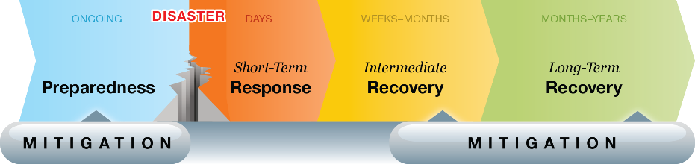
Mitigation
Mitigation is the reduction or elimination of long-term risk to human life and property from hazards
Emergency Management Activities
Breaking the damage-repair-damage cycle
Notes:
Mitigation: Reduction or elimination of long-term risk to human life and property from hazards
Mitigation is part of many aspects of emergency management. Emergency management includes the following primary activities:
Preparedness includes plans and arrangements made to save lives and property and to facilitate response operations
Response includes actions taken to provide emergency assistance, save lives, minimize property damage, and speed recovery immediately after a disaster
Recovery includes actions taken to return to a normal or improved operating condition after a disaster
Mitigation includes actions taken to reduce or eliminate long-term risk to life and property from hazards; mitigation can happen at any point in the cycle

Slide 7
Mitigation Increases Resiliency
Mitigation
Planning
Actions
Educate
public
Prevent
future
vulnerability
Understand
risk and
capabilities
Build
relationships
Reduce
impacts/
losses
Resilient
community
Less
damage
Faster
recovery
Notes:
Mitigation Increases Resiliency
Mitigation planning educates the public, increases understanding of risks and capabilities, and builds partnerships within a community
Mitigation actions reduce impacts of hazards, reduce losses, and prevent future vulnerability
With less damage, recovery time is faster, and the community is more resilient

Slide 8
Planning requirement for projects
Hazard Mitigation Planning is the cornerstone of project development.
A FEMA-approved mitigation plan is required to apply for and receive project funding, in accordance with 44 CFR Part 201.
Tribal Applicants (and any subapplicants) must have a FEMA-approved hazard mitigation plan by the application deadline to be eligible for project funding.
Extraordinary Circumstances will not be granted if Applicants or Subapplicants do not have a FEMA-approved Hazard Mitigation Plan by the application deadline.

Slide 9
Funding the Development of Mitigation Plans
Mitigation Planning is a process – on-going not one-and-done
  Even if started with Grant funds, maintenance commitment is necessary
  Local funds / staff time are involved all along the process
  Many mitigation planning efforts are entirely local-funded
Emergency Management Grant Program funds
  Possibly could fund staff positions that develop mitigation plans and/or grants
Hazard Mitigation Assistance (HMA) Program
  Pre-Disaster Mitigation (PDM) Grants –
    Annual cycle - competitive nationwide
    Hazard Mitigation Planning has always been a funding priority
  Hazard Mitigation Grant Program (HMGP) –
    Results from Disaster Declaration – limited to Declared State (or Tribe)
  Flood Mitigation Assistance (FMA) Program –
    Annual cycle – semi-competitive nationwide
    Very limited planning funds – focus is on mitigating Severe Floodprone structures

Slide 10
Polling Questions
?
Notes:
If you have a current or expired mitigation plan, how did you fund the plan development?
Local Funds/Staff Time only
Emergency Management Planning Grant (EMGP Dollars for Staff Time)
Non-FEMA Grant
FEMA Planning Grant
N/A
If you used a FEMA mitigation planning grant to fund your plan, which grant source did you use?
Pre-Disaster Mitigation Grant (PDM)
Hazard Mitigation Grant Program (HMGP)
Flood Mitigation Assistance (FMA)
Not sure
N/A

Slide 11
Pre-Disaster Mitigation (PDM)
Grant Program | Purpose | Competition | Available | Non-Fed. Share
Pre-Disaster Mitigation Grant Program (PDM) | Pre-Disaster All Hazards Plans and Projects | Nationally Competitive State Set-asides $10M Tribal set-aside | Annually $90 Million FY17 | 10% - 25%*
The PDM program provides funds for hazard mitigation measures designed to reduce injuries, loss of life, and damage and destruction of property. PDM grants are available for mitigation planning initiatives and cost-effective mitigation projects.
Notes:
Tim
*PDM is a 75% federal cost share grant. Small, impoverished communities and Tribes may be eligible for a 90% federal cost share.

Slide 12
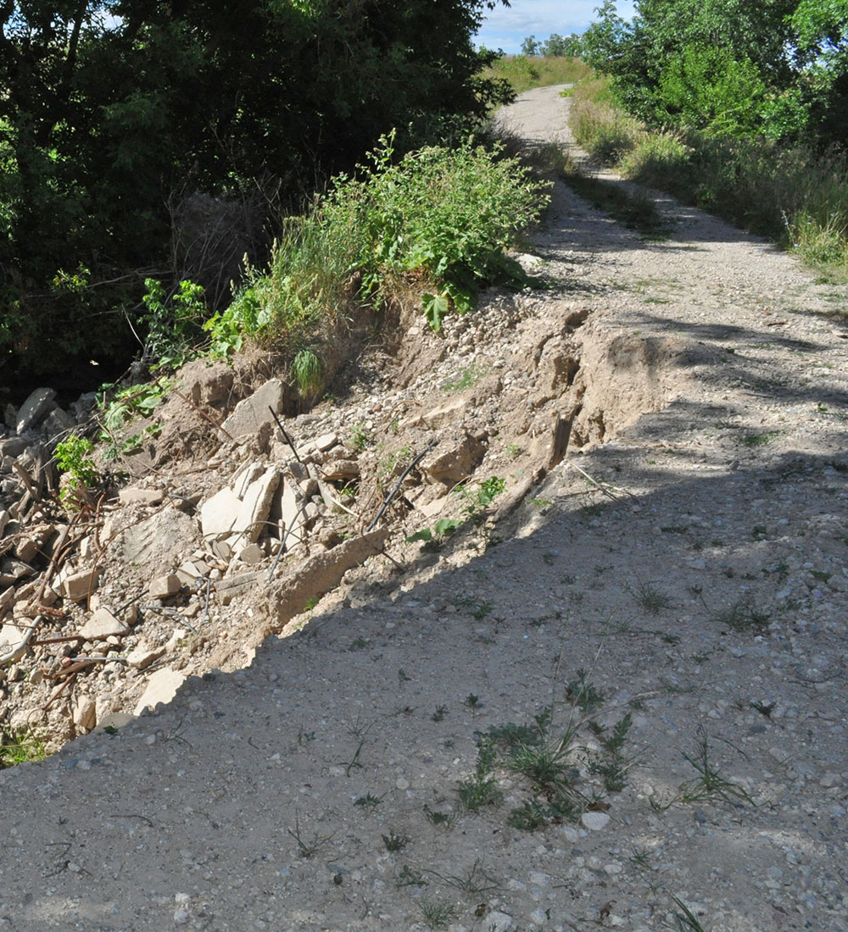
PDM Funding priorities
1
State/Territory allocation
  Up to 1% of PDM funds or $575,000, whichever is less for allocations
Tribal set aside
  Up to 10% of PDM funds, or $10 million, for $575,000 per Federally recognized tribal government applicant
Planning and/or project subapplications
There is no limit to the number of sub-applications an applicant may submit towards the allocation or set aside; however, to be eligible for consideration, the applicant’s highest ranked planning or project subapplication must be $575,000 or less.
2

Slide 13
PDM Funding Information
Tribal Set Aside:
  $10 million total for FY17 funding cycle
  Up to $575,000 per Federally recognized tribal government applicant
Planning Grant Funding Limits:
  $400,000 limit for new mitigation plans – this cap is for large-scale, very complex planning areas – average new Tribal Plan should be about $75K to $125K
  $300,000 limit for state/territorial and multi-jurisdictional local/tribal mitigation plan update – most Tribes are developing stand-alone Tribal Plans, so N/A
  $150,000 limit for single jurisdiction local/tribal mitigation plan update – again, this is a cap for very complex, large-scale planning efforts – typical Tribal Plan updates should be about $35K to $50K
Other Funding Limits
  10% of plan/project subapplication budget for information dissemination activities
  5% of plan/project subapplication budget for subapplicant management costs
  10% of grant application budget for applicant management costs (separate MC sub-application must be submitted)

Slide 14
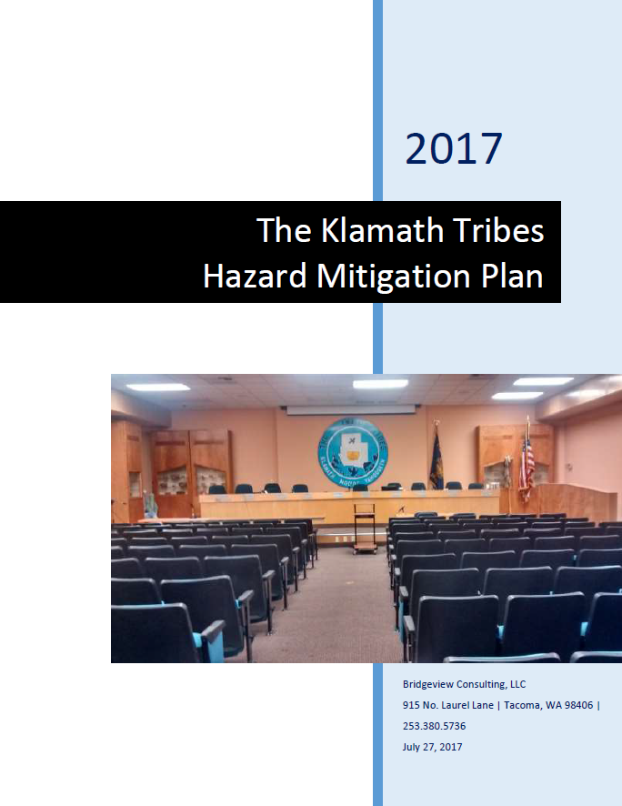
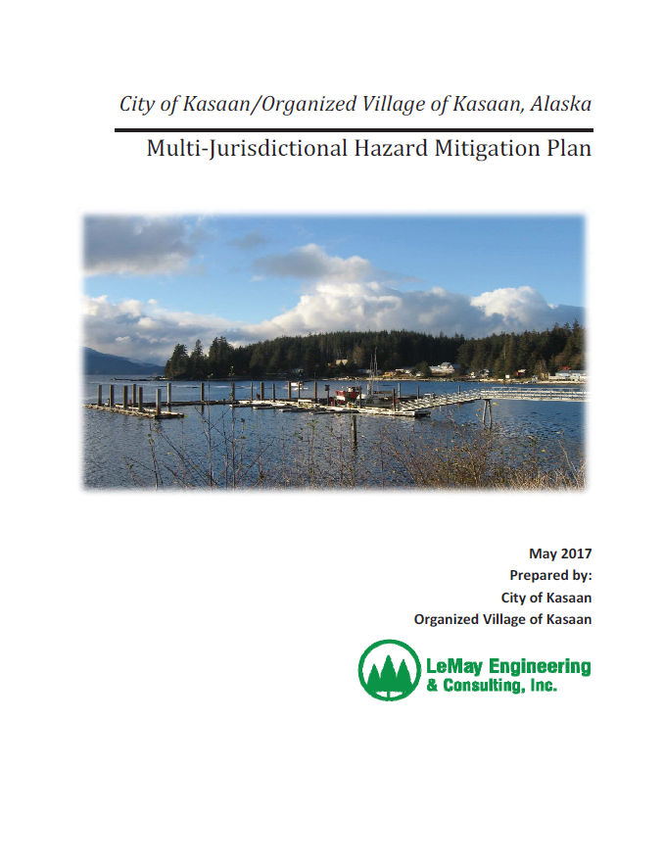
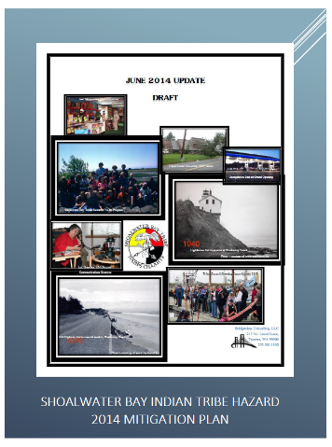
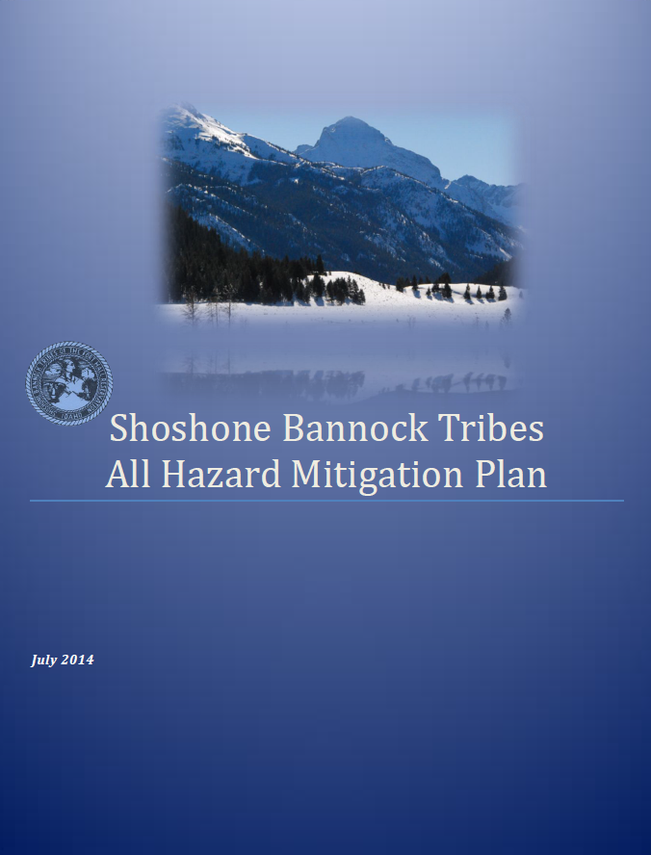
PDM Eligible Planning Activities
All planning grants received under Pre-Disaster Mitigation (PDM) grant program must result in a FEMA-approved natural Hazard Mitigation plan within the Period of Performance (POP). Either a new or updated Plan.
This means that the mitigation plan has met either all the planning requirements: 201.4/5 (state), 201.6 (local) or 201.7 (tribal)

Slide 15
FY17 PDMC: Milestones
NOFO posted to Grants.gov: July 11, 2017
Application period: August 14 to November 14, 2017
Selection date: January 30, 2018
Selection date: January 30, 2018
Period of Performance: 1/29/2021
8/14 to
11/14
Post-Selection review and revisions
7/11
1/30
8/14/2017 (for Pre-Award Costs) to January 29, 2021
2017
2018
2019
2020
2021
Period of Performance extends for 3 years after Selection Date
Date of Award depends on complexity of Post-Selection Review

Slide 16
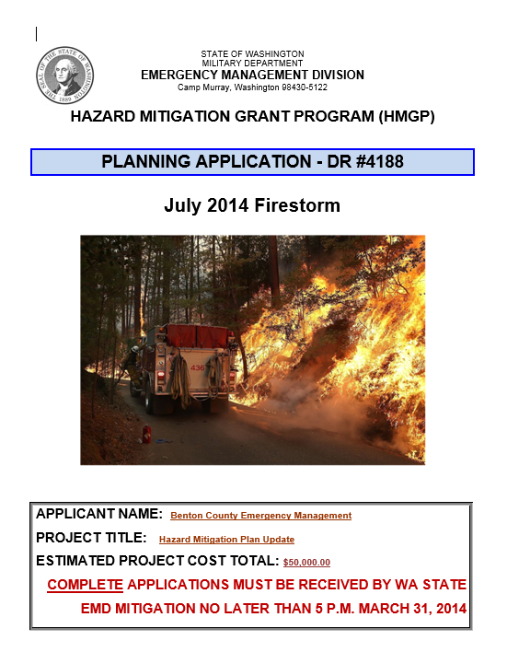

New and
Updated Tribal Mitigation Plans
Scope of Work (SOW)

Slide 17
Initial Tips
A well developed Scope of Work (SOW), task schedule, and budget improves the outcome of the planning process. End result is a well developed natural hazard mitigation plan
  Don’t focus on just meeting minimum planning requirements.
  Focus on developing an implementable plan that works for your Tribe.
The SOW must comply with the HMA Guidance (next slide) as well as the requirements set forth in 44 CFR 201.7 for Tribal Hazard Mit Plans.
Focus on the activities you want the grant to fund.
The Scope of Work says how you plan to implement the planning process. Summarize. Be brief, succinct. The SOW is not the plan.
Ensure the SOW demonstrates a clear understanding of mitigation planning, the planning process, and the purpose of the grant.
For each Planning Activity, determine the actual tasks necessary to accomplish the work. Include those in the SOW narrative.
For PDM, develop a SOW, schedule, and budget off-line, to then upload into eGrants.

Slide 18
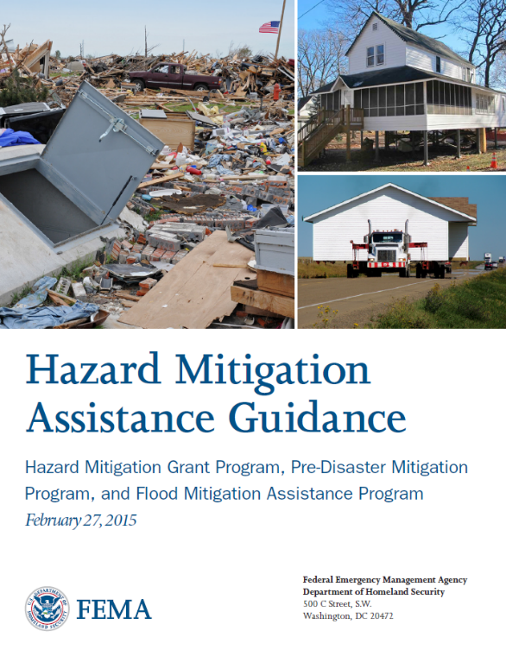
Hazard Mitigation Assistance Guidance
Latest Guidance released February 27, 2015
Refer to Part IV. Application and Submission Information:
  Section H. Scoping Narrative: Scope of Work, Schedule, and Cost Estimate
  Section H.1 Required Components
  Section H.2 Considerations for Management Costs
  H.3 Considerations for Planning Subapplications
FEMA Library: https://www.fema.gov/media-library/assets/documents/103279

Slide 19
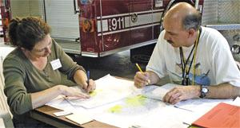
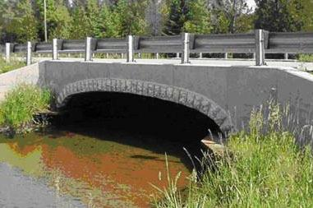
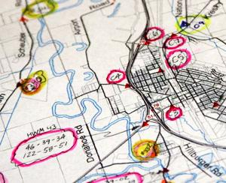
Scope of Work
Describes the
proposed activities:
  Who?
  What?
  When?
  Where?
  Why?
  How?

Slide 20
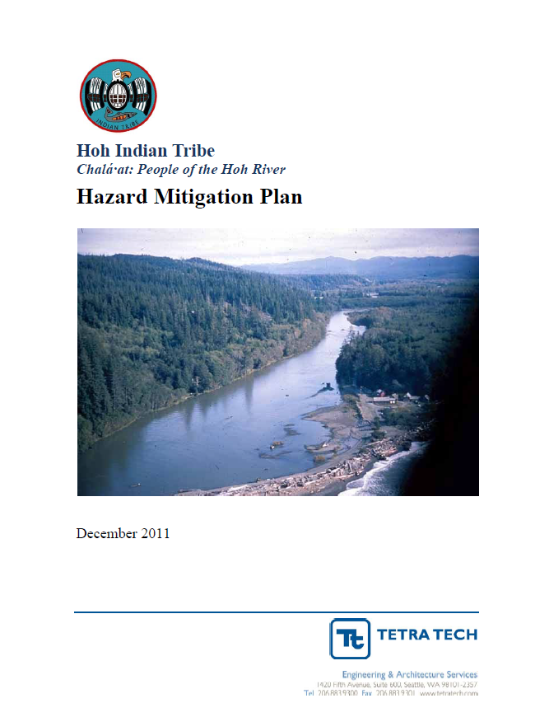
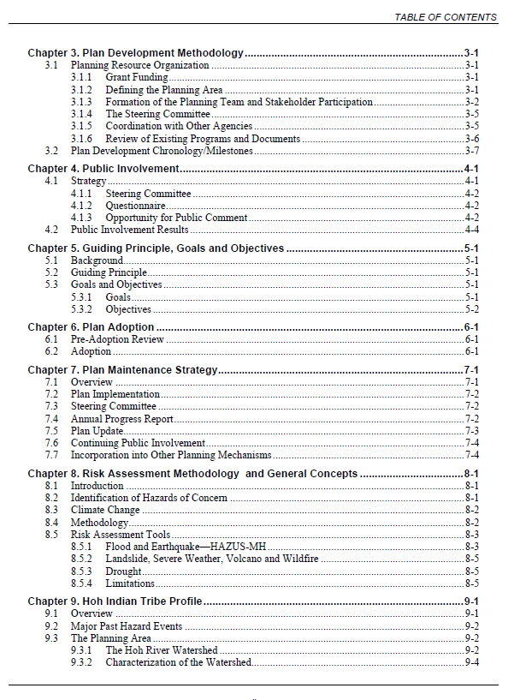
Planning Activities
Element H.3 (pp. 60-62)
This applies to all planning grant applications. The framework for the SOW.
The following elements must be included in the Activities Description (aka SOW):
  Planning Area
  Planning Process
  Previous Mitigation Planning
  Available Data and Risk Assessment Process
  Development of Mitigation Strategy
  Plan Adoption
Deliverables, Tasks, Schedule

Slide 21
1. Planning Area
Describe the planning area –
    Brief community profile, demographics. eGrants requires a Profile.
    Consider both contiguous and non-contiguous land holdings/assets;
Identify the proposed participants – Tribe only?
    Is this a single or multi-jurisdiction plan? Tribe only? Or Will it include municipalities within the Tribal borders? E.g. Nespelem in Colville Res.
    All Tribal Agencies and offices, and Private Non-Profits active with the Tribe
    Any special districts that the Tribe works with – Fire, Water, Utilities, Conservation District or that have jurisdiction within Tribal areas.
    Does the Tribe have outlying settlements that should be represented?
If this will be a formal multi-jurisdictional plan that will be adopted by cities and/or special districts, in addition to the Tribe, obtain ‘Letters of Intent’ and in-kind match commitment from each jurisdiction

Slide 22
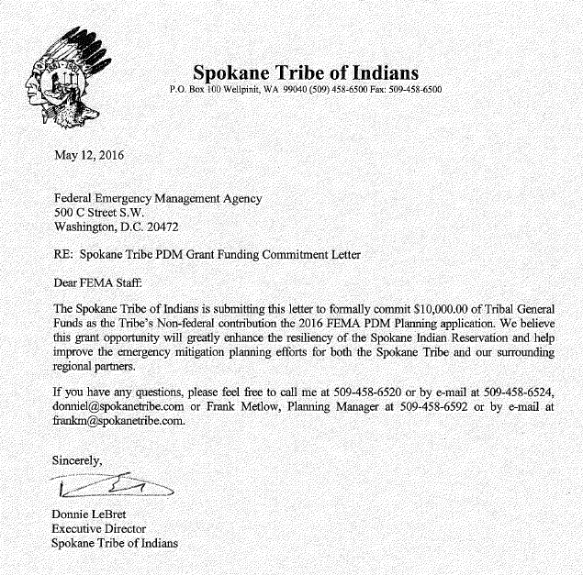
Letter of Intent

Slide 23
2. Planning Process
What is the role and composition of the planning team?
How will the team work together?
    Describe the meeting frequency
    Describe how the planning team will communicate with their respective jurisdiction staff throughout the planning process.
What is the proposed public engagement process?
    Describe all aspects and timing of public engagement. A statement that “we will comply with the requirements” is not sufficient.
    Are you conducting a public survey? If so, what kind? Who will conduct?
    Are you holding workshops or forums? How many? Describe the proposed content and target audiences, as well as desired outcomes.
    Are you integrating with Community Wildfire Protection Plan (CWPP)? If so will you have focused outreach with the wildfire community?
    Are you conducting specific stakeholder outreach such as populations, neighborhoods, etc.?
    How will you engage neighboring communities, local, regional, and Federal agencies?

Slide 24
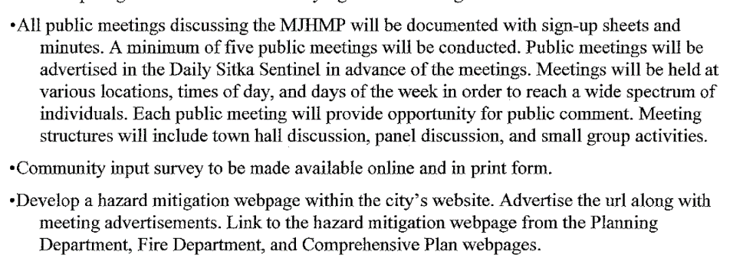
Public Engagement Process

Slide 25
3. Previous Mitigation Planning
Describe any previous mitigation planning efforts and establish priorities for this planning program
Describe an evaluation of the past plan as a basis to identify priorities for plan updates - Review last Tribal Plan Review Crosswalk
Review and incorporate any other relevant plans, studies, reports, etc.
Review and describe the outcomes of Annual Plan Reviews
Since the last plan was adopted…
  Have there been any projects implemented? Building Codes adopted? Join the NFIP?
  Have there been any major disaster events – wildfires, floods, landslides, erosion?
  Is there any new hazard data, such as a landslide inventory or FEMA RiskMAP program?
  Are there new partners to be involved in the new planning effort? Potential new sources of in-kind match?
Determine a list of priorities to address
Describe how the grant will be used to address previous deficiencies and new priorities

Slide 26
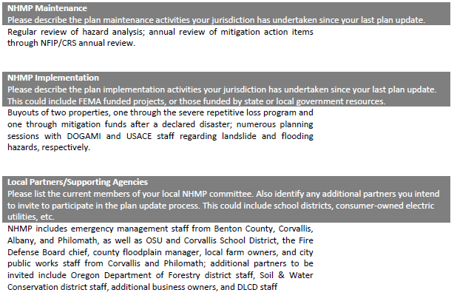
Plan Priorities
PRIOR ANNUAL REVIEWS
PROJECTS IMPLEMENTED SINCE PLAN ADOPTED
ANY NEW PARTNERS
NEW HAZARD DATA
MATCH SOURCES

Slide 27
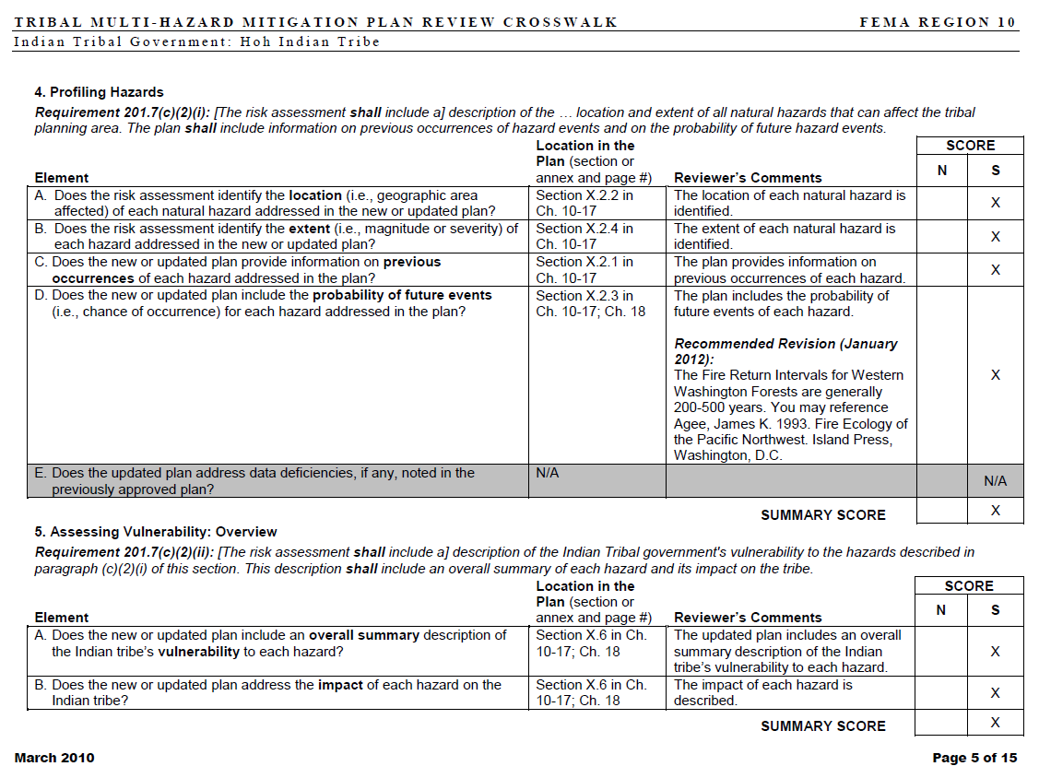
Plan Review Tool

Slide 28
4. Risk Assessment
Describe the proposed process to assess risk
What hazards do you want to assess?
    Remember, the planning grants are for natural hazards. Mitigation plans may include other hazards but the PDM grant does not pay for them.
What are the potential data sources? How will data be researched, collected, analyzed, and summarized?
    Encourage the use of existing data, such as from State HM Plans, universities or the FEMA Risk MAP program?
    Much detailed hazard data has already been developed in a GIS format that can easily be utilized by the Tribe.
What are the data gaps you have preliminarily identified?
What tools will you use? GIS, FSim, Hazus, other?
    If a specific assessment/methodology is used, then describe level of effort, timeframe, costs.
    If you are using Hazus, then complete the Hazus Checklist (SHOW HAZUS)

Slide 29
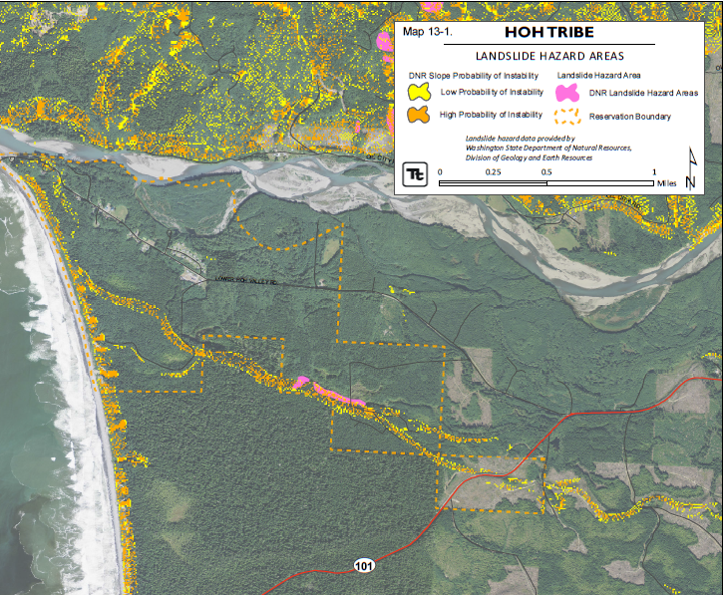
4. Risk Assessment (cont’d)
What new risk data is to be collected with funding from this grant?
    Describe the proposed process and sources
Will you be incorporating climate change data?
Vulnerability Assessment - once the Hazard Profiles are complete, now you assess the vulnerabilities that the Tribe faces:
  Tribal facilities, clinics, schools
  Housing areas, senior housing
  Utilities: water, sewer, power, gas
  Roads and bridges
  Economic engines, e.g. casinos
  Impact on emergency services
  Planned growth areas
7. Estimate potential losses

Slide 30
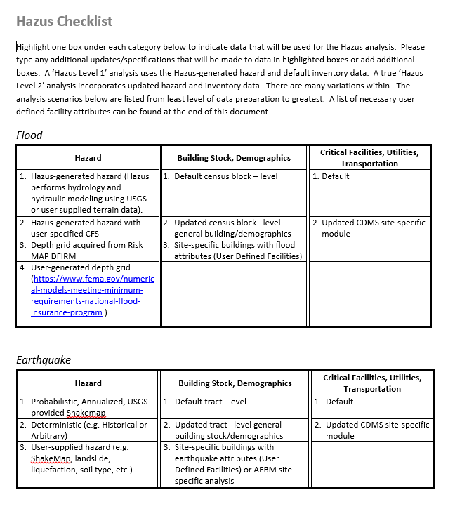
Hazus Checklist

Slide 31
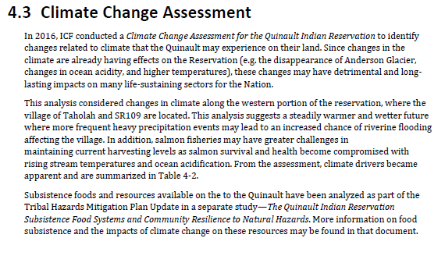
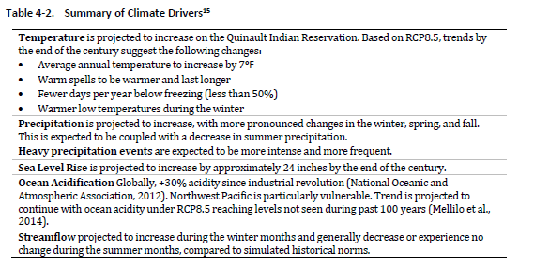
Climate Change Assessment

Slide 32
5. Development of Mitigation Strategy
Describe the process to develop a mitigation strategy based on the risk assessment
How will the strategies developed connect to the risk assessment and vulnerability analysis?
How will the planning team develop the overall hazard mitigation Goals and Objectives?
How will the team identify and analyze potential mitigation actions to address existing vulnerabilities and to ensure that future development is hazard-resistant? Will contractual assistance be required?
From the various action options, how will individual Strategies be selected? Will specific project proposals and funding sources be identified?
Will the planning grant pay for an in-depth analysis of how the plan will be integrated with the comprehensive plan and other planning mechanisms? If so, describe the level of effort and what the process entails.

Slide 33
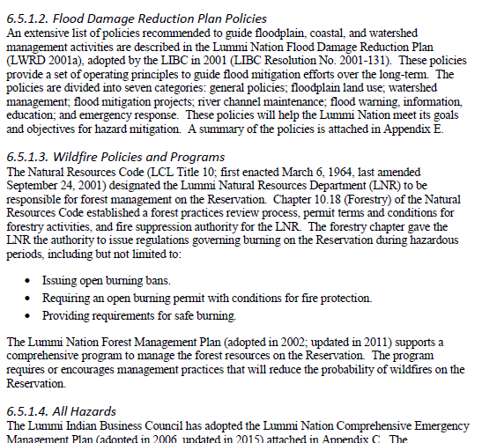
Integration with Other Plans

Slide 34
6. Plan Adoption
Describe the process for State and FEMA review, adopt by each participating jurisdiction, and final approval by FEMA.
What process will the Tribe use to provide for public and Tribal elected officials review of the Draft document?
Draft plans are to be completed and submitted to FEMA for reviewat least 6 months prior to end of grant SOW Period of Performance to ensure adequate time for review, any revisions, and adoption.
Following FEMA review, revisions may be required, and perhaps additional community involvement. Include sufficient time for revisions.
Upon completion and submittal of a FINAL Draft to FEMA, if acceptable, FEMA will issue an Approval Pending Adoption (APA) letter.
How will formal Tribal adoption of the plan occur? Any participating jurisdictions?
The adopted hazard mitigation plan must then be submitted to FEMA for approval prior to the end of the Grant Period of Performance (@ 3 yrs).

Slide 35
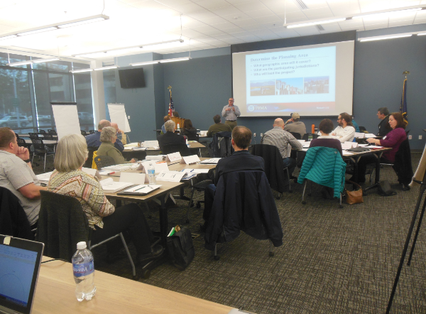
Other Considerations
Will the Tribe require translation of outreach materials and Plan documents into the native language?
Are you hiring a contractor to assist with any aspect of the plan development?
    If yes, then describe how the Steering Committee will coordinate with the contractor.
Describe any travel that the grant will fund
Describe any training that jurisdiction participants will attend. Includes, but not limited to…
    G-318: Local Mitigation Planning Workshop
    Hazus

Slide 36
Deliverables, Tasks, Schedules
Deliverables
  A new or updated FEMA-approved mitigation plan consistent with mitigation planning regulations for State (44 CFR Sections 201.4 or 201.5), tribal (44 CFR Sections 201.7 or 201.5), or local governments (44 CFR Section 201.6), as well as the applicable mitigation planning guidance.
Tasks – Will the tasks lead to an approvable plan?
  The tasks narrative describes the tasks, including the proposed planning process, as well as any procurement of contractual assistance.
  So…if the Scope of Work was carefully developed to describe both the process and the tasks involved with each Planning Activity, the Tasks Narrative is basically the Scope of Work. No need to duplicate effort!
Schedule – Is the timeline reasonable?
  The timeframe matches all tasks noted in the SOW. The schedule includes tasks for draft review and allows sufficient time for State and FEMA reviews; preparation of required revisions, if needed; formal adoption by the jurisdiction(s); and…
  FEMA approval before the end of the Grant POP.

Slide 37
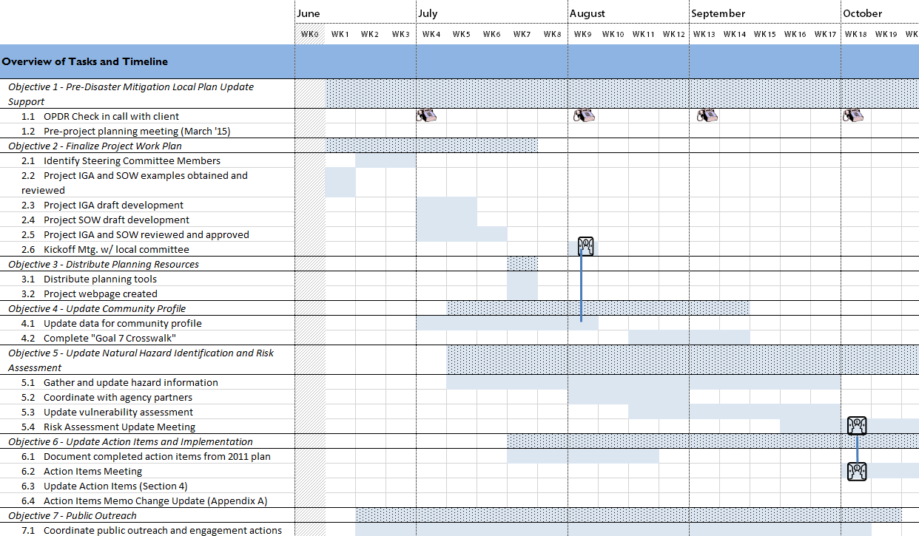
Project Schedule Example

Slide 38
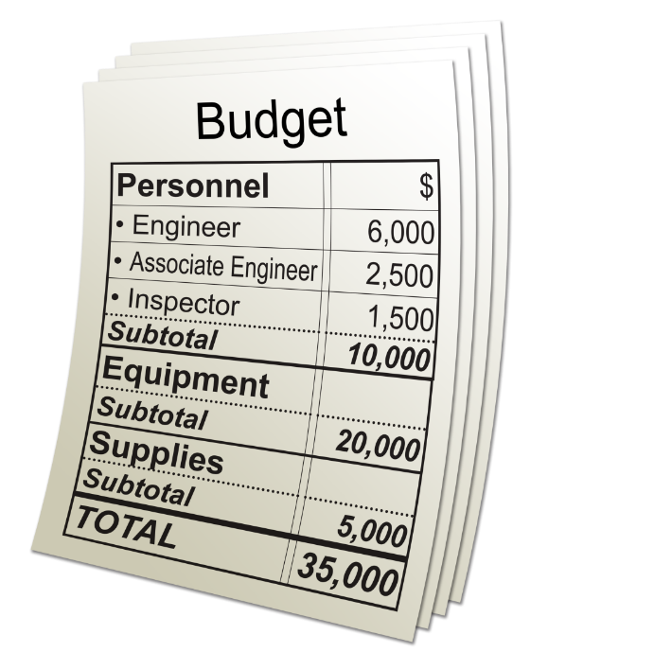

Cost Estimate/Budget
Mitigation Planning Cost Considerations:
  Risk analysis/ mapping software
  Contractor
  Personnel
  Outreach
  Printing
  Supplies
  Travel
  Project Management
  Translation Services
  In-kind match – mainly donated time from planning team members and Tribal staff not paid out of grant funds – this must be in the budget in order to be counted
Purpose:
Provides breakdown of costs for the activity
Identifies contractor costs
Includes project management costs
Documents sources for estimated costs

Slide 39
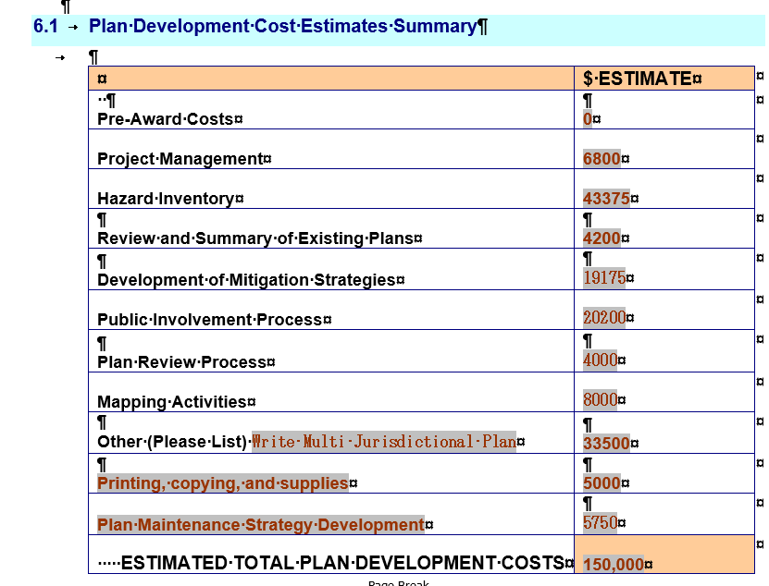
Budget Part 1: Task-related Budget
Develop cost estimates for each element of the Planning Process
Estimate:
Estimated time involved
Tribal salaries & fringe
Donated in-kind labor
Specific supplies
Contractual assistance

Slide 40
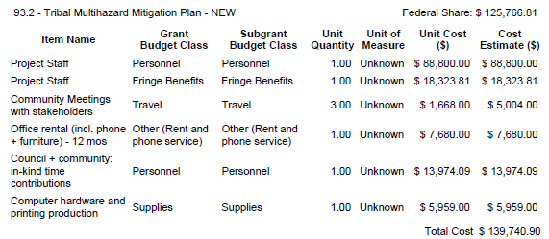
Budget Part 2: Consolidated Costs
Cost Line Item Budget
Roll-up of all Tasks
OMB Cost Categories
Personnel Salaries
Personnel Fringe
Salaries – for match
Fringe – for match
Contractual
Supplies (incl. printing!)
Travel
Pre-AWARD costs are separate cost line items

Slide 41
Budget Part 3: Budget Narrative
For every Budget, a Budget narrative is necessary!
Describes how the Budget relates to implementing the Scope of Work
Explains Cost Line Items such as supplies and printing and why they are required
Details the Salary rate and Fringe rate of Tribal staff members whose time will be charged to the Grant – and identifies those positions.
Details the estimated donated in-kind match from members of the Planning Team that are not paid out of the Grant funds. That includes other Tribal staff, Tribal Board members, and Planning Team members that represent community areas within the Tribe, or cities or special districts that are participating in the Tribal planning effort.
Describes what type of work will be contracted, and the estimated hours/rate or lump sum cost of that work.
Travel for training for the planning effort, as well as for travel to distant parts of the Tribal areas in order to engage community members. Itemize the estimated expenses for each identified trip.

Slide 42
Budget and Budget Narrative Example
Item Name | Cost Category | Unit Quantity | Unit Measure | Unit Cost ($) | Cost Estimate ($)
Pre-Application Development | Personnel | 20 | Hours | $ 31.00 | $ 620.00
Contracted Plan Development | Contractual | 1 | Flat | $ 28,000.00 | $ 28,000.00
Grant Administration | Personnel | 56 | Hours | $ 31.00 | $ 1,736.00
Distribution | Personnel | 5 | Hours | $ 20.00 | $ 100.00
Total |  |  |  |  | $ 30,456.00
Pre-Application Development– This cost covers the County Manager’s time to develop the plan (20 hours @ $20/hour including fringes =$400)
Contracted Plan Development– These fees will cover the cost for the contracted firm to oversee the plan development per the submitted scope of work. Selection of the contracted firm will follow the County’s bidding process.
Grant Administration– The management cost of the project and grant. This also covers the cost to bid the project and perform contract and grant administration. The County Manager will oversee the project (36 hours @ $20 /hour including fringes = $1,736)
Distribution – Time spent by County support staff to distribute the plan for review by the participating jurisdictions and community (5 hours @ $20/ hour including fringes = $100)

Slide 43
Pre-Award Costs
F.2 (pp. 55)…….
Preparing and submitting the Grant application
Preparing Planning Activity 3 to be included in the Scope of Work – Prior Planning Activities
  Steering Committee/Planning Team working together to develop SOW is eligible
  Most of these costs will be in-kind match through donated time – need to document the hours and the rates
  Work by staff to be charged to the grant can be included
Attending planning training: G-318: Local Mitigation Planning Workshop course –
  Travel costs based on Federal mileage and per diem, and actual airfare
  Paid or in-kind match time of personnel participating
Pre-award costs may be used as part of the cost-share
Friendly warning! Work on the writing of the plan or starting risk assessment work cannot start until funding is obligated to the Tribe.

Slide 44
Cost Share Requirements
Generally FEMA will pay 75% of the total cost.
For small, impoverished communities, FEMA will pay up to 90%. (defined in Hazard Mitigation Assistance Guidance,Part VIII. Additional Program Guidance: Pre-Disaster Mitigation Program, B.2 Small Impoverished Communities)
Small and impoverished qualifications:
Be a community of 3,000 or fewer individuals identified by the Applicant as a rural community that is not a remote area within the corporate boundaries of a larger city or jurisdictional area or boundary
Be economically disadvantaged, with residents having an average per capita annual income not exceeding 80 percent of the national per capita income, based on best available data. For the most current information on the national income, see http://www.bea.gov.
Have a local unemployment rate that exceeds by 1 percentage point or more the most recently reported, average yearly national unemployment rate. For the most current unemployment information, see http://www.bls.gov/eag/eag.us.htm.

Slide 45
Potential Match Sources
Staff time
  All participating agencies
Stakeholder meetings
  Time donated by all team members
  Travel to the meeting
Volunteer time – those Planning Team members
In-kind donations – time is “in-kind” donation
Careful documentation is required – like Red Cross
  Track the number of hours
  Track the hourly rate of donated time by individual
  Or use standardized rates and apply to entire group
NOTE: Match Commitment letter is required from the Tribal Board or Executive
Hazard Mitigation Assistance Cost Share Guide
https://www.fema.gov/media-library/assets/documents/117020

Slide 46
Possible Federal Funds for Cost Share
In general, the non-Federal cost-share requirement may not be met with funds from other Federal agencies; however, authorizing statutes explicitly allow some Federal funds to be used as a cost share for other Federal grants. Federal funds that are used to meet a non-Federal cost-share requirement must meet the purpose and eligibility requirements of both the Federal source program and the HMA grant program.
Bureau of Indian Affairs funding
HUD CDBG funds
Indian Health Services funds
See Part III. Eligibility Information, Section C.1 Federal Funds Allowed to Be Used as Non-Federal Cost Share

Slide 47
Management Costs: (Indirect Costs)
Management Costs– for overall Grant (10% cap)
  Separate sub-application from the Planning sub-application
  Purpose is for financial management of the Planning project, including
    Processing vendor invoices
    Drawing down reimbursement funding from FEMA’s PARS system
    Preparing and submitting Quarterly Reports to FEMA Regional Offices
  Or the entire Management Cost sub-grant may be used to fund Indirect Costs for the Direct costs to implement the Planning sub-grant
  STRONGLY RECOMMEND THAT ALL TRIBES include a separate Management Cost Sub-application in their overall Grant Application
Management Costs in Planning sub-application (5% cap)
  Separate cost line item in Cost Estimate
  Must be labeled as “Sub-applicant Management Costs”
  Same purpose as for Management Costs
  Can be entirely Indirect Costs

Slide 48
Indirect Costs
Per HMA Guidance, INDIRECT COSTS are only eligible as “Management Costs”
Management Costs are capped by Guidance at:
  5% of individual sub-application or
  10% of overall Grant as noted above
For Tribes…typically the approved Indirect Cost Rate is from 30-50% of eligible Direct Costs (Salaries and Fringe paid by the grant, etc.)
FEMA cannot pay the full Indirect Cost rate.
However, the entire 10% Management Costs sub-award for a Tribe can be Indirect Costs, e.g.
  for $112,000 Planning subapplication,
  the Tribe can add a $11,200 Management Cost sub-application
  The Cost Estimate in that sub-application can have a single Cost Line Item: Indirect Costs
STRONGLY RECOMMEND that each Tribe develop both:
  a Planning Sub-application and
  a Management Costs sub-application,
  Attach both to their Grant Application in eGrants.
  That way the Tribe secures the maximum amount of Indirect Costs available.

Slide 49
How to Apply to PDM 2017

Slide 50
FY17 PDM Cycle
NOFO posted to Grants.gov (July 11, 2017)
Application period (August 14 – November 14, 2017
Selection date (January 30, 2018)
Award Process (Feb-Sept 2018)
Period of performance
Feb-Sept 2018
August 14, 2017- January 30, 2021
2017
2018
2019
2020
2021

Slide 51
FY17 PDM Application Period
We strongly encourage you to submit applications by November 1, 2017 to avoid
system slow downs.
Application Deadline is 3pm Eastern Time on November 14, 2017.
NOFO posted to Grants.gov
July 11, 2017
Selection date
January 30, 2018
Application period
August 14 – November 14, 2017
Award Process
Feb-Sept 2018
2017
2018

Slide 52
FY17 PDM Application System
PDM and FMA grant applications must be submitted to FEMA via the Mitigation eGrants system: https://portal.fema.gov
For access to eGrants: contact Regional office
If you have trouble accessing eGrants or trouble submitting your application, you must contact the eGrants Helpdesk prior to the application deadline to report system issues that prevent grant application submittal by the application deadline to receive a ticket number AND must email the HMAHelpline to request late submittal within 24 hours of the deadline.
Egrants Job Aid available at:
https://www.fema.gov/media-library/assets/documents/117615

Slide 53
EGrants requirements
Complete Fields (blank application available to help gather answers)
Attach SOW, Schedule, and Budget
Required forms: https://www.fema.gov/application-development-1
  All applications must have proper forms. Below is a list of the application and assurances and certifications forms.
  FEMA Grant Application form 112-0-10 – Regional Office will provide
  Assurances for Non Construction Programs (SF-424B)
  Assurances for Construction Programs (SF-424D)
  Certifications Regarding Lobbying, Debarment, Suspension and Other Responsibility Matters; and Drug-Free Workplace Requirements (FEMA Form 112-0-3C – Regional Office will provide)
  Disclosure of Lobbying Activities (SF-LLL) if applicable

Slide 54
Review Learning Objectives
At the end of this webinar, participants will understand:
  The planning activities available under the PDM grant program
  What is required when developing a mitigation plan scope of work, schedule, and budget.
  The FY2017 Pre-Disaster Mitigation (PDM) grant program application period process and schedule
Notes:
The public isn’t always interested in mitigation plans, natural hazards, community resilience, emergency management, community planning
Communities become disengaged when they are asked to provide input on a decision that has already been determined.

Slide 55
Mitigation Planning Resources
Tribal Mitigation Planning Guidance: This Guidance is currently being revised and any grants funded via PDM 2017 may be subject to the revised guidance. 44 CFR Section 201.7 remains unchanged.
https://www.fema.gov/media-library/assets/documents/18355
More information on the updated guidance this fall.
Mitigation Planning site
https://www.fema.gov/hazard-mitigation-planning
Region 10 Mitigation Planning Coffee Break Series
http://www.starr-team.com/starr/RegionalWorkspaces/RegionX/mitigationplanning/SitePages/2017_Coffee_Break.aspx
Notes:
Speaker:

Slide 56

2017
FEMA REGION 10 COFFEE BREAK CALENDAR
January: Introduction to Mitigation Planning
February: Building the Mitigation Planning Team
March: Effective Public Engagement in Mitigation Planning
April: Developing FEMA Mitigation Planning Grants
May: Performing Natural Hazard Risk Assessments
June: Integrating Natural Hazard Mitigation Plans and Community Wildfire Protection Plans
July: Developing Natural Hazard Mitigation Strategies
August: Climate Adaptation and Mitigation Planning
September 22: Tribal Mitigation Planning
October: Addressing Social Equity through Mitigation Planning
November: Integrating Natural Hazard Mitigation Plans into Local Comprehensive Plans
December: Bringing the Mitigation Plan to Life
Register at http://www.starr-team.com/starr/RegionalWorkspaces/RegionX/mitigationplanning

Slide 57
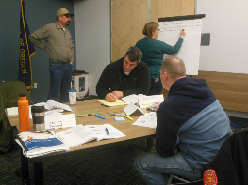
Region 10
In-Person Training
Anchorage, Alaska
September 27-28
Hosted by Alaska Division of Homeland Security & Emergency Management
Registration open
Contact Eva.Edwards@Alaska.gov
Camp Murray, Washington
November 1-2
Hosted by WA Emergency Management Division Register at: https://www.train.org/washington/course/1064698/live_event
Contact Justin Fordice, WA EMD Training Manager emd.training@mil.wa.gov
2017 Schedule
G-318: Mitigation Planning Workshop

Slide 58
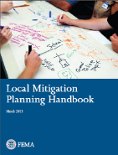
PDM Grant Resources
Hazard Mitigation Assistance Guidance
https://www.fema.gov/media-library/assets/documents/103279
Hazard Mitigation Assistance Cost Share Guide
https://www.fema.gov/media-library/assets/documents/117020
Mitigation eGrants System Webpage:
https://www.fema.gov/mitigation-egrants-system-0
Hazard Mitigation Assistance site
https://www.fema.gov/hazard-mitigation-assistance
Notes:
Speaker:

Slide 59
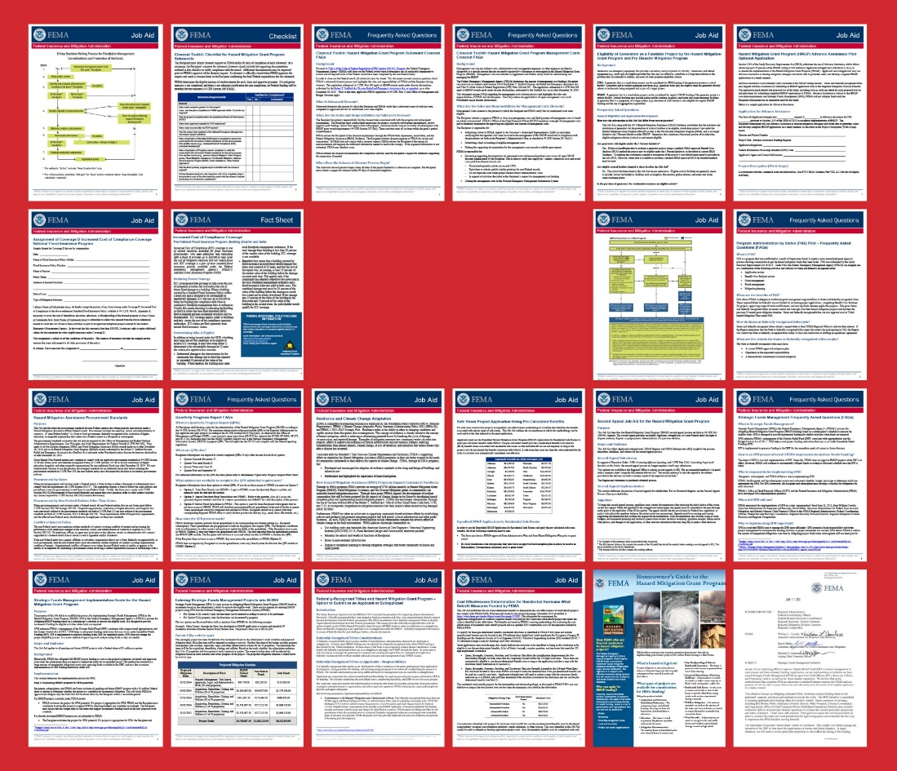
Job
Aids
HMA Webpage:
https://www.fema.gov/hazard-mitigation-assistance
  Job Aids:
  https://www.fema.gov/media-library/assets/documents/102051
  Publications:
  https://www.fema.gov/hazard-mitigation-assistance-publications

Slide 60
Help Lines
  eGrants Helpdesk:
    MTeGrants@fema.dhs.gov
    1-855-228-3362
BCA Helpline:
  BCHelpline@fema.dhs.gov
  1-855-540-6744
Feasibility and Effectiveness Helpline:
  FEMA-BuildingScienceHelp@fema.dhs.gov
HMA Helpline:
  HMAGrantsHelpline@fema.dhs.gov
  1-866-222-3580

Slide 61
Time for Questions and Answers

