Slide 1
G318 Local Mitigation Planning Workshop Workshop Conclusion

Slide 2
Workshop Conclusion
Review workshop goals and objectives
Workshop evaluation
Questions/answers/suggestions?

Slide 3
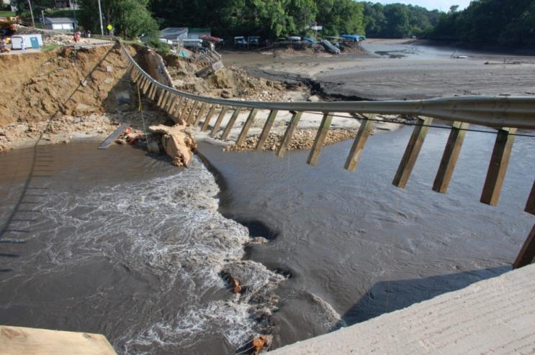
Workshop Goal
To provide plan developers with the information necessary to prepare and implement a local hazard mitigation plan
Visual 5.2

Slide 4
Workshop Objectives
At the end of this workshop, participants will be able to:
Define hazard mitigation and identify the benefits of mitigation planning
Develop or update a local hazard mitigation plan
Identify resources and guidance available for mitigation planning
Visual 5.3

Slide 5
Evaluation
Please complete the Workshop Evaluation Form
We value your feedback!
Visual 5.4

Slide 6
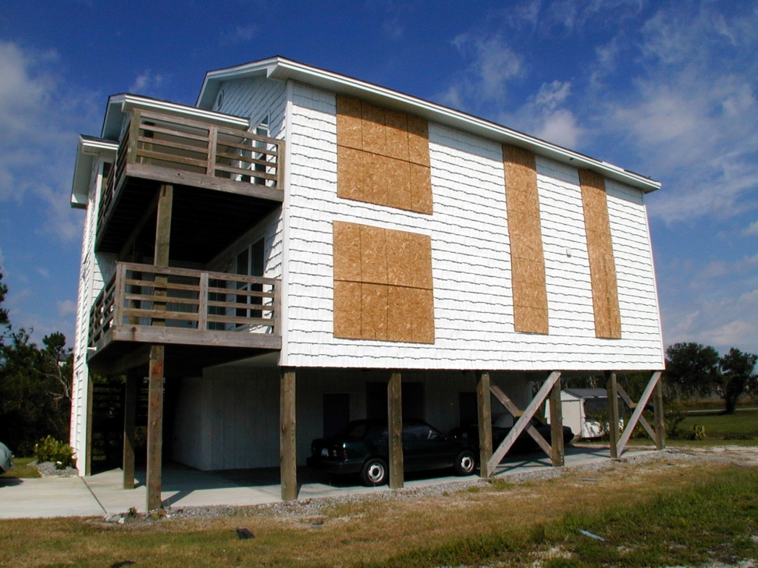
Workshop Closing
Final questions
Suggestions
Observations about the workshop
Congratulations!
Visual 5.5

