Slide 1
G318 Mitigation Planning Workshop
Module 4:
Community Resilience in Action

Slide 2
Unit 1
Putting the Plan into Action
Notes:
Students will be able to identify some of the benefits of planning as well as some of the obstacles to plan implementation.

Slide 3
Planning Has Important Benefits
Engages the whole community in a process to:
Assess vulnerabilities and risks
Identify policies and actions to reduce risk
  Builds partnerships
  Increases awareness of hazards and risks
  Communicates priorities
  Aligns with other community objectives

Slide 4
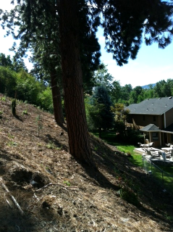
Risk Reduction Requires Action
Implement plan to:
Protect public safety
Prevent damage to
community assets
Reduce costs of disaster response and recovery
Improve community capabilities
Create safer, more sustainable development

Slide 5
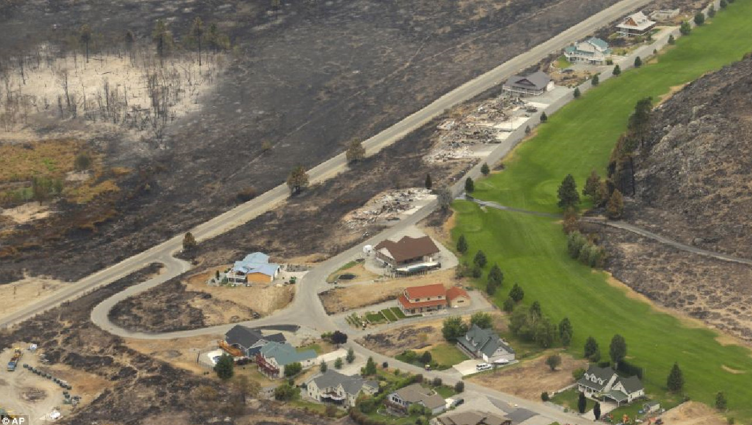
Challenges to Achieving Mitigation Goals
Notes:
Potential responses:
Lack of budget
Need to address more pressing issues
City leadership does not understand purpose of mitigation
Local staff wear many hats and have many responsibilities

Slide 6

Discussion Question
What are challenges to implementing mitigation actions in your community?

Slide 7

Common Challenges
Competing priorities
Apathy, loss of interest
Lack of funding and resources
Limited local capability or capacity
Insufficient political will
Disconnect with day-to-day operations

Slide 8
Unit 2
Mitigation at Work

Slide 9
Local Success Stories
St. George, Utah
Wichita, Kansas
Colorado Springs, Colorado
Rock Springs, Wyoming

Slide 10
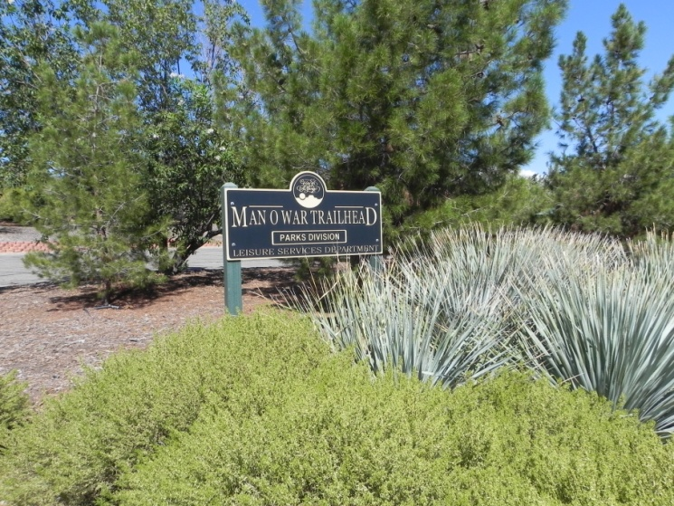
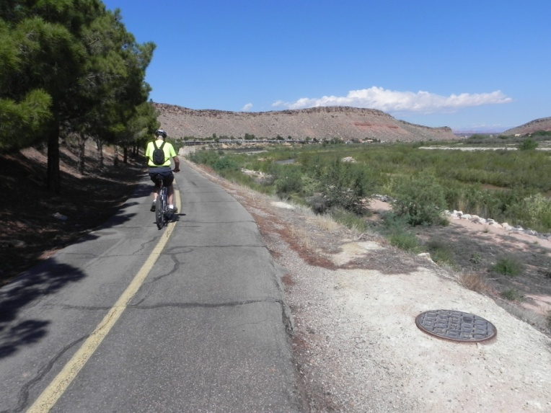
Happy Trails in St. George, Utah
Potential high risk development converted to open space
Flood mitigation creates popular trail system
Initial FEMA funds spur State and local investment
Mindset of community altered by win/win solution

Slide 11
Safer Schools in Wichita, Kansas
Near miss creates sense of urgency
Success requires whole community
One school district paves way for schools across State

Slide 12
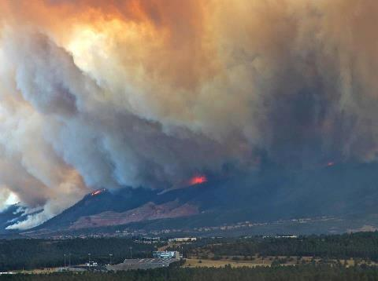
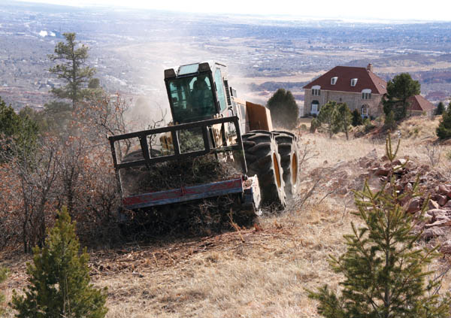
Owners’ Actions Save Homes in Colorado
Local champion’s passion for mitigation results in millions for City
Firewise creates a structure for neighborhood projects and builds awareness
Property owners’ sweat equity is secret to success

Slide 13
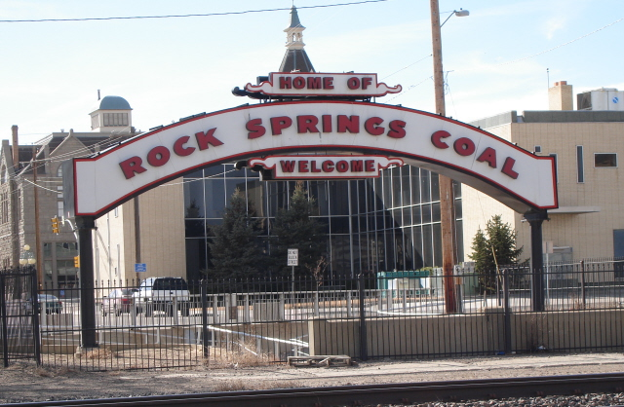
Comprehensive Planning in Rock Springs
“Hazard mitigation planning is not something to be done in isolation; it’s part of the overall vision for a healthy, safe community; it belongs as part of the master plan.”
--Jana McCarron, Planner, City of Rock Springs

Slide 14
Discussion Question
What factors contributed to success in the local success stories?

Slide 15
Unit 3
Recommendations for Success

Slide 16
Recommendation for Success
Use post-disaster window of opportunity
Focus on quality over quantity
Build on existing strengths
Encourage local champions
Develop strong messaging

Slide 17
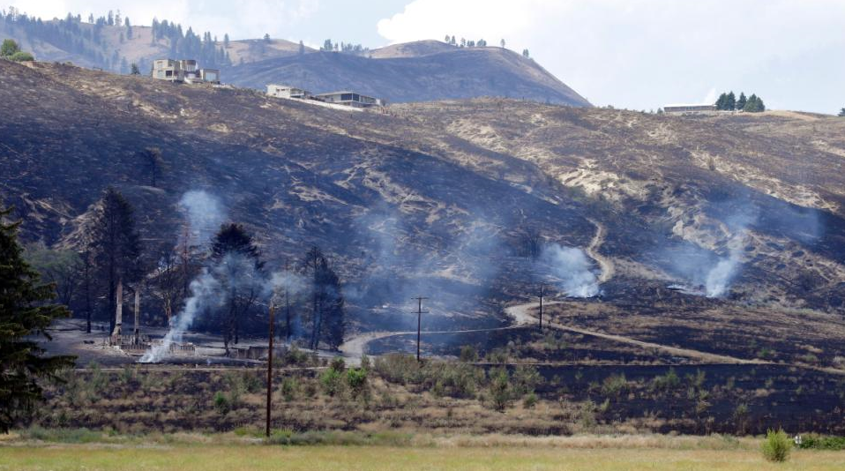
Use Post-Disaster Window of Opportunity
Take advantage of public interest and political will
Funding opportunities to address problems
Chance to re-invent community
Okanogan County, Washington

Slide 18

Focus on Quality over Quantity
Balance staff available and the time allotted to the project
Plans can always be updated to include future projects
Identify and focus on projects that target the highest risks and greatest community needs
Resources
Projects

Slide 19
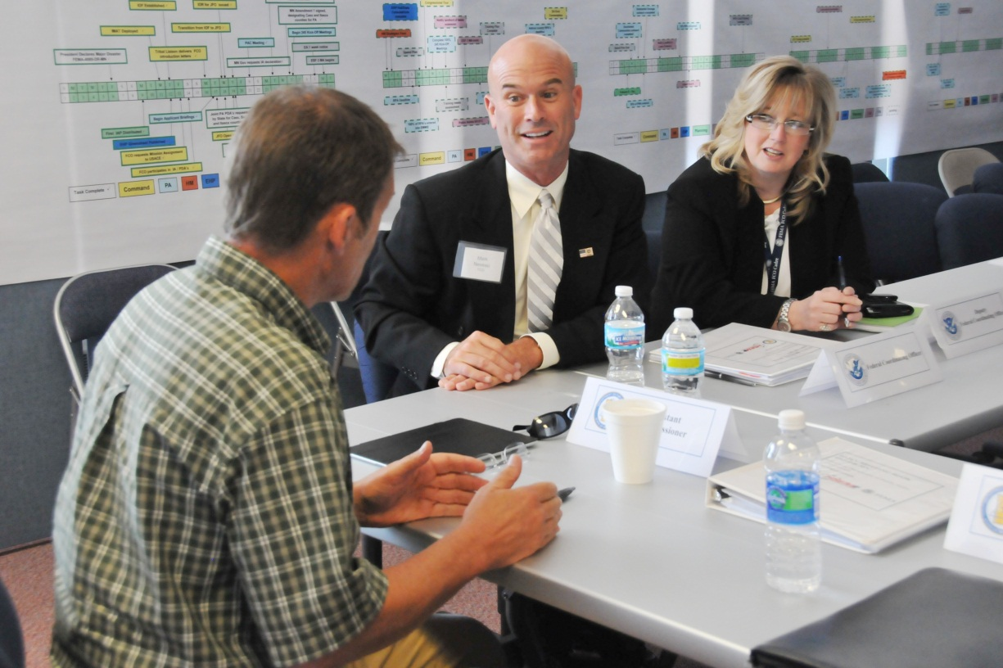
Build on Existing Strengths
Look at existing programs and plans to match with mitigation actions and proposed projects.

Slide 20
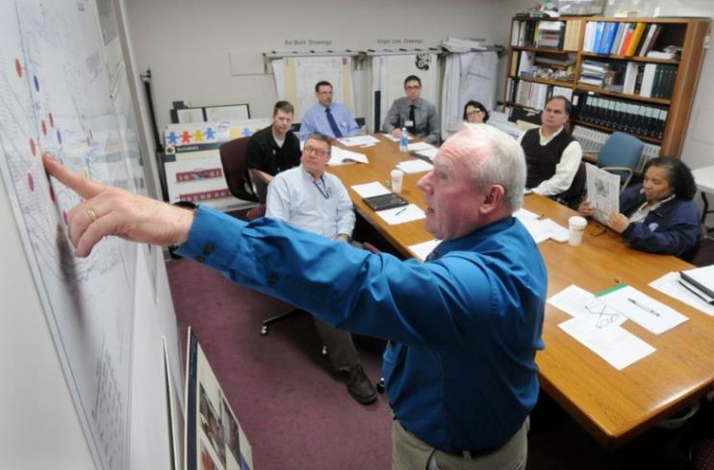
Encourage Local Champion
Must have sufficient authority
Understands the vision and can clearly communicate it to others
Ideally from an organization that will be spearheading the project
Notes:
QUESTION: Are you the local champion?

Slide 21
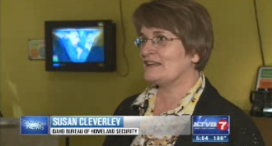
Develop Strong Messaging
Stakeholders need to see
personal value
Community officials want to see the financial benefit
Agency leads want to see the benefit to their goals and objectives
Businesses want to see how the plan will protect their investments
The public wants to see how it will protect their lives and property

Slide 22
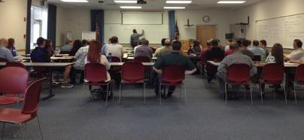
Activity 4.1
Win Support for a Mitigation Action
Allotted Time: 30 minutes
Eugene-Springfield Mitigation Planning Meeting

Slide 23
Activity 4.1:
Win Support for a Mitigation Action
Instructions
Work with your small group. Identify a mitigation action that will be the focus of this activity for the group; it can be an action that we’ve talked about during the class or one that you already know is needed in your community.
Imagine that your community has a newly adopted and approved mitigation plan. You are ready to move forward with implementing this mitigation action or project designated as a high priority in your plan.
You have 2 minutes at a meeting of your elected officials to convince them to support the adoption and/or funding of the action.
How will you make your case for resiliency? Consider the unique characteristics and values of your community and the risk and vulnerabilities identified in the plan. What are the key points that you would make in your two minute speech?

Slide 24
Unit 4
Mitigation Funding and Assistance

Slide 25
Funding and Assistance
Types of Assistance
Funding Sources
    Private property owner funding
    Local community funding
    State government funding
    Federal government funding
  FEMA Programs
    Hazard Mitigation Assistance grants
    Other FEMA resources

Slide 26
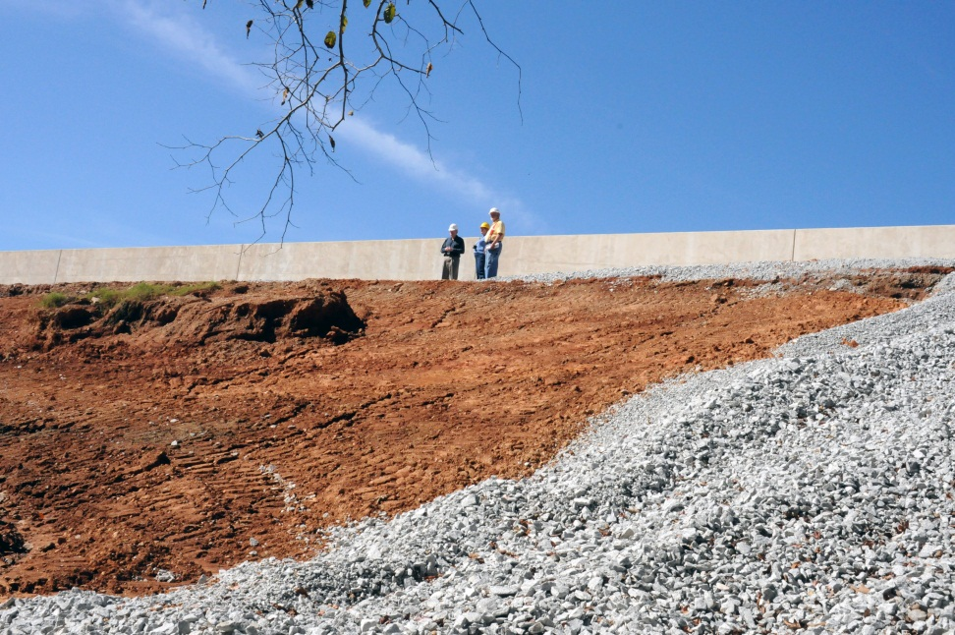
Types of Mitigation Funding Available
Grants
Loans
Local revenue
  Bonds
  Taxes
Technical assistance
In-kind services
and materials

Slide 27
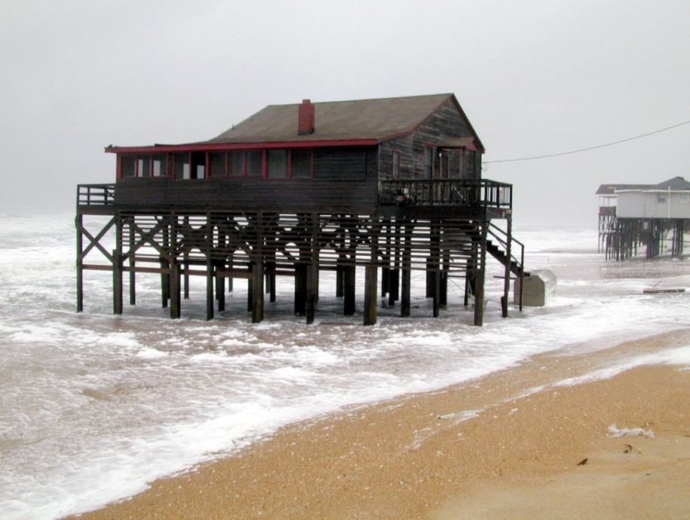
Private Property Owners
Homeowners or property owners may be asked to cover a portion of the cost of mitigation measures for their property.
All or part of the
non-Federal share
Increases the
likelihood of buy-in

Slide 28

Local Funding
Some local resources that are often leveraged as grant matching funds and can be used to fund mitigation projects:
General fund
Capital improvement budget
Special revenue sources

Slide 29
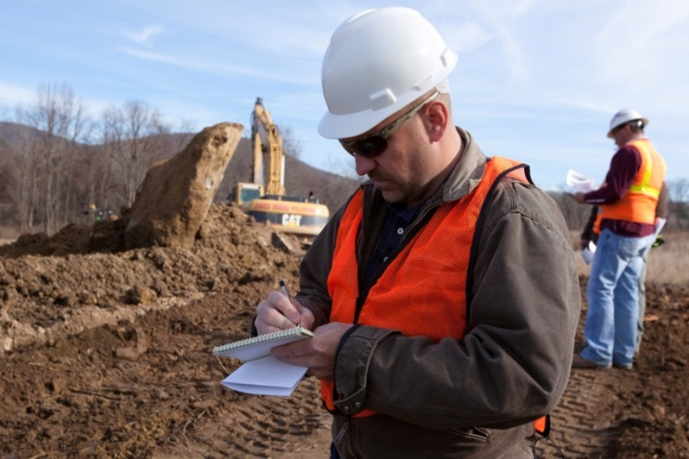
Tribal Funding
Tribal funding resources can be used to fund mitigation projects or provide non-federal cost share for grants.
These funds can be used for mitigation to tribal housing, infrastructure, facilities, resources, or other priorities identified in the plan.

Slide 30
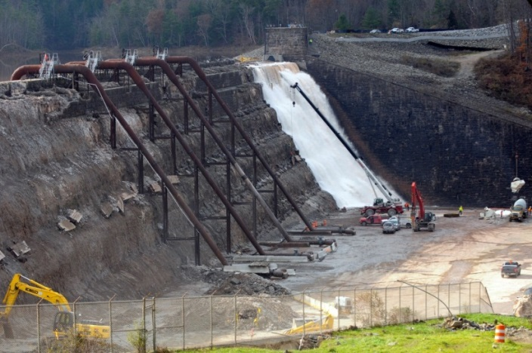
State and Federal Funding
State and federal funding may be:
    Available as grants to support community resilience
    Leveraged alongside other funding sources
Federal agencies with relevant Grant Programs Include:
    Department of Housing and Urban Development
    US Environmental Protection Agency
    US Army Corps of Engineers
    Department of Health and Human Services
    US Department of Agriculture
    US Department of Transportation
    Bureau of Indian Affairs

Slide 31

FEMA Hazard Mitigation Assistance Grants
FEMA offers grants to Tribal, State, and local governments to support mitigation projects. Specific funding availability may vary from year to year and program requirements vary.
Hazard Mitigation Grant Program (HMGP)
Pre-Disaster Mitigation (PDM)
Flood Mitigation Assistance (FMA)
Tribal Governments with a FEMA approved mitigation plan may apply directly to FEMA depending on the grant program offering and Tribe’s preference.

Slide 32
Pre-Disaster Mitigation (PDM)
Grant Program | Purpose | Eligible | Non-Fed. Share | Application Timeline
Pre-Disaster Mitigation Grant Program (PDM) | Pre-Disaster All Hazards Plans and Projects | Broad | 10% - 25% | Annual national competition, contingent on Congressional appropriation Application period generally 90 days each spring-summer

Slide 33
Flood Mitigation Assistance (FMA)
Grant Program | Purpose | Eligible | Non-Fed. Share | Application Timeline
Flood Mitigation Assistance (FMA) Program | Pre-Disaster Flood Hazard Only Projects Only | NFIP participating communities NFIP Insured properties | 10 - 25% | Annual national competition, contingent on Congressional appropriation Application period generally 90 days each spring-summer

Slide 34
Hazard Mitigation Grant Program (HMGP)
Grant Program | Purpose | Eligible | Non-Fed. Share | Application Timeline
Hazard Mitigation Grant Program (HMGP) (Stafford Act Section 404) | Post-Disaster All Hazards Plans and Projects | Broad | 25% | Available to Tribes with a disaster declaration Available through the State following disaster declaration Generally due to State 12 months after declaration State application process and priorities may vary each disaster

Slide 35
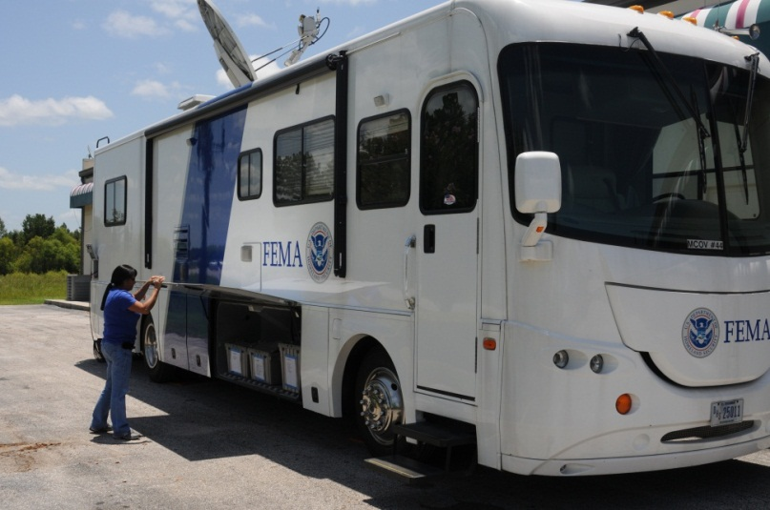
Other FEMA Resources
There are many FEMA programs that help fund mitigation projects.
Public Assistance (PA)
Section 406 Mitigation
Emergency Management
Performance Grant (EMPG)
Increased Cost of Compliance
(ICC) under the NFIP

Slide 36
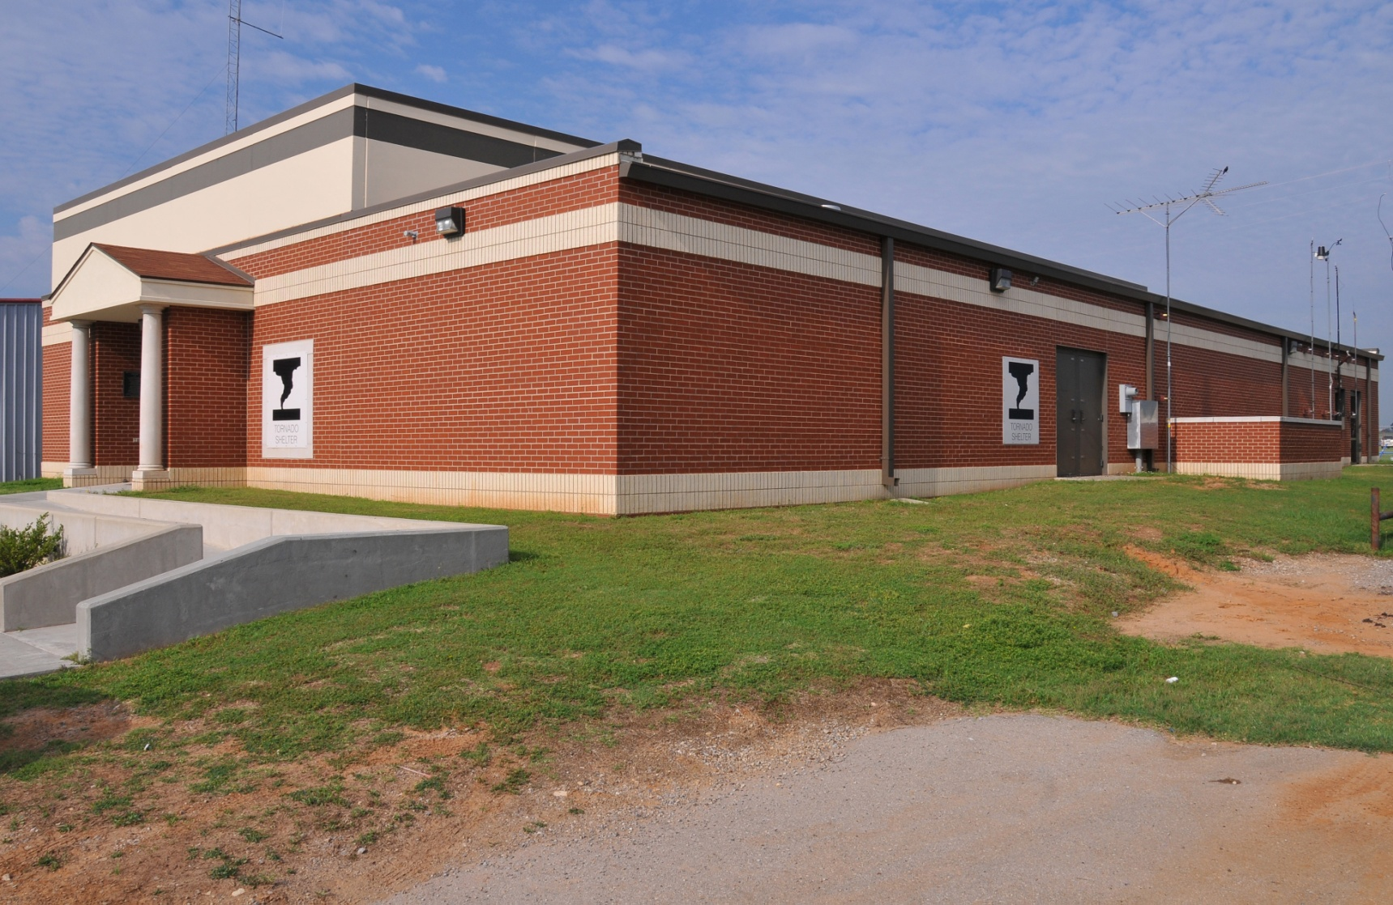
Questions?

