Slide 1
Mitigation Planning Workshop
Module 3:
Mitigation Strategy

Slide 2
Unit 1
Community Capabilities
Notes:
Students will be able to identify the capabilities their community currently has to accomplish hazard mitigation.

Slide 3

Tribal or Community Capabilities
What existing capabilities (laws, regulations, policies, programs, plans, funding) currently reduce long-term vulnerability?
What capabilities could be used to implement mitigation and reduce vulnerability in the future?

Slide 4
Capability Assessment
Describe existing authorities, policies, programs, and resources available to accomplish hazard mitigation
Describe the plans, reports, and technical information reviewed and incorporated
Review and update capabilities, highlighting changes since previous plan
Notes:
Let’s look at the requirements…
A recommended approach is to distribute a capabilities worksheet to planning team members to take back to their community or agency to complete

Slide 5
Types of Community Capabilities
Planning and Regulatory
Administrative and Technical
Financial
Education and Outreach

Slide 6
Discussion Questions
How would you collect information on capabilities in your community?
What community capabilities might be identified?
What limits to community capabilities might be identified?

Slide 7
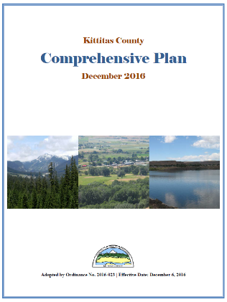
Examples of Capabilities
Planning and Regulatory
  Plans, policies, and ordinances
  such as:
  Comprehensive plans
  Capital improvement programs
  Transportation plans
  Emergency operations plans
  Zoning ordinances
  Building codes

Slide 8

Examples of Capabilities
Administrative and Technical
  Staff and skills for planning and
  mitigation such as:
  Engineers
  Planners
  GIS analysts
  Building inspectors
  Emergency managers
  Grant writers

Slide 9

Examples of Capabilities
Financial
Resources available to fund
mitigation actions such as:
  Operating budgets
  Stormwater utility fees
  Development impact fees

Slide 10

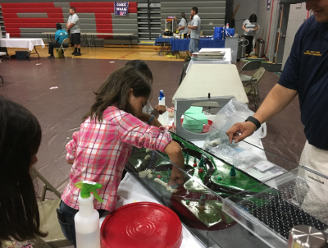
Examples of Capabilities
Education and Outreach
Existing programs that implement
mitigation and communicate risk such as:
  School programs
  Firewise communities
  Storm Ready communities
  Hazard awareness campaigns
  (Tornado Awareness Month)
  Public Information Officer
  Community newsletter

Slide 11
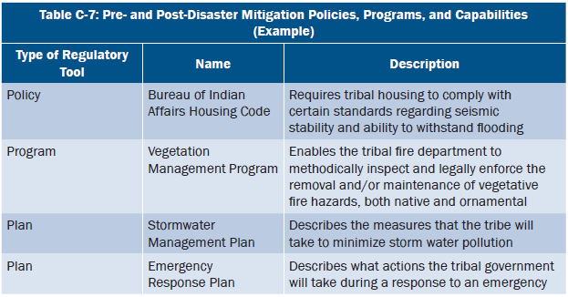
Tribal Capabilities example

Slide 12
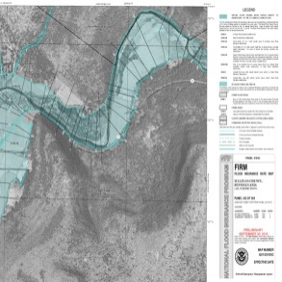
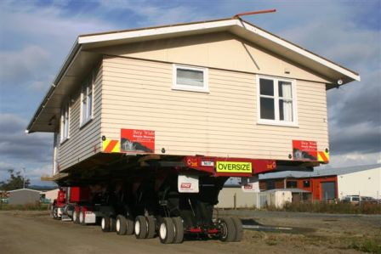

National Flood Insurance Program
The plan must describe participation in the NFIP
Floodplain Mapping
Floodplain Management
Flood Insurance

Slide 13
NFIP
Coordinate with local floodplain manager for:
Information on community participation
Repetitive loss properties
Mitigation opportunities

Slide 14
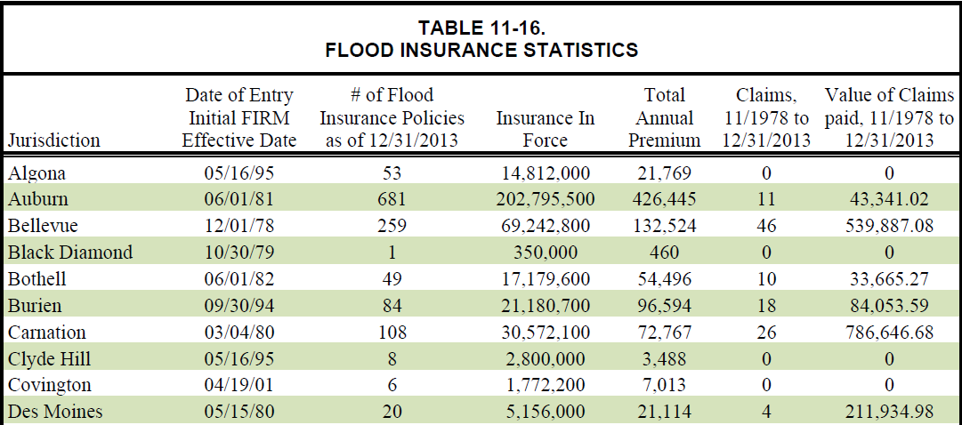
NFIP Information
Notes:
This is an example from King County, WA on how to present information on how community participates in the NFIP.

Slide 15
NFIP Repetitive Loss Properties
A repetitive loss property:
an NFIP insured structure that has had at least two paid flood losses of more than $1,000 each in any 10-year period since 1978. (Source: NFIP Flood Insurance Manual, FEMA. Revised October, 2012. http://nfipiservice.com/pdf/October%202012/splashscreen.pdf).
Severe repetitive loss properties single or multifamily residential properties that are covered under an NFIP flood insurance policy and:
1. That have incurred flood-related damage for which 4 or more separate claims payments have been made, with the amount of each claim (including building and contents payments) exceeding $5,000, and with the cumulative amount of such claims payments exceeding $20,000; or
2. For which at least 2 separate claims payments (building payments only) have been made under such coverage, with cumulative amount of such claims exceeding the market value of the building.
3. In both instances, at least 2 of the claims must be within 10 years of each other, and claims made within 10 days of each other will be counted as 1 claim.
(Source: 44 CFR §79.2(g), Definitions)

Slide 16
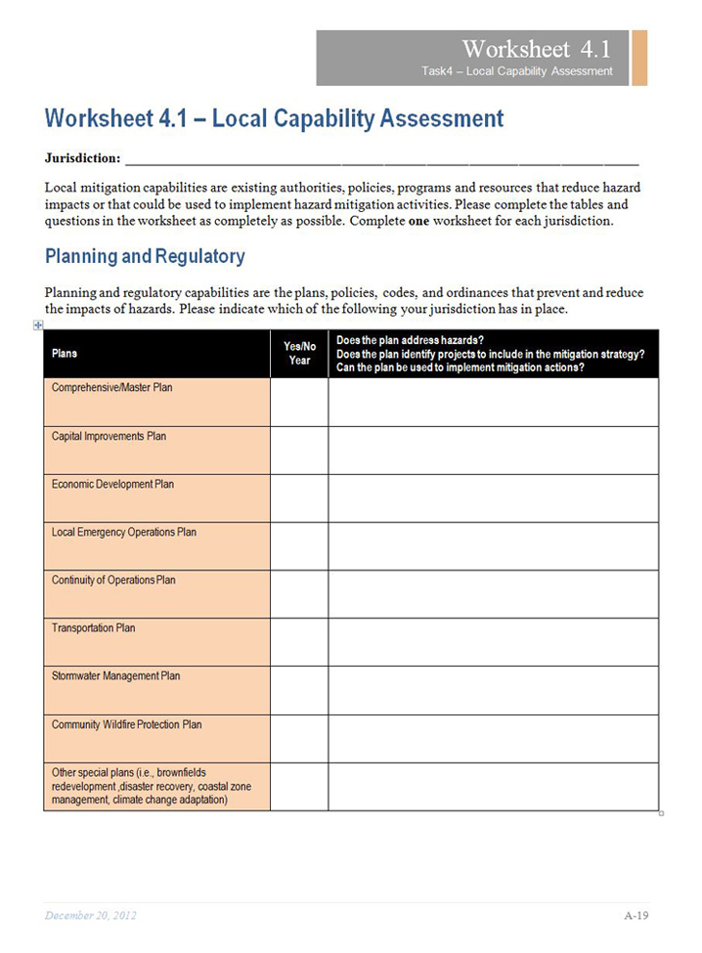
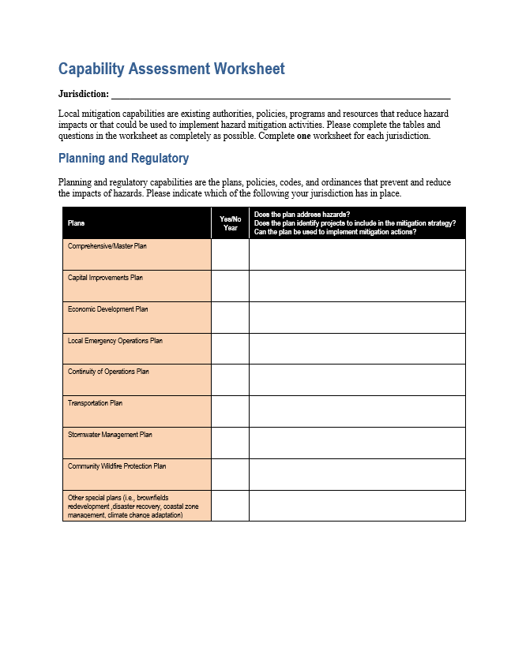
Capability Assessment Worksheet
Local Mitigation Planning Handbook
Modify worksheet as appropriate:
    for your community
    To gather information from another agency
  Safe Growth Audit

Slide 17
Unit 2
Develop the Mitigation Strategy
Visual 3.16
Notes:
Students will be able to:
Set mitigation goals
Identify mitigation actions based on the community’s risk assessment
Evaluate and prioritize mitigation actions
Prepare a plan for implementation

Slide 18
Mitigation Strategy
Actions
  Long-term outcomes
  Specific
  To reduce risk
  Priorities
  Implementation
Goals
Action Plan
Notes:
* The heart of the mitigation plan is the mitigation strategy, which serves as the long-term blueprint for reducing the potential losses identified in the risk * assessment.
* QUESTION: Do you agree? If so, do you feel this is where you focus most your energy in the planning process?

Slide 19
Mitigation Goals and Actions
 | Goals | Actions
 | Broad, long-term, policy-type statements | Specific projects and activities that help achieve goals
Ex 1 | Reduce losses due to flooding | Amend flood damage prevention ordinance to require elevation of first floor at least 1 foot above base flood elevation
Ex 2 | Prevent damage to structures and infrastructure | Retrofit historic school for earthquake safety
Notes:
Other examples
Enhance planning activities
Promote a sustainable economy
Promote a disaster-resistant and resilient community
Protect, restore, and enhance environment quality
Reduce the adverse impacts on the economy caused by natural disasters

Slide 20

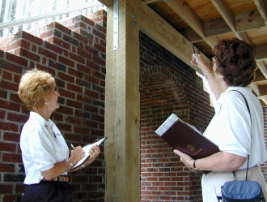


Types of Mitigation Actions
Local Plans and Regulations
Structure and Infrastructure Projects
Natural Systems Protection
Education and Awareness Programs

Slide 21

Local Plans and Regulations
Notes:
Authorities, policies, or codes that influence the way land and buildings are developed and built

Slide 22
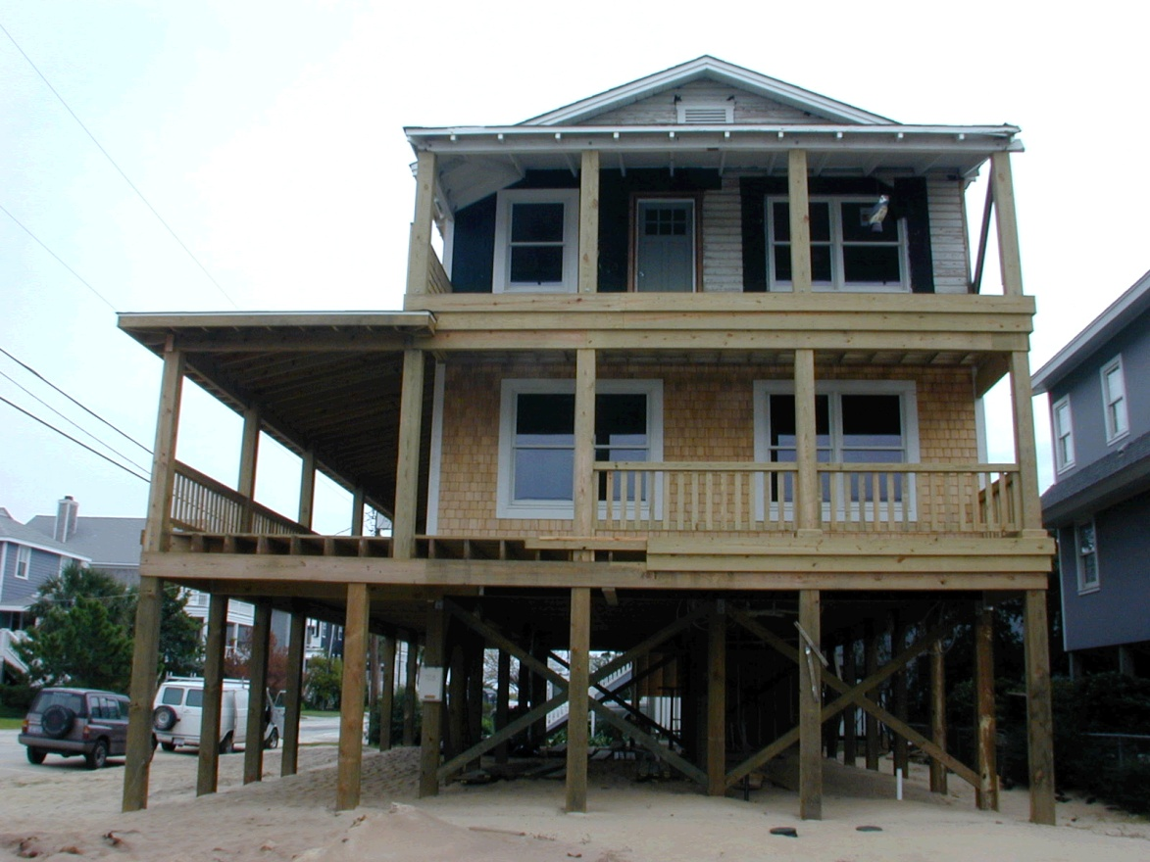
Structure and Infrastructure Projects
Notes:
These actions involve modifying existing structures and infrastructure to protect them from a hazard or remove them from a hazard area. This could apply to public or private structures, as well as critical facilities and infrastructure.

Slide 23
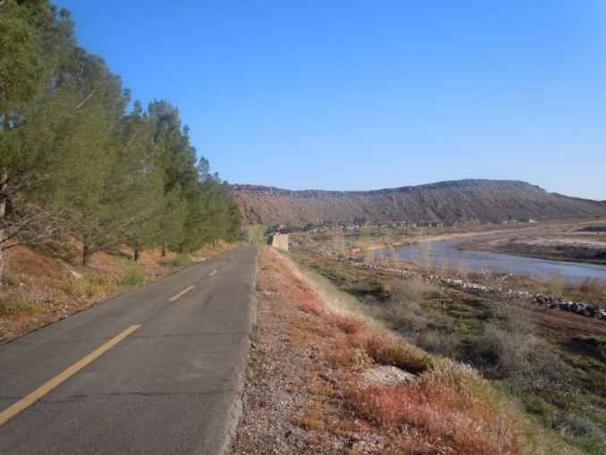
Natural Systems Protection
Notes:
These are actions that minimize damage and losses and also preserve or restore the functions of natural systems. Actions may include sediment and erosion control or wetlands restoration projects.

Slide 24

Education and Awareness Programs
Notes:
These are actions to inform and educate the public, elected officials, and property owners about hazards and potential ways to mitigate them. Actions may be posting hazard maps on a Web site or mailing information about a hazard to owners of properties in a hazard-prone area.

Slide 25
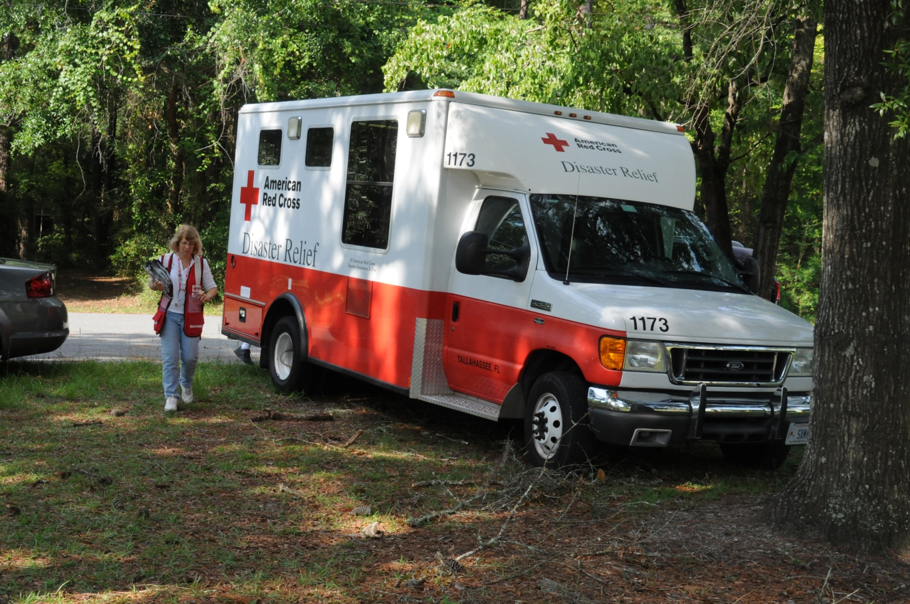
Other Actions in the Mitigation Plan

Slide 26
Discussion Questions
What are some examples of mitigation actions?
What are examples of activities related to preparedness and response, but not mitigation?

Slide 27
Steps for Developing a Mitigation Strategy
1. Develop Mitigation Goals
2. Identify Comprehensive Range of Mitigation Actions
3. Evaluate and Prioritize Actions
4. Develop Action Plan for Implementation

Slide 28
1. Develop Mitigation Goals
The plan must include mitigation goals consistent with the hazards identified in risk assessment
Evaluate previous goals and reaffirm or change based on current conditions and priorities

Slide 29
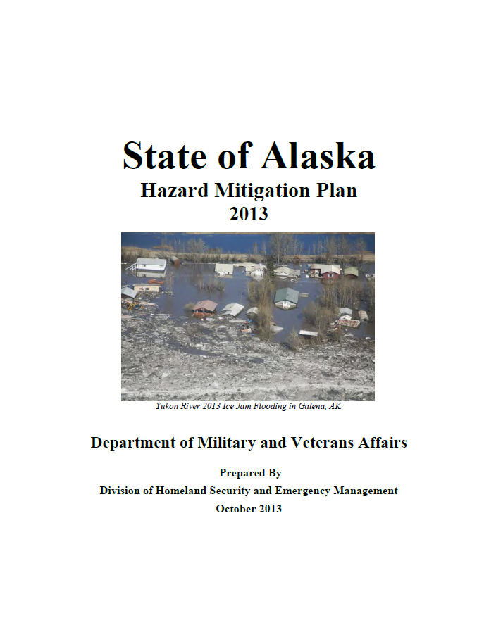

How to Develop Goals
Risk assessment findings
Outreach findings
Community goals
State Hazard Mitigation
Plan goals
Notes:
QUESTION: Does anyone have a good example to share?

Slide 30
2. Identify Mitigation Actions
Each jurisdiction must:
Identify and analyze a comprehensive range of specific mitigation actions to reduce the impacts of hazards identified in the risk assessment
Consider actions that reduce risk to:
    Existing buildings and infrastructure
    New development and redevelopment

Slide 31


How to Identify Mitigation Actions
Review Risk Assessment
Assess Capabilities
Planning and Regulatory
Administrative and Technical
Natural
Hazards
Community
Assets
RISK
Financial
Education and Outreach
Notes:
* Start with the problem statements from the risk assessment. For each problem statement, consider different types of mitigation actions for addressing the problem.

Slide 32
NFIP Compliance
NFIP communities must describe continued compliance with the program
Plan updates must meet the same requirements and document any change in floodplain management programs
Notes:
These could include unmet needs in staff training, CAVs, CRS participation, or flood hazard mapping. Jurisdictions can also consider how to mitigate identified repetitive loss properties.

Slide 33
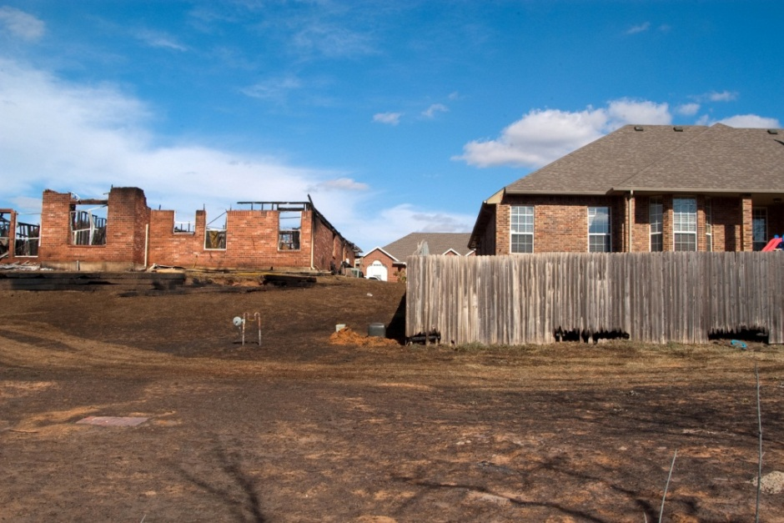
Example Problem Statement
In wildland-urban interface areas, two critical facilities (school and county maintenance shop) and $500 million in property value are at risk, and there is increasing development pressure.

Slide 34
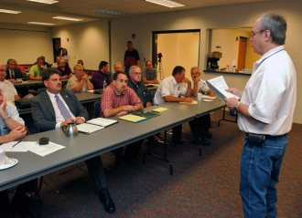
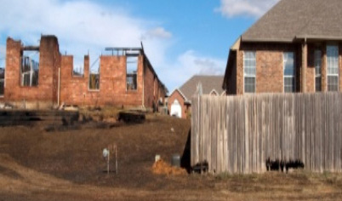


Comprehensive Range of Actions
Adopt a wildfire mitigation code
Retrofit school and maintenance shop with fire-resistant materials
Identify land for acquisition by Parks Department for trails and open space
Implement Firewise programs to
educate property owners

Slide 35
Example Problem Statements
The school is in a low lying areas that is flooded frequently causing disruptions for students.

Slide 36
Comprehensive Range of Actions
Elevate the school in its current location
Retrofit school with flood proof materials
Relocate school to new, less flood-prone location
Identify an secondary location for classes if school is flooded

Slide 37

Ideas for Mitigation Actions
Subject matter experts, stakeholders, public
Neighboring or similar communities
FEMA Mitigation Best Practices Portfolio
Student Manual Attachment F Mitigation Ideas

Slide 38
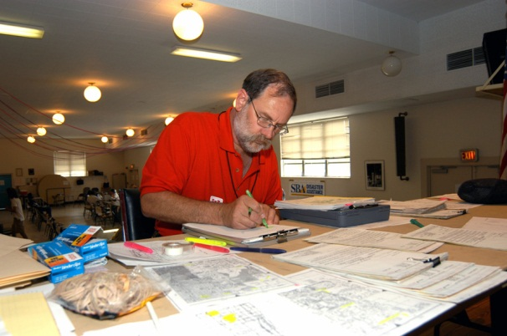

Activity 3.1
Identifying Mitigation Actions
Allotted Time: 30 minutes
Consider the problem statements written for Activity 2.1. Choose one and identify at least three potential mitigation actions to address the problem. Write each mitigation action in the space below. If possible, identify mitigation actions that fall into different categories.
One person per group will share the identified mitigation actions with the class.
Visual 3.37

Slide 39
3. Evaluate and Prioritize Actions
Describe how actions will be prioritized, including emphasis on benefit-cost review
  Benefit-Cost Review
    Are costs reasonable
    compared to problem
    and probable benefits?
    Estimate costs using
    planning level assessment
    Consider quantitative ($)
    and qualitative
Costs
Benefits
$
Losses Avoided

Slide 40
Evaluation Criteria
Technical
Political
Legal
Environmental
Social
Administrative
Local champion
Protect lives
Other community objectives
Cons
Pros
Protects Structures
High Cost $
Funding Available
Low Political Support
Technically Feasible

Slide 41
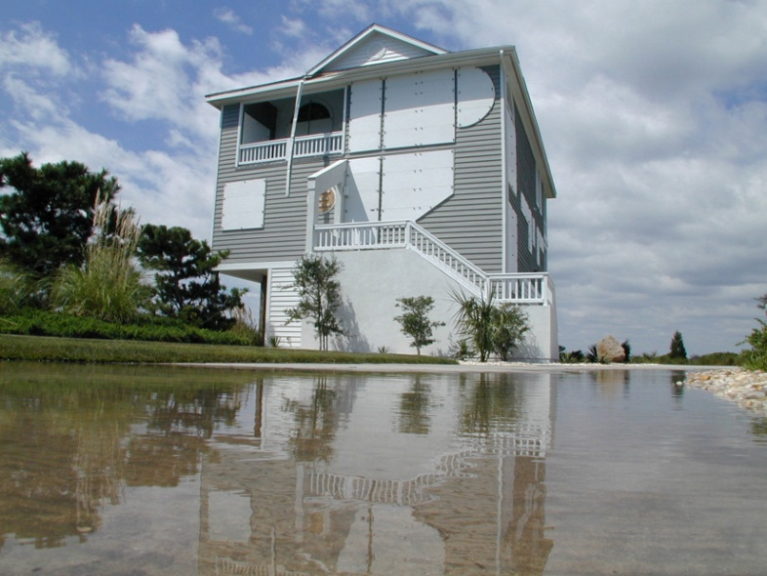
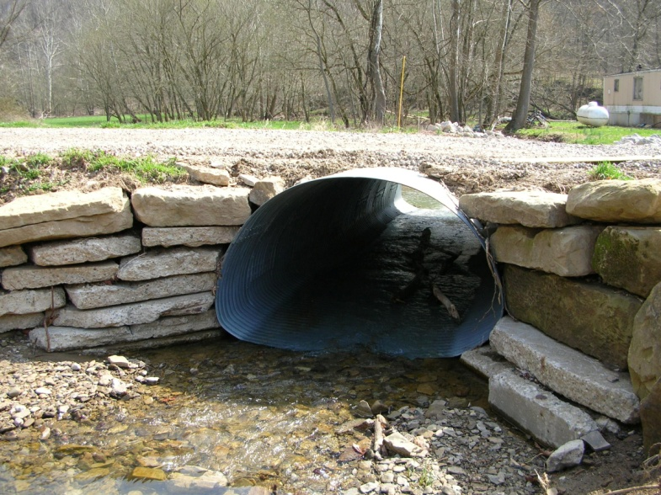
Action Prioritization
Considers plan goals and hazards addressed
Weighs the pros and cons
Is appropriate for community capabilities

Slide 42


Activity 3.2
Prioritizing Mitigation Actions
Allotted Time: 35 minutes

Slide 43
Activity 3.2:
Prioritizing Mitigation Actions
Part I Instructions
The entire class will review approximately five actions using a limited set of criteria to identify top priority actions
2. Rate each action
  Zero (0) if the action would not do well or would be neutral on that criterion
  One (1) if an action would do well on a criterion
  Two (2) if an action would do very well on a criterion
3. Total the numbers
Identified Action | Technical | Political | Environmental | Other Community Objectives | Protect Lives | Total

Slide 44
Activity 3.2:
Prioritizing Mitigation Actions
Part II Instructions
Each participant will receive three (3) sticky dots
Each participant can go to the easel and place a sticky dot by the actions that they consider to be top priority

Slide 45
4. Develop Action Plan for Implementation
Describe how the mitigation plan will be incorporated into existing planning mechanisms
Describe how the mitigation actions will be prioritized, implemented, and administered by each jurisdiction

Slide 46
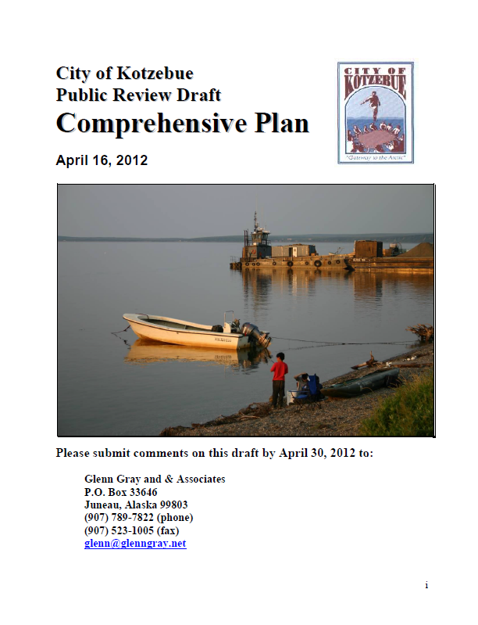
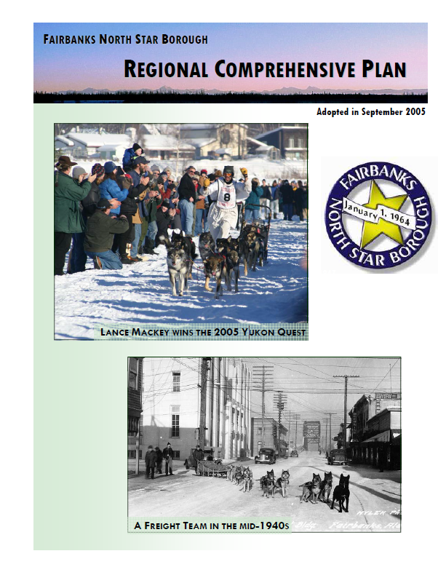
Integrating Mitigation
Integrate plan goals with other community objectives
Use the risk assessment to inform plans and policies
Implement mitigation actions through
existing mechanisms

Slide 47
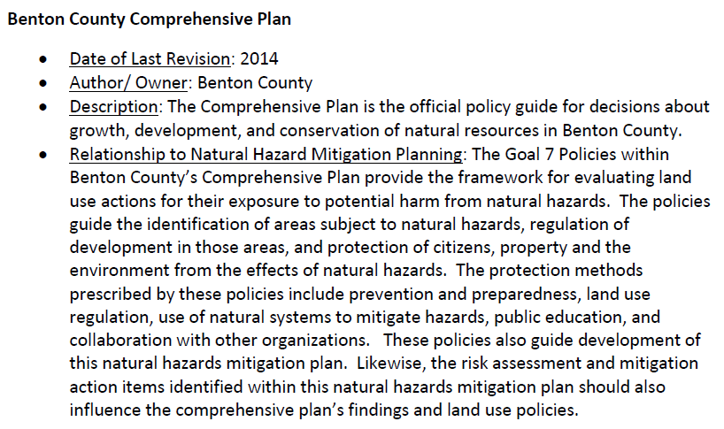
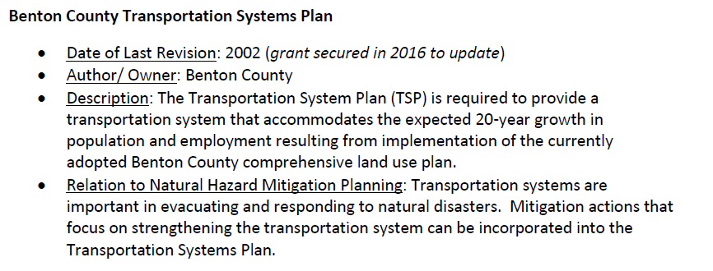
Integration Examples

Slide 48
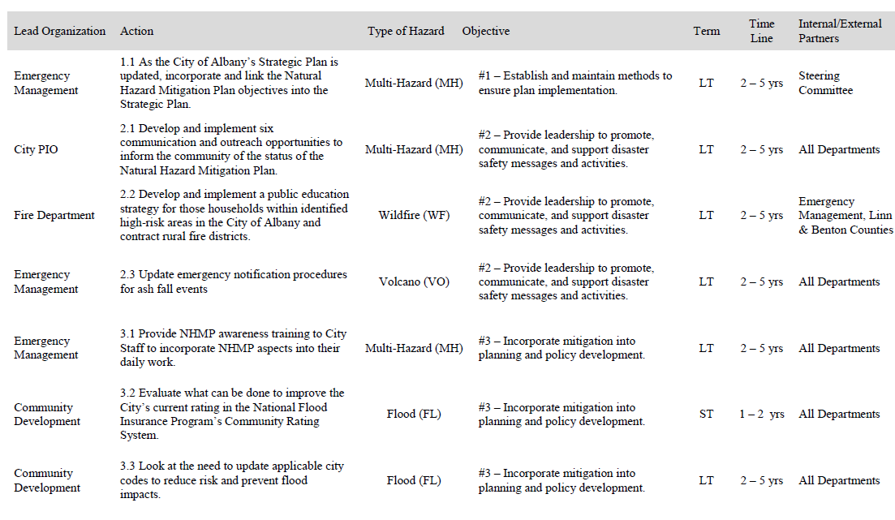
Communicating the Action Plan
Albany, Oregon

Slide 49
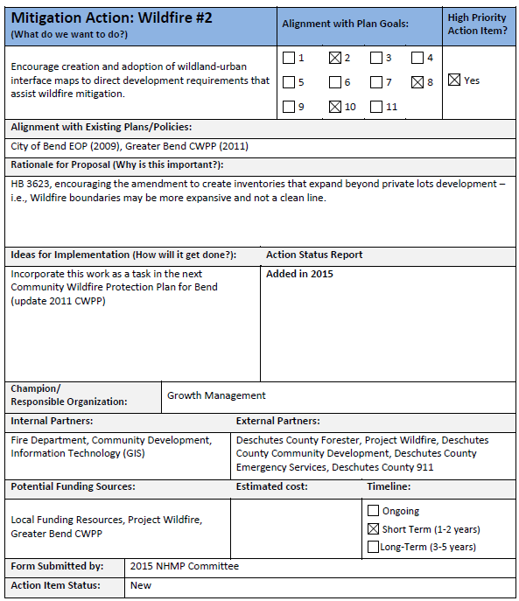

Slide 50
Steps for Developing a Mitigation Strategy
Develop Mitigation Goals
Identify Comprehensive Range of Mitigation Actions
Review risk assessment
Assess capabilities
Evaluate and Prioritize Actions
Develop Action Plan for Implementation
Integrate with existing planning mechanisms
Describe implementation
of actions

Slide 51

Questions?

Slide 52
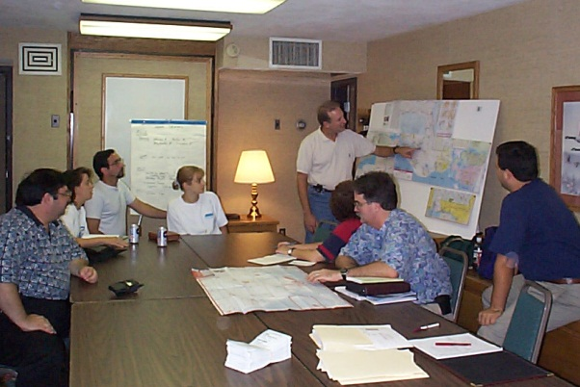

Activity 3.3
Implement an Action
Allotted Time: 20 minutes

Slide 53
Activity 3.3:
Implement an Action
Instructions
For the action assigned to your small group, discuss how to develop an implementation strategy by considering:
What administrative, regulatory, or other planning mechanisms are already in place for implementing this action?
Who will be responsible for implementation?
Who else needs to be involved to ensure success?
How will the action be financed?
When will the action be completed?
Identify potential problems that a community will encounter in answering these questions.

Slide 54
Unit 3
Updating the Mitigation Strategy

Slide 55
Update the Mitigation Strategy
Evaluate progress in plan implementation
Describe changes in priorities

Slide 56

Evaluate Progress in Implementation
How was the plan integrated into other
planning mechanisms?
What is the status of each action?
Completed
Not Completed
Did action have the intended results?
Still relevant – include in updated mitigation strategy?
What factors contributed to success?
What were barriers to implementation?

Slide 57
How Have Priorities Changed?
Identify new actions based on updated risk and capability assessments
Reprioritize with remaining actions from previous plan
Factors influencing changes:
    Hazard events and recovery priorities
    Rate of growth and development
    Political and economic changes
    New State or Federal funding sources

Slide 58
Unit 4
Keep the Plan Current
Visual 3.57
Notes:
Students will be able to document the planning process, including how the plan will be implemented and how progress will be monitored over time.

Slide 59
Plan Maintenance
A plan maintenance process ensures the plan remains an active and relevant document
Describe method and schedule for monitoring, evaluating, and updating the plan include discussions of:
    progress on achieving goals
    mitigation measures and project closeouts
Identify methods for keeping the public involved
Visual 3.58

Slide 60
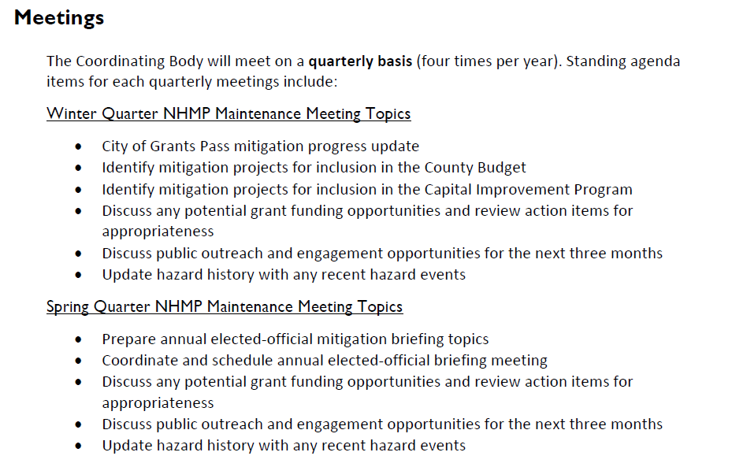
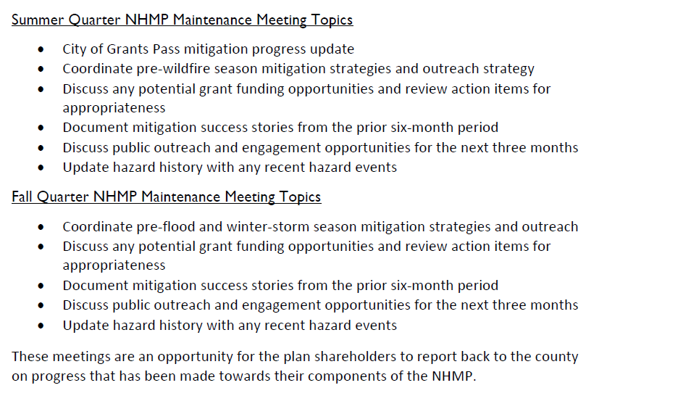
Plan Monitoring and Evaluation
 | Monitoring: Tracking implementation of mitigation actions | Evaluating: Assessing the effectiveness of the plan at achieving its goals
Who | Mitigation Committee | Mitigation Committee
When | Quarterly | Annually After a disaster event
How | Progress report forms from responsible agencies | Evaluate process and implementation Identify lessons learned Report to elected officials
Visual 3.59

Slide 61
Plan Update
Develop a method and schedule for updating the plan on a 5-year cycle
Determine a responsible party for the update process
Estimate a practical schedule
Identify steps in process
    Develop scope of work
    Coordinate participating jurisdictions
    Apply for funding or budget cost
Visual 3.60

Slide 62

Plan Maintenance Procedures
Discussion Question:
How will you monitor the plan in your community?

Slide 63
Unit 5
Review and Adopt the Plan
Visual 3.62

Slide 64
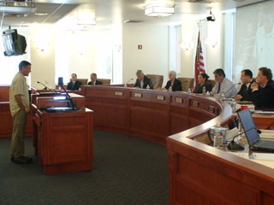
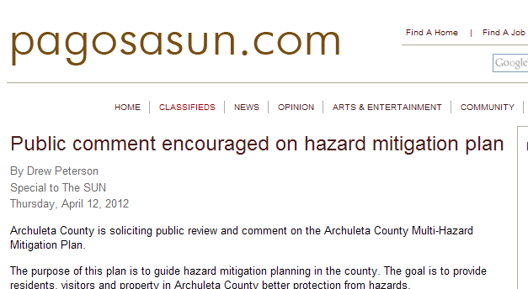
Review Final Draft Plan
Follow existing process for
public review
Make available to community
Publicize comment period
Present to
elected officials
Visual 3.63

Slide 65
State and FEMA Plan Approval
Submit plan to SHMO for State review
Revisions Required
State submits to FEMA Region for review
FEMA issues “approvable pending adoption”
Local jurisdictions adopt plan and submit resolutions
FEMA issues approval letter and final review tool
Visual 3.64

Slide 66
FEMA Plan Approval
Submit to State for review
Submit to FEMA Region for review
Tribal Government
FEMA issues “approvable pending adoption”
Revisions Required
Tribal Council adopts plan and submits resolution
FEMA issues approval letter and final review
Visual 3.65
Notes:
Note that the lighter highlighted area “Submit to the State for Review” only occurs if the Tribal government chooses to work with the state. Tribes can either work directly with FEMA or states depending on what works best.
Once the planning team is confident the plan meets the required elements and includes all supporting documentation, they forward the plan to the State Hazard Mitigation Officer (SHMO), or FEMA, depending on who the tribe is working with. If the plan is sent to the SHMO, they will review the plan and respond with any required revisions.
Once the state is satisfied that the plan meets the requirements, the SHMO will forward the plan to the FEMA Regional office for approval. FEMA will conduct its review within 45 days, if possible, and return the completed Tribal Plan Review Crosswalk to the State or Tribe, as applicable. The FEMA Regional office and /or the SHMO may contact you to discuss additional revisions to the plan to ensure that it meets the Tribal mitigation planning regulations.
Approvable Pending Adoption
Once FEMA determines the plan is in compliance with the regulations, FEMA will notify the SHMO or the Tribe that the plan is “approvable pending adoption” (APA). APA is a recommended and potentially time-saving process by which the community submits the final draft of the mitigation plan to the State and/or FEMA for review prior to formal adoption by the Tribal Council or other authorized governing body. If FEMA determines the plan is not approvable, and revisions are needed, the Tribe will be able to make revisions before taking the plan through adoption, thereby avoiding unnecessary delays in plan approval.
Plan Adoption
The final plan must include documentation that it has been formally adopted by the governing body of the jurisdiction(s) requesting approval. Adoption by the local governing body demonstrates the Tribe’s commitment to implementing the mitigation strategy and authorizes responsible agencies to execute their the mitigation strategy.
Plan Approval
Upon receiving the record of adoption, FEMA will issue an official approval letter stating that the Tribe has adopted the plan and the expiration date. Attached to the approval letter will be a FEMA completed Tribal Mitigation Plan Review Crosswalk. Tribes should contact their FEMA Region to discuss ways in which their plan could be approved during the next update.
Plan Adoption
All jurisdictions seeking plan approval must adopt the plan and submit the documentation for final plan approval.
Adoption must take place within 1 year of receipt of FEMA’s APA letter. At least one of the participating jurisdictions must adopt within 1 year from the APA
notice; however, it is recommended that jurisdictions coordinate the adoption process as soon as the plan has received APA status to ensure that all participants are covered by a plan for the full 5 years.

Slide 67
Plan Adoption
All jurisdictions seeking plan approval must adopt the plan and submit documentation
Visual 3.66

Slide 68

Keep in Mind
Communicate often with your State or FEMA planners
Keep Tribal or local decisionmakers informed of the plan’s progress
Allow time for State and FEMA review and Tribal or local adoption
Celebrate your success!
Visual 3.67

Slide 69
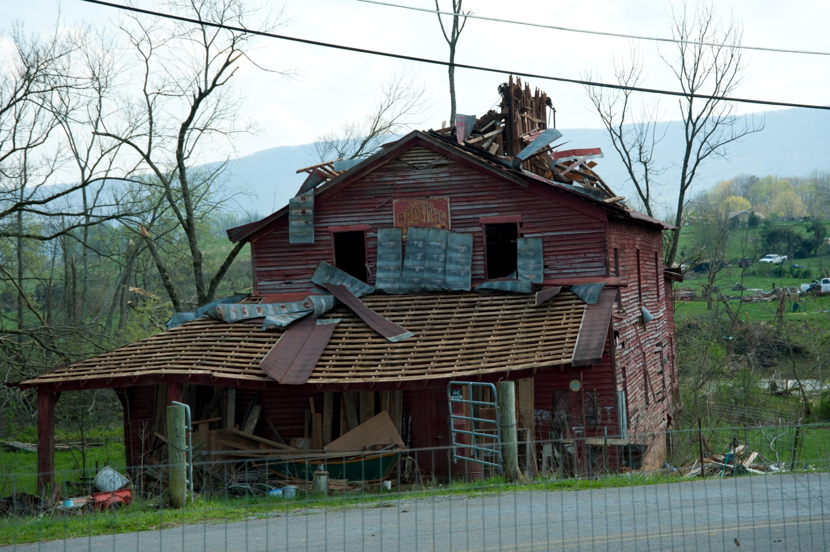
Questions?

