Slide 1
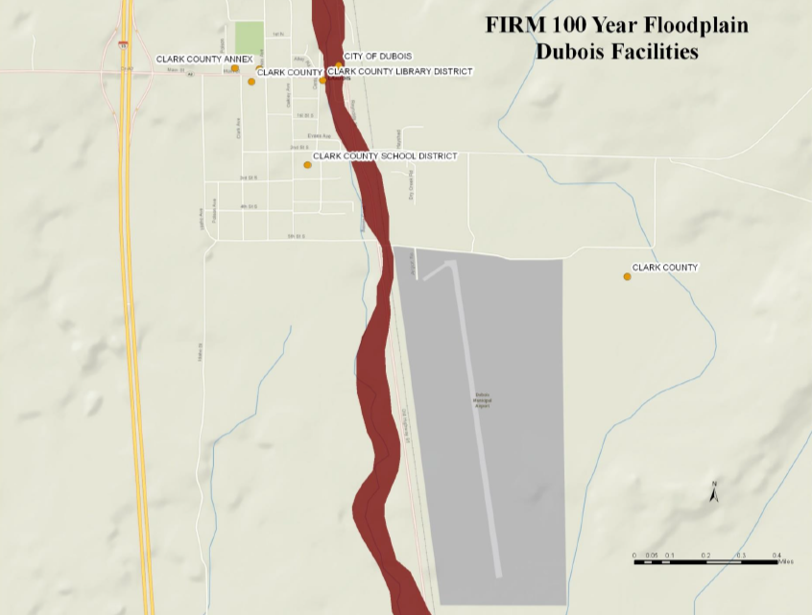
Mitigation Planning Workshop
Module 2:
Risk Assessment
Notes:
Students will be able to:
Understand risk assessment terminology
Recognize hazards and community needs
Determine potential losses to vulnerable community assets
Be able to summarize their community’s vulnerability to the identified hazards

Slide 2
Unit 1
Risk Assessment

Slide 3
Risk Assessment
Process that collects information and assigns values to risks to:
    Identify or compare courses of action
    Develop priorities
    Inform decisionmaking
Foundation for mitigation strategy to reduce future losses
Notes:
Also used for THIRAs, Emergency Response Plans, Recovery Plans

Slide 4
Risk Assessment Terms
Natural Hazard
Community Asset
Vulnerability
Impact
Risk
Notes:
Have students read each one!

Slide 5


Venn Diagram
NATURAL HAZARDS
COMMUNITY ASSETS
Location
Extent
(Magnitude/Strength)
Previous Occurrences
Future Probability
Population
Built Environment
Natural Environment
Economy
RISK
Note: Modified from U.S. Geological Survey and Oregon Partnership for Disaster Resilience Models.

Slide 6
Multi-Jurisdiction Considerations
Describe unique or varied hazards
Assess assets and risks for each jurisdiction
Town
County
District
Tribe
City
Multi- Jurisdiction

Slide 7
Steps to Assess Risks
Describe Hazards
Identify Community Assets
Analyze Risks
Summarize Vulnerability

Slide 8
Updating the Risk Assessment
Changes in hazards
(example: disaster declarations, new data, new hazard occurrences)
Changes in community assets
    Emphasis on changes in development

Slide 9
Unit 2
Describe Hazards

Slide 10
Step 1: Describe Hazards
Describe Hazards
Identify Community Assets
Analyze Risks
Summarize Vulnerability

Slide 11
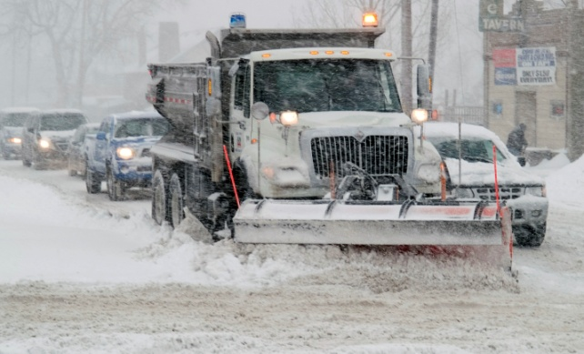
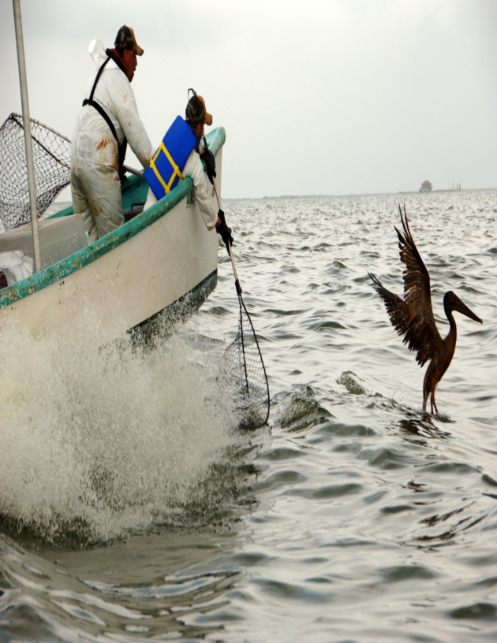
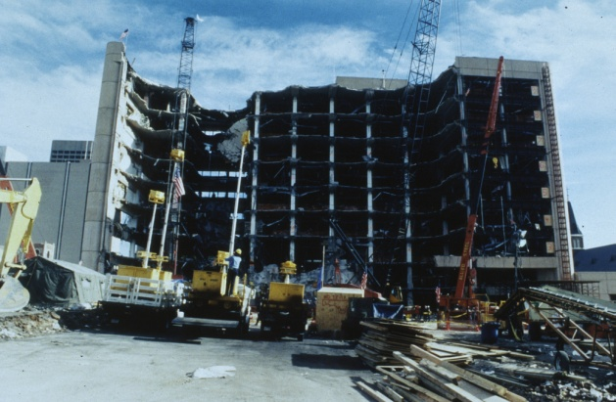
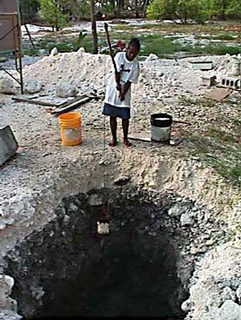
Types of Hazards
Natural Hazard
Technological Hazard
Human-caused Hazard
Climate Change
Notes:
Natural hazards must be addressed in a plan; however some communities may choose to assess other hazards in their planning process

Slide 12
Hazard Mitigation & Climate Adaptation
“CLIMATE ADAPTATION is a process that intends to reduce long-term risks from hazards associated with climate variability and climate change.”
        Baltimore Disaster Preparedness Plan

Slide 13
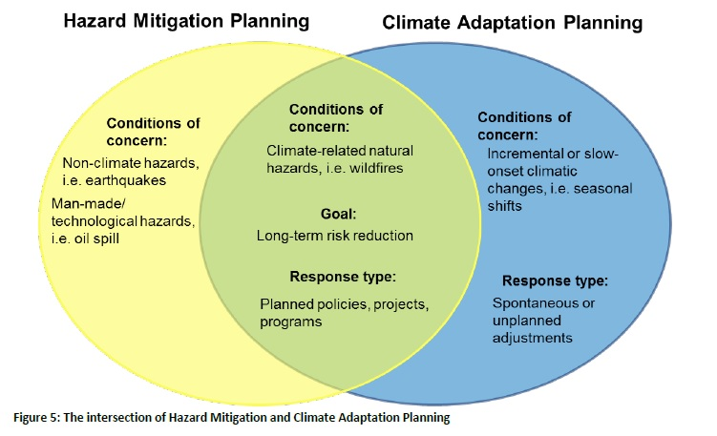
Hazard Mitigation & Climate Adaptation
SOURCE - Integrating Hazard Mitigation and Climate Adaptation Planning: Case Studies and Lessons Learned, ICLEI

Slide 14
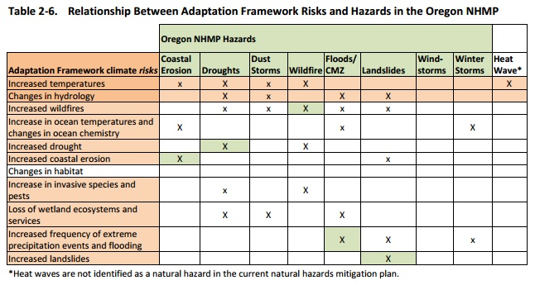
Relationship between Adaptation and Hazards Risk
SOURCE: OR Natural Hazard Mitigation Plan, Chapter 2. Risk Assessment
Notes:
Illustrate how climate change may exacerbate already existing hazards. Discuss benefits of integrating climate adaptation in existing processes/assessments; as opposed to a separate climate action plan.

Slide 15
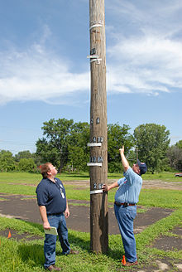
Sources of Hazard Information
State Hazard Mitigation Plan
Disaster declarations
Hazard-related
reports/plans
State and federal agencies
Colleges/universities
Planning team and
stakeholders
Local knowledge and records

Slide 16
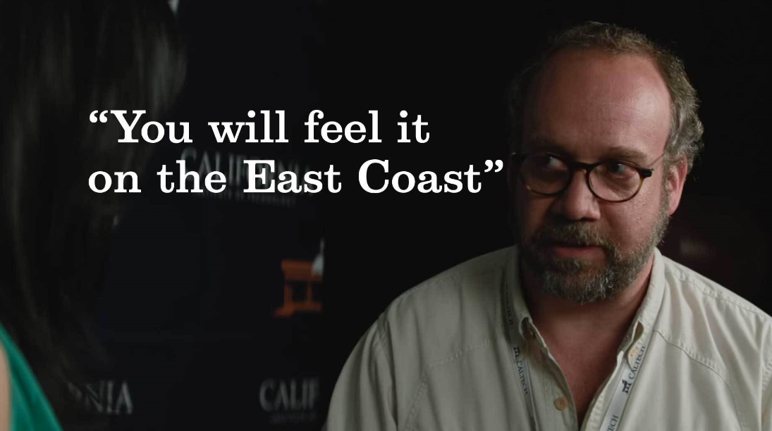

Discussion Questions
What natural hazards affect your community?
What information sources would you use for your plan?

Slide 17
Hazard Descriptions
Location
Extent
Previous Occurrences
Probability of Future Events

Slide 18
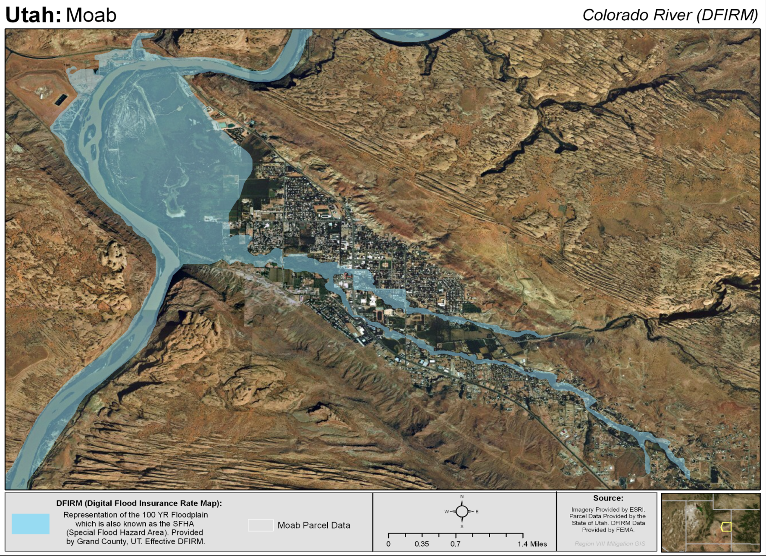
Location

Slide 19
Location
From 2010 Deschutes County Natural
Hazards Mitigation Plan

Slide 20
Extent
Magnitude
Severity
Speed of Onset
Duration of event
Notes:
Extent defines the characteristics of the hazards regardless of the people and built environment it affects
while
Impacts refers to the effect of a hazard on the people and property in the community

Slide 21
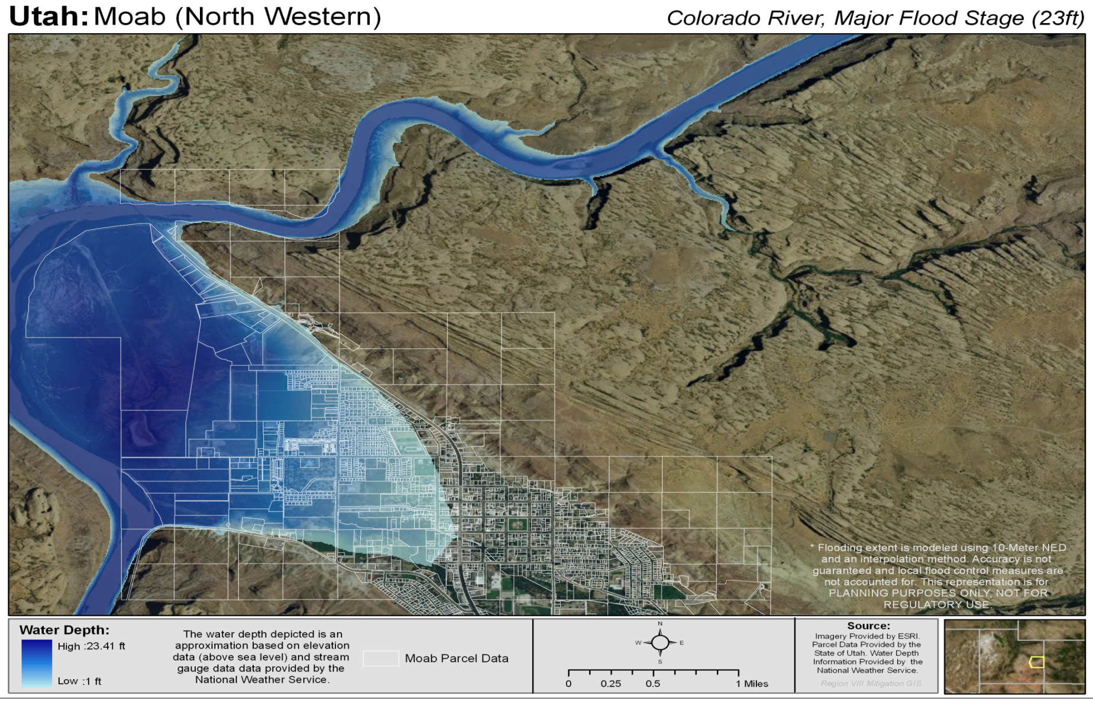
Extent
Notes:
This map shows potential depth of water during a flood in Moab, UT

Slide 22
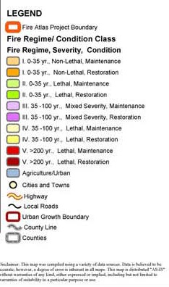
Extent
From 2010 Deschutes County Natural Hazards Mitigation Plan
Notes:
This shows the Condition Class for the wildfire hazard;

Slide 23
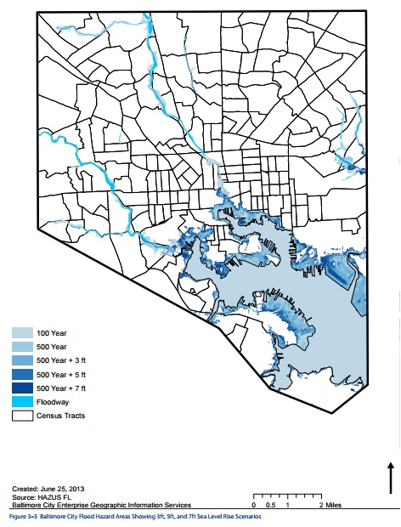
Changes to Hazards Location & Extent
Notes:
This will impact current and future shoreline development. The impacts of rising sea level on communities will continue to present significant short- and long-term challenges.

Slide 24
Changes to Hazards
    Wildfire:
“Climate change has the potential to affect multiple elements of the wildfire system: fire behavior, ignitions, fire management, and vegetation fuels. Hot dry spells create the highest fire risk. Increased temperatures may intensify wildfire danger by warming and drying out vegetation. Climate change also may increase winds that spread fires.”
        King County, WA HMP
Notes:
Won’t read off the slide, but use it as an example of a plan addresses exacerbation to existing hazards.

Slide 25
Previous Occurrences
Date of Flood | Property Damage
August 19, 2010 | $2,500,000
August 28, 2007 | $1,000
July 23, 2007 | $1,000
October 14, 2006 | $15,000
October 9, 2006 | $20,000
October 6, 2006 | $500,000
October 3, 2006 | $25,000
July 10, 2006 | $25,000
September 9, 2005 | $3,000
Date of Flood | Property Damage
September 12, 2002 | $25,000
July 30, 1999 | $2,000
July 14, 1999 | $60,000
September 6, 1997 | $175,000
July 31, 1976 | $50,000
September 18, 1972 | $385
July 29, 1969 | $1,250
August 2, 1963 | $5,000
Source of data: http://webra.cas.sc.edu/hvri/products/sheldus.aspx
Notes:
When data are available, describe the extent of the event and the impacts that occurred, such as fatalities and injuries, building and infrastructure damage, and loss of services
Illustrates information on previous occurrences of flooding from the Colorado River in Grand County, UT

Slide 26
Probability of Future Events
The previous slide shows:
    There were 17 occurrences of flooding in Grand County, UT
    Over 48 years from 1962 through 2010
With 17 occurrences in 48 years, probability of future occurrence is 17/48 = 0.3542 or about a 35% chance of flooding in any year
Notes:
Probability: Likelihood of the hazard occurring in the future
Maybe defined using historical frequencies or statistical probabilities
If using terms such as “highly likely”, “likely”, “unlikely”, then they must be defined

Slide 27
Changing Probabilities
“Idaho’s State Hazard Mitigation Plan (SHMP) is taking critical steps to decrease and potentially avoid these impacts associated with climate change….
Vulnerabilities include:
    Increased occurrences and magnitudes of hazard events, including: severe storms, flooding, drought, and wildland fires
    Changing climatic and precipitation patterns that may impact the State’s agricultural, hydroelectric, recreational, and economic sectors
    Increased exposure to hazard events for all of Idaho’s citizens and infrastructure
    Expanding diversity of extreme weather events
    Increased temperatures and altered streamflows impacting the ecosystem and species migration “
Notes:
How much do you risk? Different risk thresholds for different assets; for wanting lowest risk, don’t just take historic trends into consideration.

Slide 28
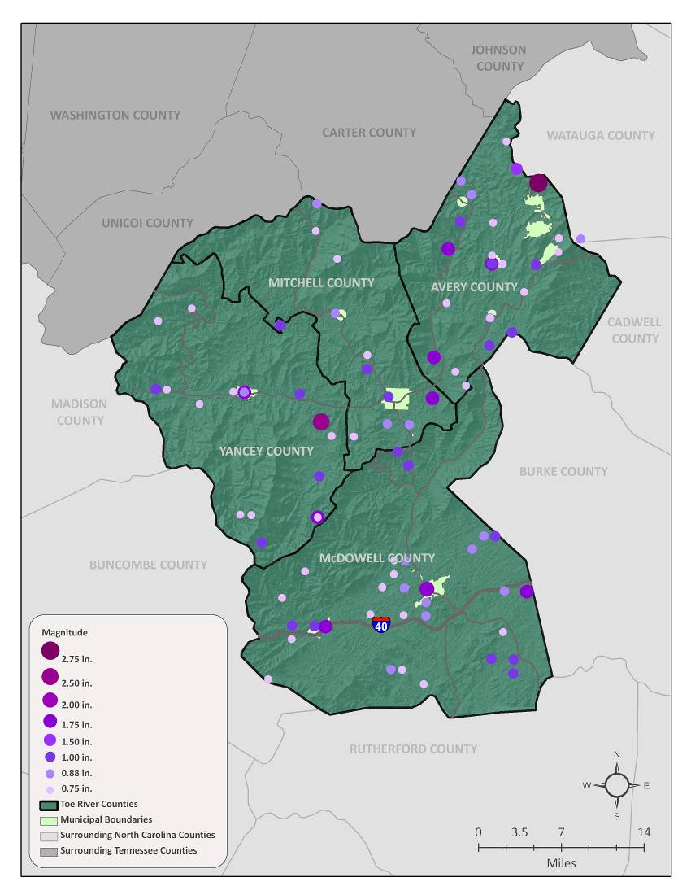
Hazard Map
Location
Extent
Previous occurrences
Reference: Toe River Region, NC Hazard Mitigation Plan
Notes:
This map of the Toe River watershed in North Carolina shows the location of previous hail events, indicates the extent or size of the hail, and shows the number of previous occurrences

Slide 29
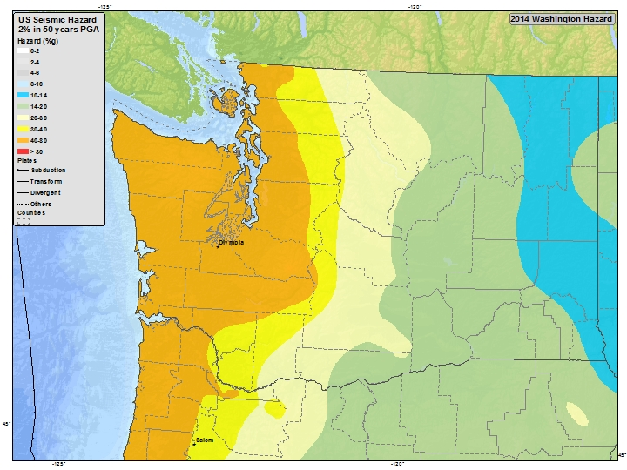
Hazard Map
Location
Extent
Probability
USGS Washington 2014 Seismic Hazard Map 2% in 50 years Peak Ground Acceleration Hazard (%g)
http://earthquake.usgs.gov/hazards/
Notes:
This map shows Peak Ground Acceleration (PGA) for Washington. It identifies the locations with the greatest EQ risk, the extent of the risk based on a scientific scale, and probability of damage based on location

Slide 30
Summarize Hazard Information
Hazard | Location | Extent | Probability
Tornado | Entire planning area | EF2 | 2% chance per year
Hail | Entire planning area | 1” diameter | 10% chance per year
Flood | Along 0.2 mile of stream in Town A only | 6” to 12” depth | 25% chance per year

Slide 31
Summarize Hazard Information
Hazard | Yes/No | Decision to Profile Hazard
Avalanche | No | Shaktoolik’s topography is not one likely to produce avalanches; no instances of avalanches havv been observed in Shaktoolik.
Earthquake | Yes | Designated as a hazard in Alaska All‐Hazard Risk Mitigation Plan. Community members remember feeling the 1964 Earthquake. However, no earthquakes have been felt since 1964.
Erosion | Yes | Designated as a hazard due to extensive history of erosion.
Example excerpt from City of Shaktoolik/Shaktoolik Tribal
Council, Alaska Multi‐Jurisdictional Hazard Mitigation Plan

Slide 32
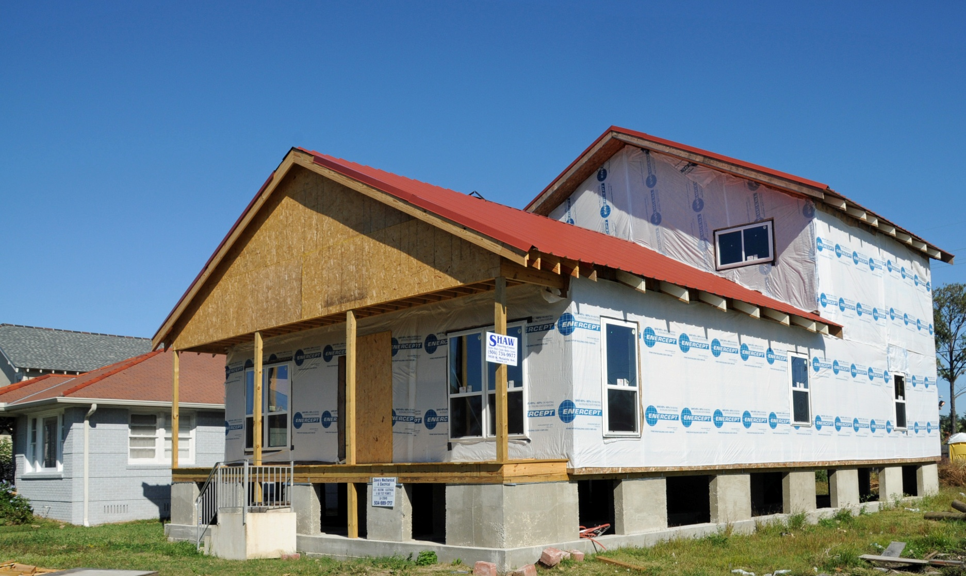
Questions?

Slide 33
Unit 3
Identify Community Assets
Notes:
Students will be able to identify the community assets that are vulnerable to identified hazards

Slide 34
Step 2: Identify Community Assets
Describe Hazards
Identify Community Assets
Analyze Risks
Summarize Vulnerability

Slide 35
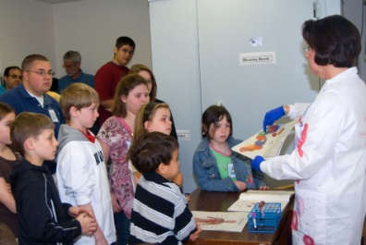
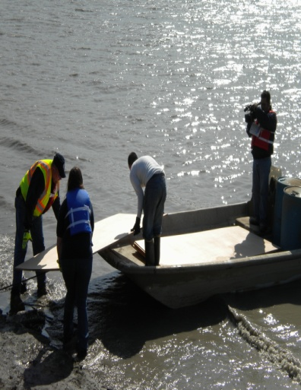
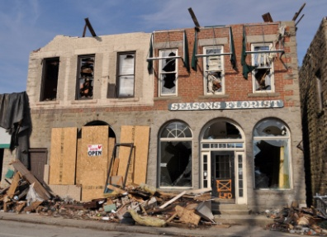
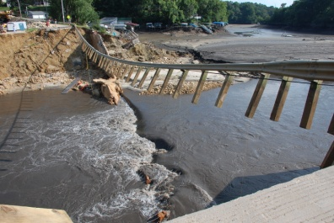
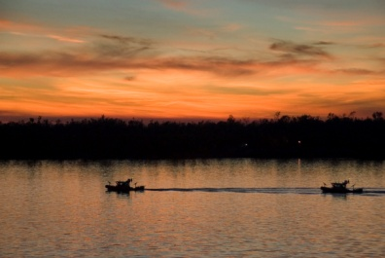
Community Assets
People
Economy
Structures
Critical Facilities and Infrastructure
Natural Environment
Notes:
Ask yourself, “What’s important to us?”

Slide 36

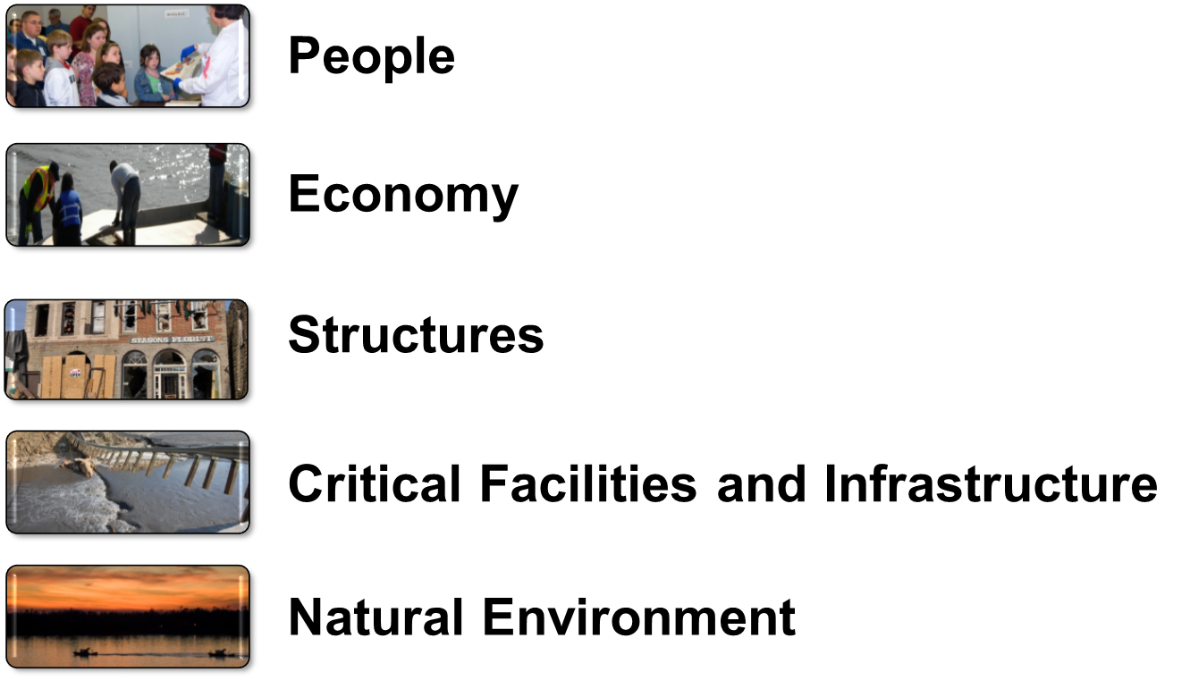
Discussion Question
What are assets in your community?

Slide 37
People
Locations and concentrations of residents and employees
Locations and concentrations of special needs and dependent populations
Types and locations of visiting populations

Slide 38
Economy
Major employers
Primary economic sectors
Commercial centers
Dependencies between economy and infrastructure

Slide 39
Structures
Existing and Future
Locations, types, and values of structures
Cultural and historic resources
Locations and types of planned new development/redevelopment
Infrastructure for new development
Planned critical facilities and capital improvements
Notes:
QUESTION: Why identify future development?
QUESTION: How can we identify future development? Think about Buildable Lands Inventory

Slide 40
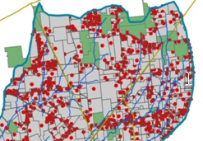
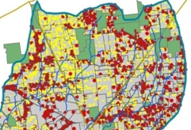
Structures (Existing and Future)
Existing Structures
(red dots)
Existing (red dots) and Future Structures
(yellow dots)
Source: FEMA Region VIII, undated

Slide 41
Critical Facilities and Infrastructure
Location, age, and value of critical facilities and infrastructure
Dependencies that exist among critical facilities and infrastructure

Slide 42
Natural Environment
Environmental functions that reduce magnitude of hazards
Critical habitat areas to protect
Hunting, gathering, and/or fishing areas
Areas where conservation reduces risk and achieves other community objectives
(example: trails and parks)
Other cultural and historic natural resources
Notes:
This is key to reducing risk
Wetland Mitigation Banking
Prescribed Fire
Forest health/logging

Slide 43
Unit 4
Analyze Risks and Summarize Vulnerability
Notes:
Students will be able to:
Determine potential impacts to vulnerable community assets
Summarize community’s overall vulnerability to the identified hazards

Slide 44
Step 3: Analyze Risks
Describe Hazards
Identify Community Assets
Analyze Risks
Summarize Vulnerability

Slide 45
Natural Hazards, Community Assets, and Risk
NATURAL HAZARDS
COMMUNITY ASSETS
Location
Extent
(Magnitude/Strength)
Previous Occurrences
Future Probability
Population
Built Environment
Natural Environment
Economy
RISK
Note: Modified from U.S. Geological Survey and Oregon Partnership for Disaster Resilience Models.

Slide 46
Assess Impacts and Vulnerability
For each hazard
Evaluate vulnerable assets
Assess potential impacts
Estimate future losses
Notes:
Regardless of how the results are expressed or methods of analysis used, this step must result in….
a description of the potential impacts
of each hazard
for each participating jurisdiction in the plan

Slide 47
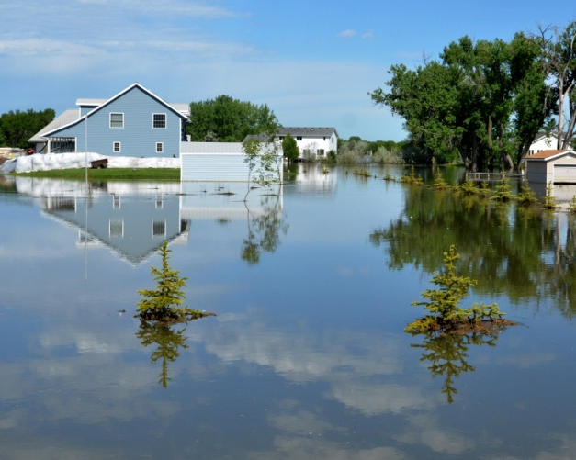
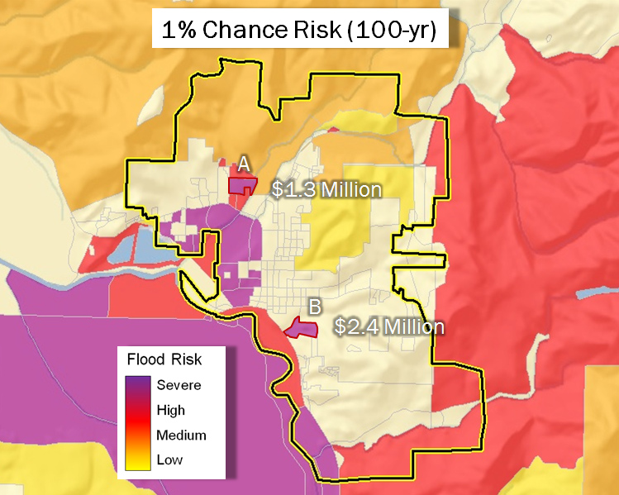
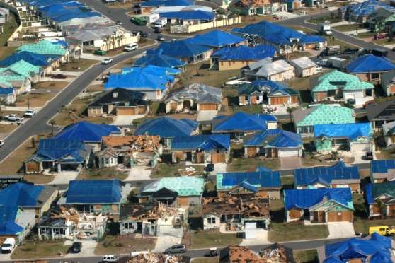
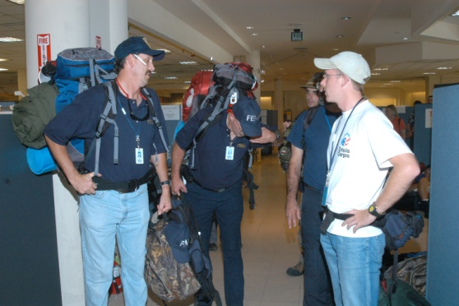
Methods for Analyzing Risk
Exposure analysis
Historical analysis
Scenario analysis

Slide 48
Exposure Analysis
What assets are located in hazard-prone areas?
Quantify number, type, value of assets
Estimate future development in hazard-prone areas based on planning and zoning
Consider magnitude of hazard or event
(high vs. moderate wildfire hazard areas)
Use maps and GIS for analysis

Slide 49
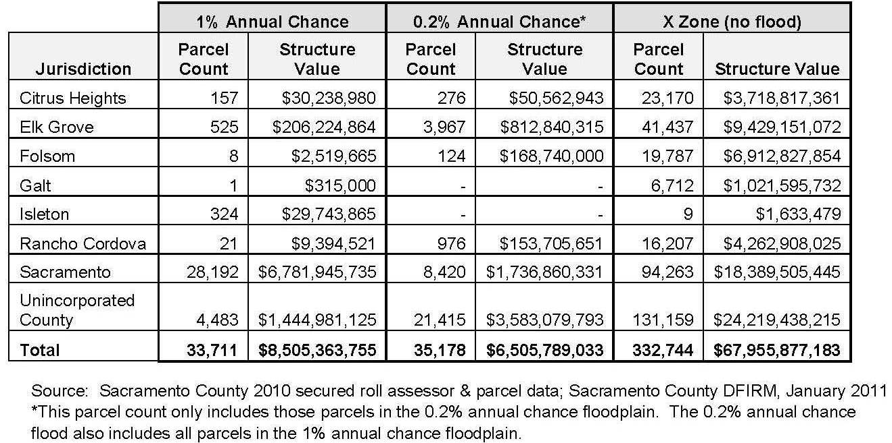
Exposure Analysis
Notes:
This table summarizes exposure by providing the full value of structures in flood zones; it does not estimate potential loss; damage will not typically equal 100% of the value of a structure

Slide 50
Historical Analysis
Based on past events, what are potential future impacts and losses?
Use for higher frequency events with available data on past impacts and losses
(e.g., winter storms, stormwater flooding)
Consider vulnerability of new development

Slide 51
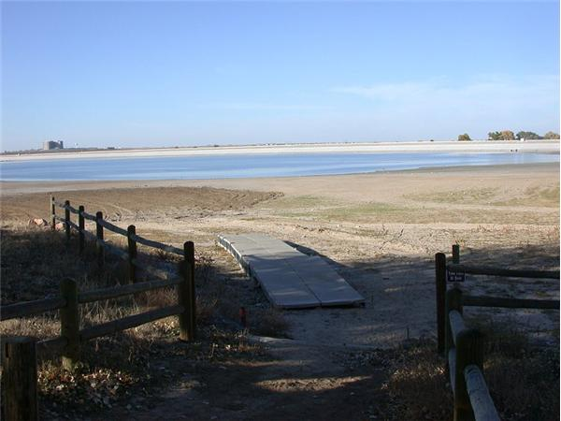
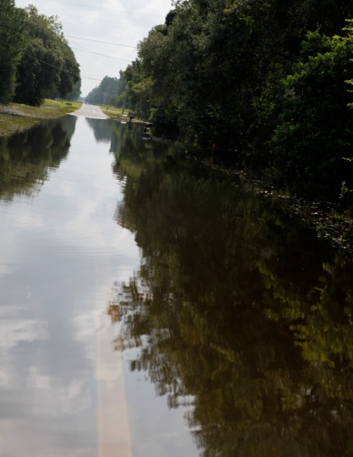
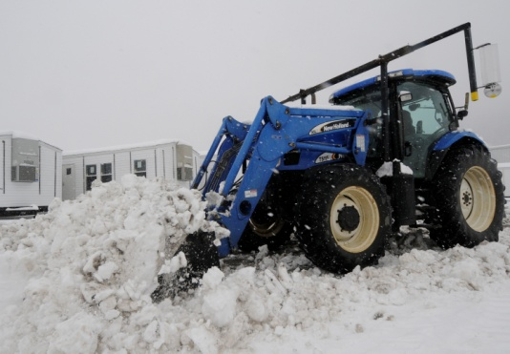
Hazards Suitable for Historical Analysis
Drought
Flooding
Severe Winter Weather
Notes:
Frequent events with lots of data to support

Slide 52

Scenario Analysis
What are the potential impacts and losses if a particular event occurs?
Monetary costs, casualties, down time, etc.
Consider a scenario analysis for low-frequency, high-consequence events (e.g., earthquake)
Use modeling tools, such as Hazus
Notes:
* Scenario analysis asks “what if” a particular event occurred
* Tool for assessing low-frequency, high-consequence events, such as earthquakes

Slide 53
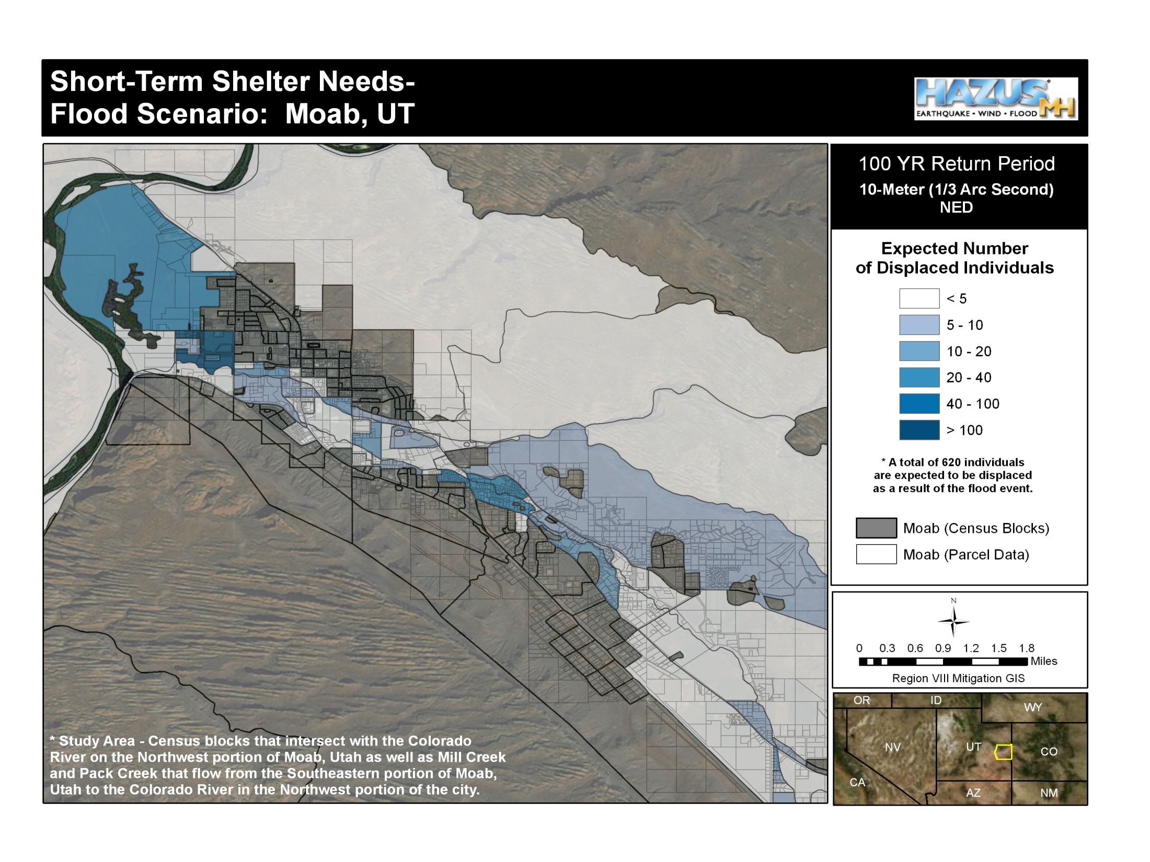
[INSERT Image]
100-yr
Notes:
Slide shows the population along the Colorado River in Moab. The information can be used to estimate the number of displaced individuals and short-term shelter needs for a flood scenario

Slide 54
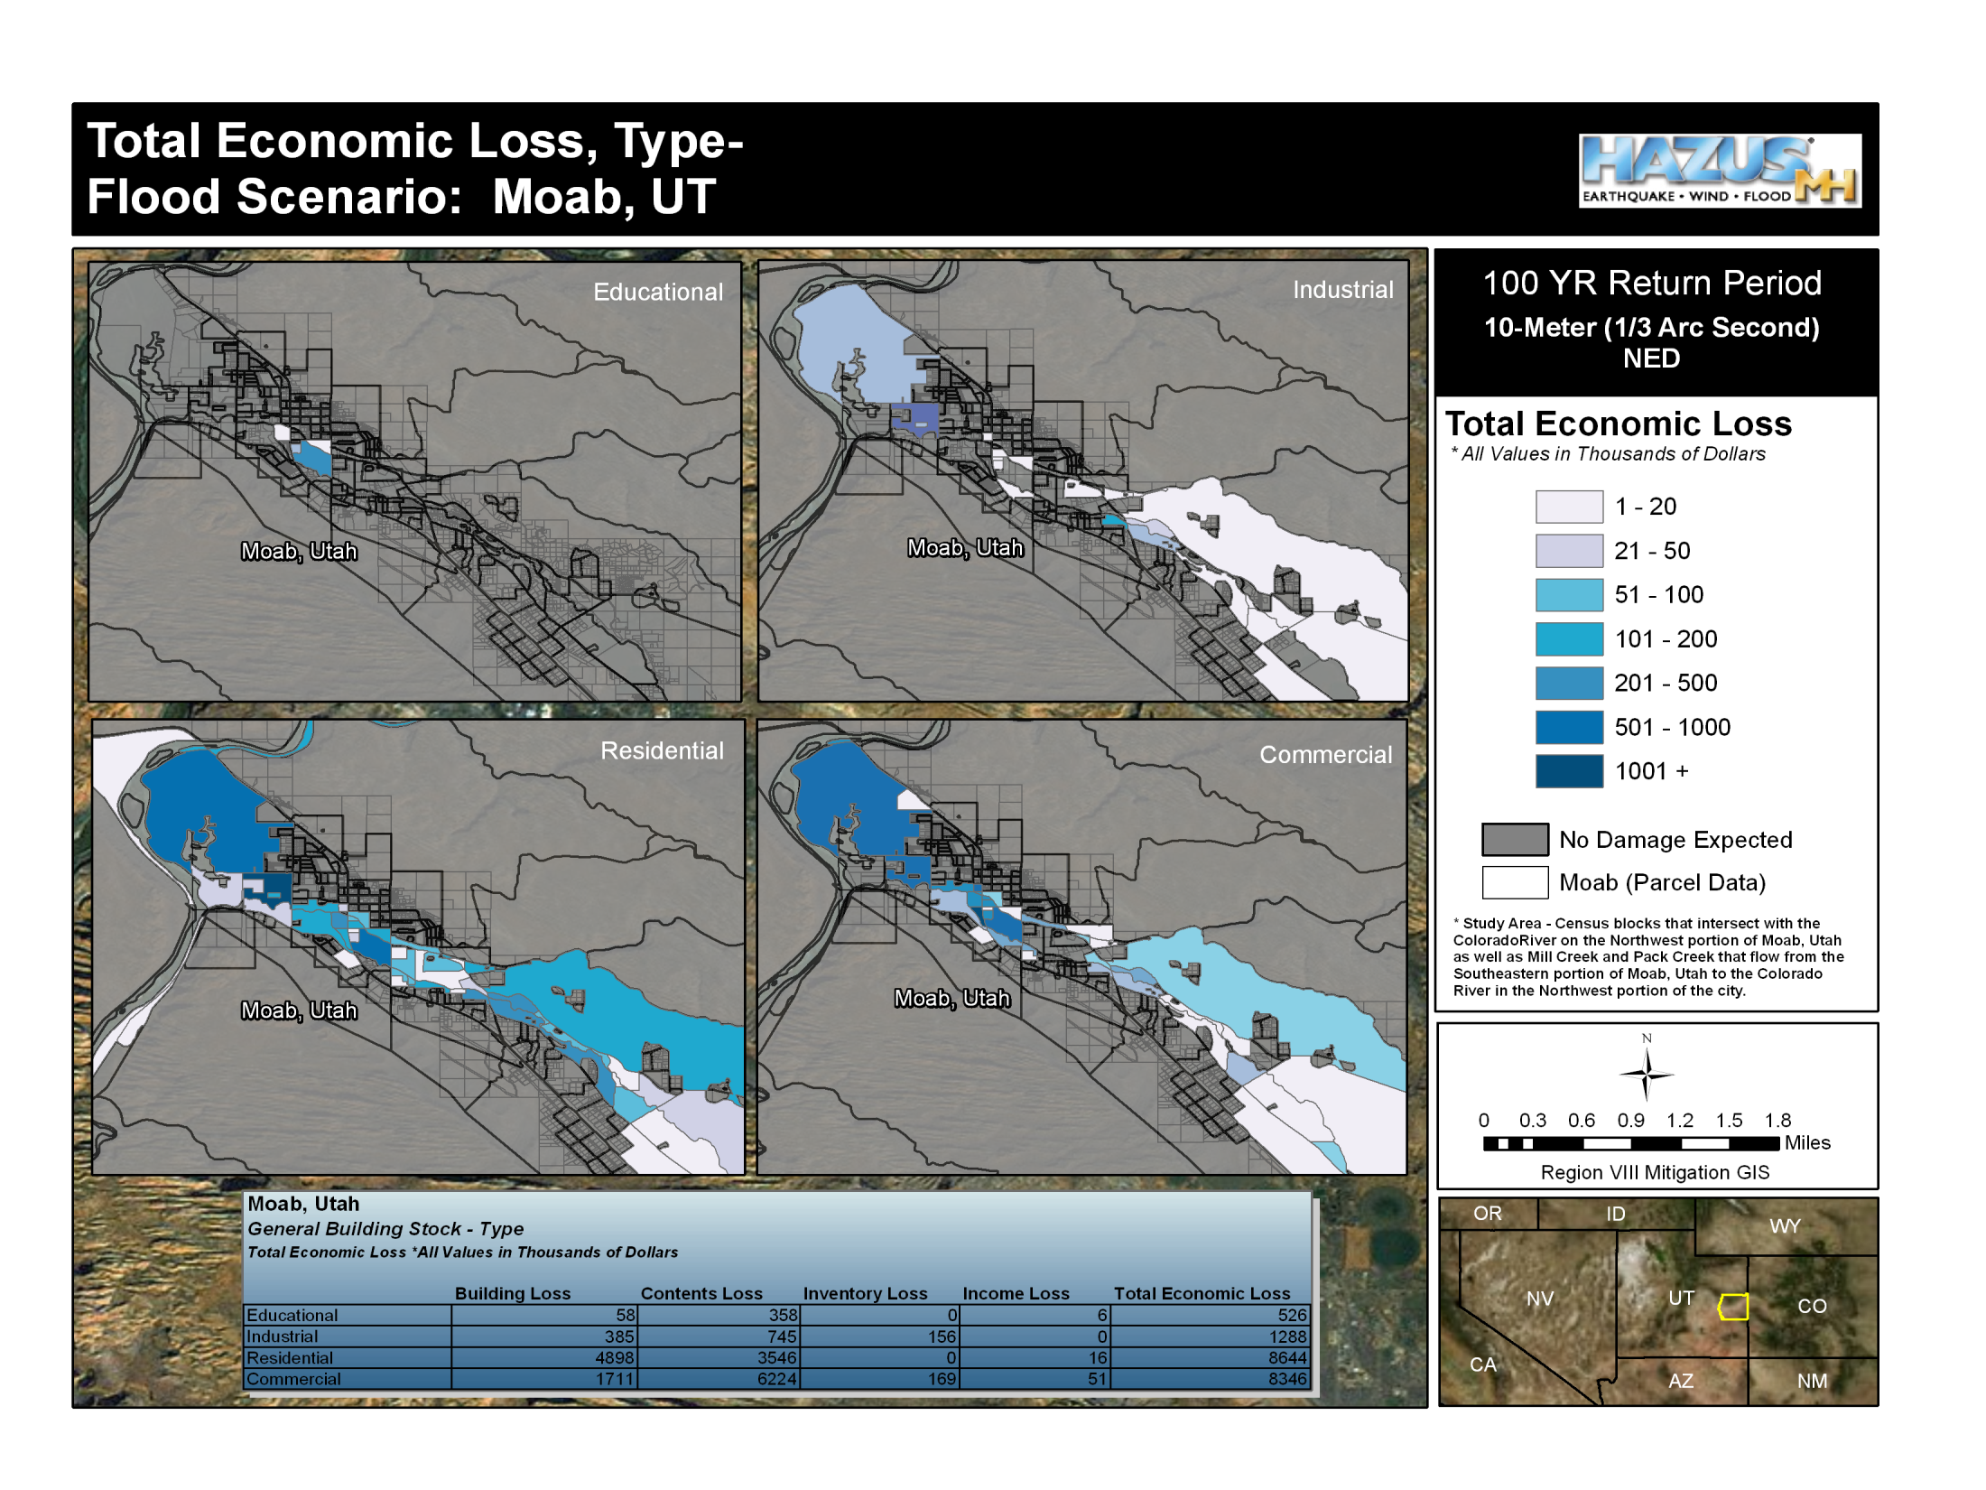
Building Type
100-yr
Notes:
This slide shows relative amount of estimated damages or economic losses due to flooding along Colorado River in Moab, UT.

Slide 55
Risk Index
Hazard | Location | Probability | Extent | Impact | Rank
Tornado | Entire planning area | 5% chance per year | EF2 | Damage > $35 million | 1
Hail | Entire planning area | 75% chance per year | Up to 1” diameter | Damage $50,000 to $100,000 | 2
Subsidence | Northwest corner of planning area | Very low; there is no history of subsidence | Minimal | Damage <$500 | 3
Notes:
Useful way to compare results

Slide 56
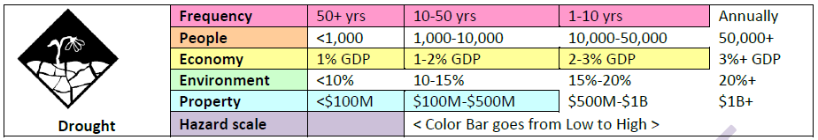
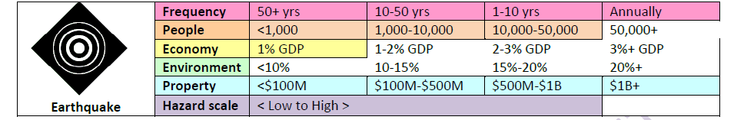
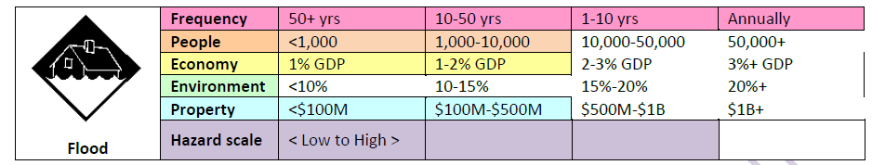
Risk Index
Example excerpts from Washington State Hazard Mitigation Plan

Slide 57
Step 4: Summarize Results
Describe Hazards
Identify Community Assets
Analyze Risks
Summarize Vulnerability

Slide 58
Summarize Overall Vulnerability
Summarize each jurisdiction’s overall vulnerability to hazards
Communicate findings to:
    Educate public, stakeholders, elected officials
    Inform decisionmaking
    Develop mitigation strategy

Slide 59
Develop Problem Statements
To communicate vulnerabilities, develop problem statements
Clear, concise
Not overly technical
Identify key issues or problems
Based on results of the risk assessment
Pertain to specific community assets or hazards
Pertain to individual jurisdictions or to the entire planning area
Notes:
QUESTION: Who has actually done this?

Slide 60
Example Problem Statements
Newberg City recently annexed the South Woods area located in the wildland-urban interface. The City’s land use and building codes do not address wildfire hazard areas. Future development in South Woods will increase vulnerability to wildfires.
The North Creek Sewage Treatment Plant is located in the 100-year floodplain and has been damaged in past events.

Slide 61
Example Problem Statements
Residents of the Village describe ground failure impacts such as some homes and facilities sinking on their pilings, particularly in the downtown “old town” area.
The boardwalk to the new school, which is used for evacuation, has ground failure damage.
In addition, the community’s marine fuel header has begun to sink into the ground and slant to one side.
Example excerpts from Village of Kongiganak Draft Hazard Mitigation Plan

Slide 62

Activity 2.1:
Develop a Problem Statement for Your Community
Allotted Time: 30 minutes
In your small group, discuss the hazards, assets, and risks that exist in your communities. Based on your small group discussion, choose two problems statements to share with the group as a report out. The problem statement should describe a specific risk to one of the communities in your group.

Slide 63
Update to Reflect Development Changes
Increasing vulnerability
Climate change
New development in hazard-prone areas
Decreasing vulnerability
Mitigation actions implemented to reduce risk
Adopted codes to protect future development
Notes:
Plan updates must describe changes in development that have occurred since the last plan was approved.

Slide 64
Risk Assessment Summary
Plan document focuses on communicating analysis and findings to:
    Emergency managers
    Planners
    Policy makers
    Community members
Background data in appendices or integrated in local systems

Slide 65

Review of the Risk Assessment
For each hazard, the plan must provide
Description of:
  Hazards (location, extent, previous occurrences, and future probability)
  Potential impacts for each participating jurisdiction
  Repetitively damaged NFIP-insured structures (More on this in Module 3)
  Changes in development since previous plan was developed if plan is an update
Summary of vulnerability

Slide 66
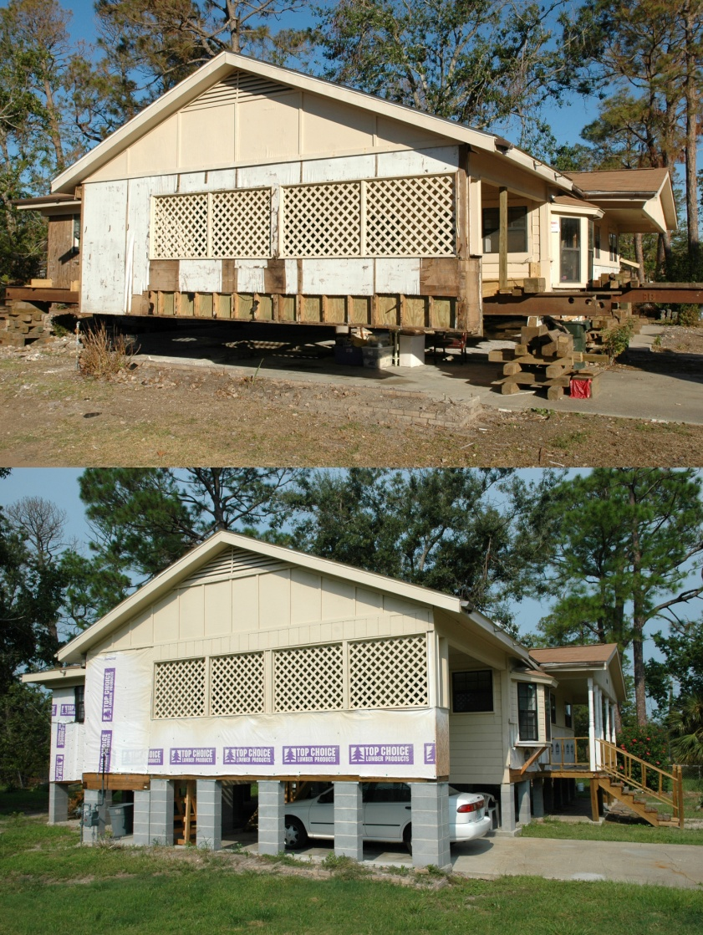
Questions?

