Slide 1
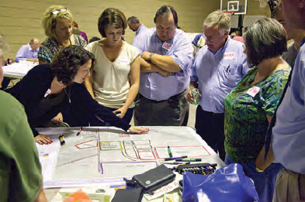
Mitigation Planning Workshop
Module 1:
Planning Process

Slide 2
Unit 1
Mitigation and Mitigation Planning

Slide 3
What Is Hazard Mitigation?
Sustained action taken to reduce or eliminate long-term risk from hazards
Prevention / Protection
Response
Recovery
Mitigation

Slide 4
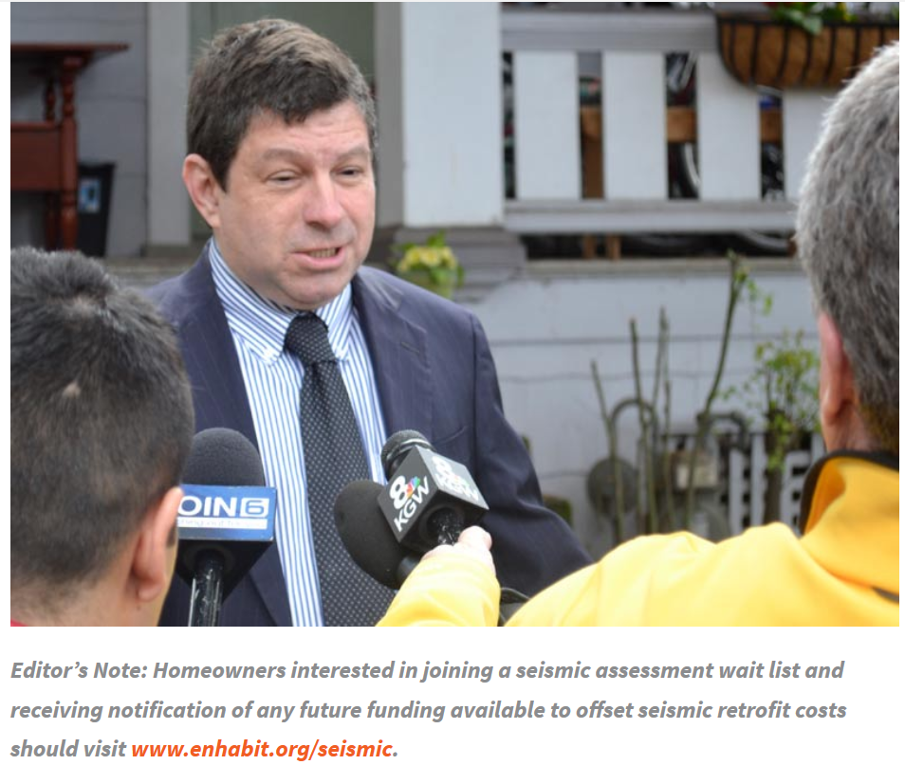


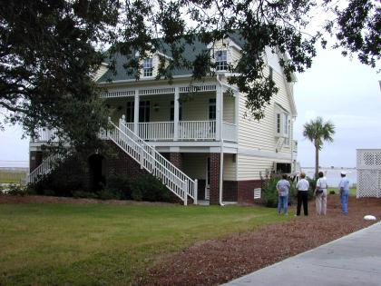
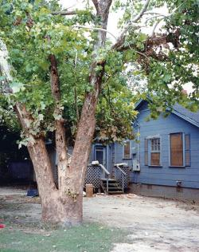
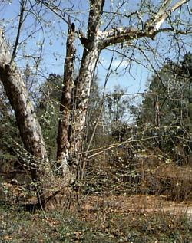
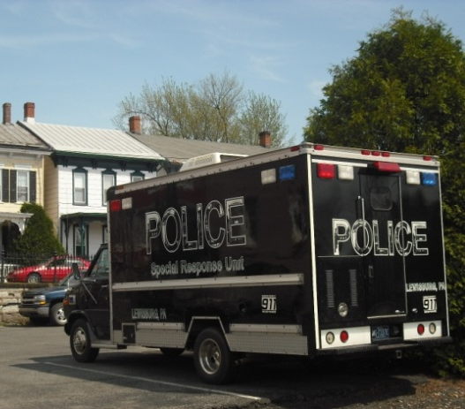
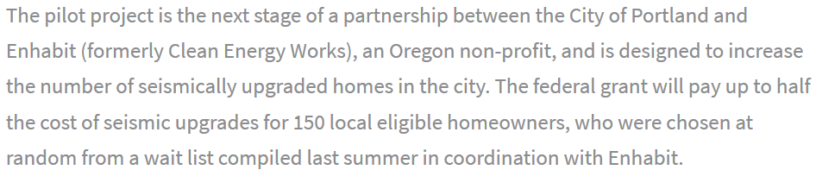
Hazard Mitigation: Example
City of Portland Seismic Retrofit Program
Retrofit a critical facility, enforce building codes, land use planning, removal of structure from hazard area
MITIGATION: Elevated Home by the River
MITIGATION: Property Acquisition
PREPAREDNESS AND RESPONSE: Purchase of Police Command Vehicle

Slide 5

Mitigation Is an Investment
Prevent injury and loss of life
Prevent damage to
community assets
(existing and future)
Reduce costs of disaster response/recovery
Advance other community objectives

Slide 6
Disaster Resilience
“Instead of repeated damage and continual demands for federal disaster assistance, resilient communities proactively protect themselves against hazards, build self-sufficiency, and become more sustainable” (Godschalk et al., 2009).
Notes:
This is the goal we are trying to achieve

Slide 7
Hazard Mitigation Planning
Assess vulnerabilities and risks
Identify policies and actions to reduce risk
Engages the whole community in a process to:
Notes:
This is the process we go through to work towards resilience

Slide 8
Why Mitigation Planning?
Strengthen community disaster resilience
  Identify cost-effective actions to reduce risk
  Focus resources on greatest vulnerabilities
  Build partnerships
  Increase awareness of hazards and risk
  Communicate priorities
  Align with other
  community objectives
Notes:
Ask Students: Why do you do Mitigation Planning?

Slide 9
Federal Planning Regulations
Disaster Mitigation Act of 2000
    Establishes eligibility for FEMA Hazard Mitigation Assistance (HMA)
    Requires Tribal, State, and local governments to submit plan to FEMA for review
Title 44 Code of Federal Regulations (CFR) 201.6 or 201.7
    Publishes requirements for approval of a local or Tribal mitigation plan

Slide 10
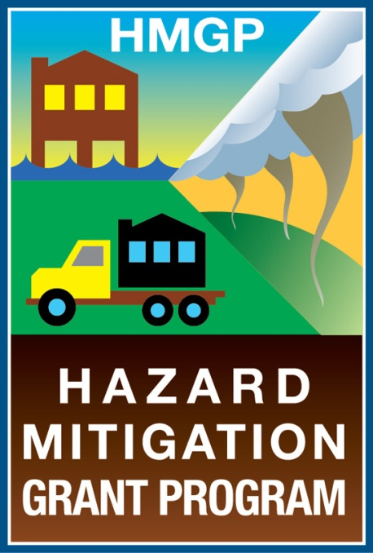
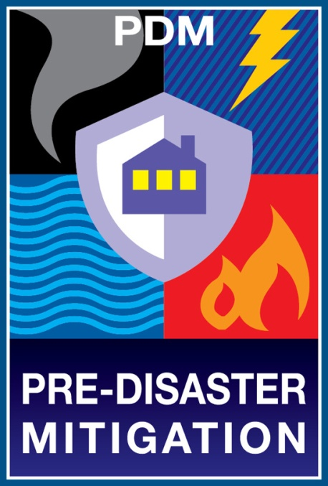
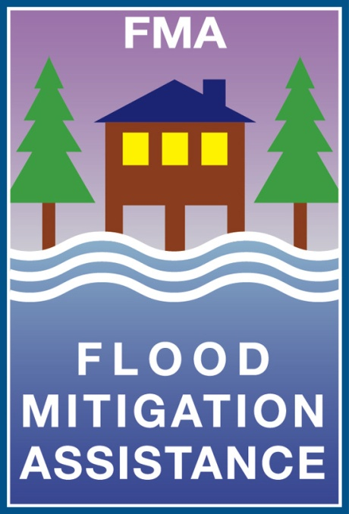
Hazard Mitigation Assistance (HMA)

Slide 11

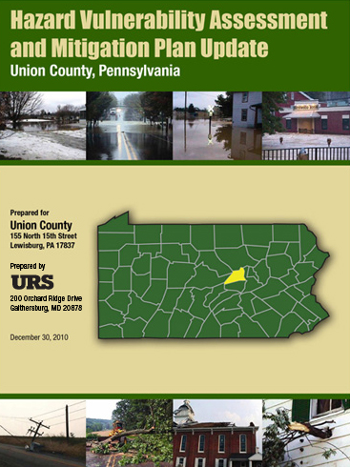
This Is the Community’s Plan
Focus on the mitigation strategy
Process is as important as
the plan
Develop plan to serve your community
Notes:
There is no required format for the plan’s organization

Slide 12
Plan Updates
Mitigation plans must be updated every 5 years to maintain HMA eligibility
Update requirements and recommendations are addressed in this Workshop

Slide 13
Unit 2
Establish the Planning Area

Slide 14



Determine the Planning Area
What geographic area will it cover?
What are the participating jurisdictions?
Who will lead the project?

Slide 15
Single or Multi-Jurisdictional
Jurisdiction = local government
Participating jurisdiction seeks plan approval and grant eligibility
Tribal governments must meet Tribal mitigation planning requirements
Town
County
District
Tribe
City
Multiple Jurisdictions
One governing body
Single Jurisdiction
Notes:
Most plans are multi-jurisdictional
In Region 10 ~70% of plans are MJ

Slide 16
Benefits of Multi-Jurisdictional Plans
Improves communication and coordination
Enables comprehensive mitigation approaches
Maximizes economies of scale by sharing costs and capabilities
Avoids duplication of efforts
Provides organizational structure

Slide 17
Challenges of Multi-Jurisdictional Plans
Reduces individual control over process
Involves coordinating multiple jurisdictions (with past histories)
May result in:
    Less detailed assessment of risks
    Less specific mitigation actions
Requires organization of large amounts of information into a single document

Slide 18
Discussion Questions
What is an example of a situation when a multi-jurisdictional planning project would work well?
What problems would you anticipate or have you experienced with multi-jurisdictional plans?

Slide 19

Additional Considerations for Multi-Jurisdictional Planning
Plan update
Existing plans and partnerships
Available resources and capabilities
Secure commitment to participate

Slide 20
Multi-Jurisdiction Requirements
  Each jurisdiction seeking plan approval must:
  Participate in the planning process
  Assess unique risks
  Identify specific mitigation activities
  Adopt the plan
Notes:
The orange symbol with the letter “R” is used in this workshop to identify a topic as a Federal Planning requirement.
Refer to Attachment C: 44 CFR 201.6

Slide 21
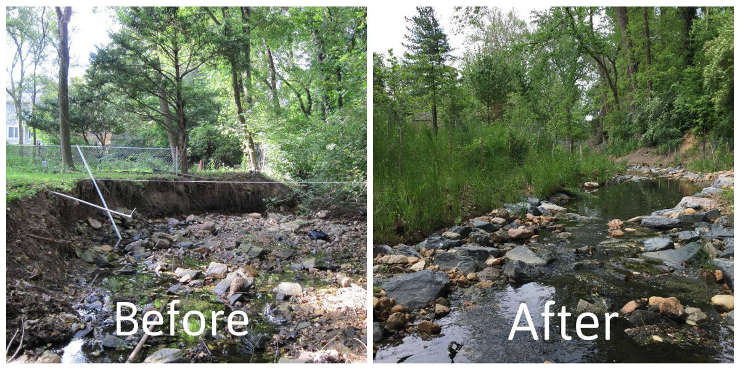
Questions?

Slide 22
Unit 3
Build the Planning Team
Notes:
End of unit, you will be able to:
Identify stakeholders and establish a planning team
Document the planning process and stakeholder engagement

Slide 23

Role of the Planning Team
Engage community members
Identify vulnerabilities of each jurisdiction
Develop potential solutions for each jurisdiction
Be champions for community resilience and hazard mitigation

Slide 24
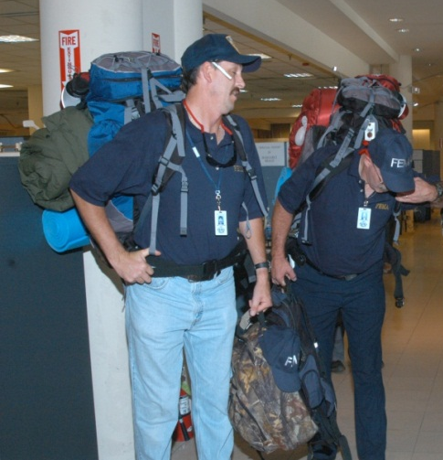
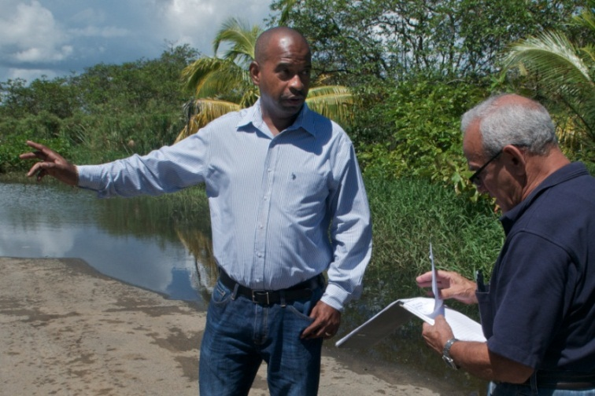
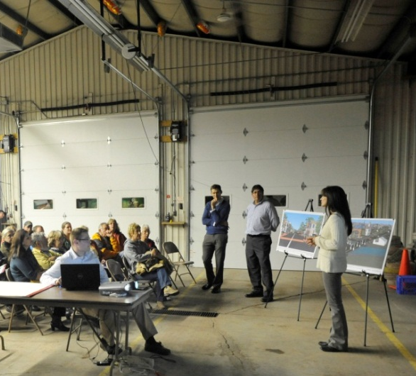
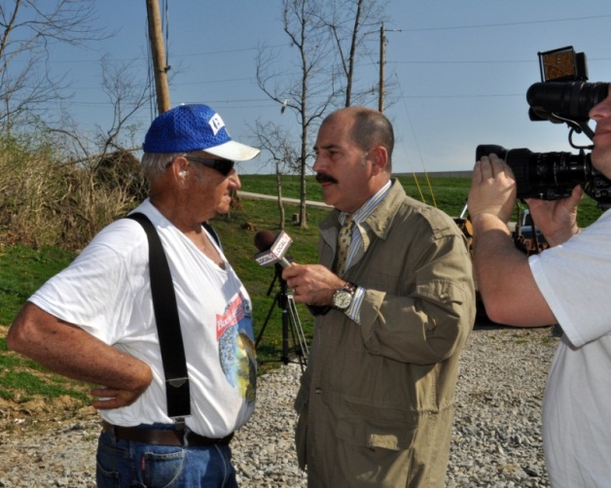
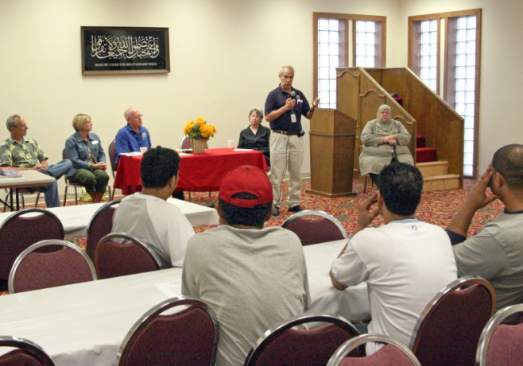
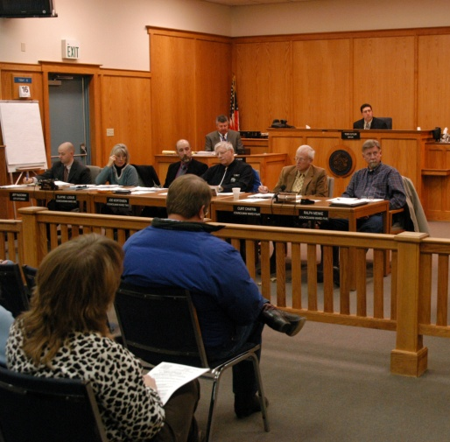
Leadership
Notes:
Strong leadership is needed
An important decision of local officials is assigning the agency or individual that will lead the hazard mitigation planning effort
Responsibilities can be shared
Not specific to just EM

Slide 25
Planning Team Members
Expertise
People and social conditions
Built and natural environments
Hazards and disaster history
Responsibility
Implement programs and activities
Make decisions on policies and resources

Slide 26

Technical Assistance
You could seek help with:
Assessing risks
Facilitating meetings and outreach strategy
Creating plan document
Regional Planning Agencies
Universities
Private Consultants
State or FEMA Region

Slide 27
Tips for Consultant Selection
Private consultant should:
  Be familiar with applicable policies
  Understand importance of process
  Know mitigation concepts
  Recognize the role of
  local leadership
  Have experience developing local plans
Community should:
Check references
Ensure experience
See Attachment E: Choosing Contracting Help

Slide 28


Planning Team and Other Stakeholders
Planning Team
      Members of
      Previous planning team
      Committee that oversees land use planning
      Local emergency planning committee
      Representatives of agencies that
      Promote hazard mitigation
      Regulate development
Other Stakeholders
Elected officials
Business leaders
Public agencies
Cultural institutions
Colleges and universities
Nonprofit organizations
Neighborhood groups
Notes:
There are differences between the planning team and other stakeholders
Unlike planning team members, stakeholders need not be involved in all stages of the planning process

Slide 29
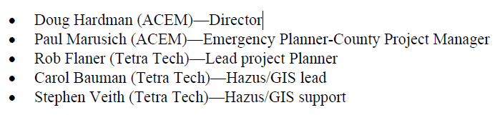
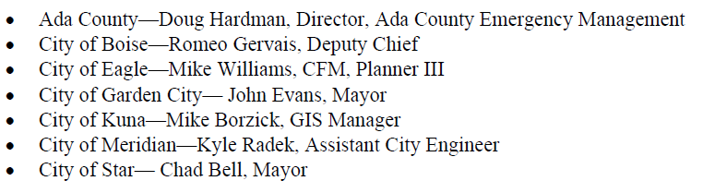
Planning Team Example (Ada County)

Slide 30
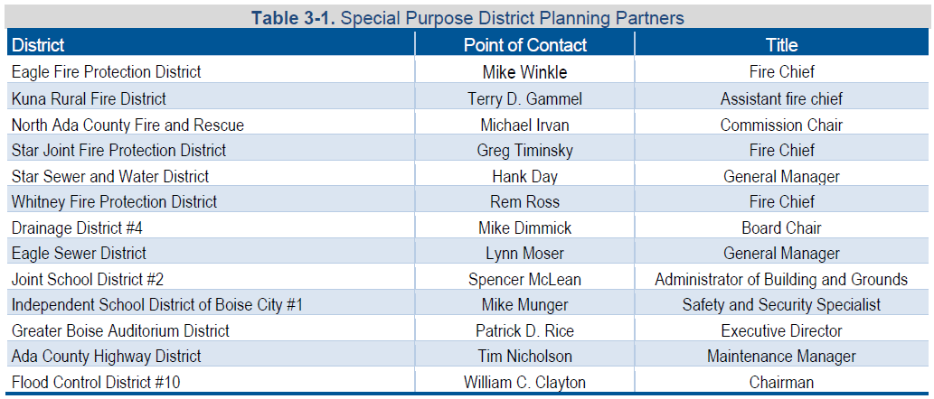
Planning Team Example (Ada County)

Slide 31
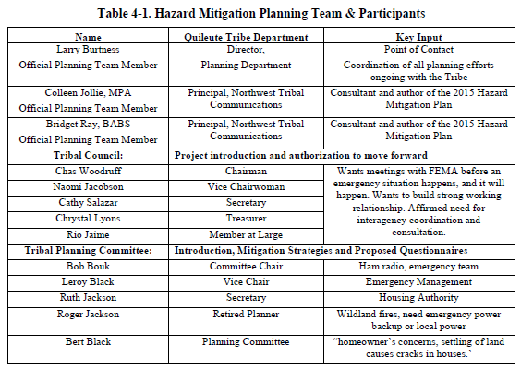
Planning Team (Quileute Indian Nation)

Slide 32
Opportunity for Involvement
Certain stakeholders must be given the opportunity to be on the planning team or otherwise involved in the planning process
  Agencies involved in hazard mitigation activities
  Agencies that have authority to regulate development
  Neighboring jurisdictions
  Business, academia, other private and nonprofit interests

Slide 33
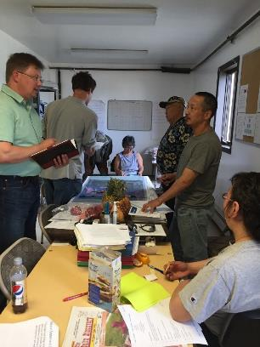
Discussion Question
What agencies, organizations, and officials would be valuable members of the planning team?

Slide 34


Promoting Participation
Send formal invitation from elected official or department head
Follow up with a phone call
Plan meetings in multiple convenient locations
Provide refreshments

Slide 35
Getting Buy-In
Develop a mission statement
Obtain official recognition of the planning team
Build relationships to:
    Increase coordination and commitment
    Build resilience and enhance post-disaster response and recovery
Notes:
Also consider developing a Committee Charter – defines expectations

Slide 36
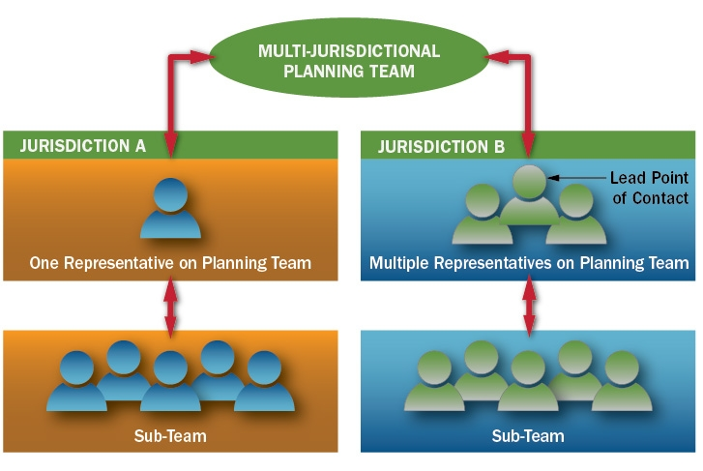
Multi-Jurisdiction Planning Teams
Notes:
Develop a planning team structure that promotes coordination and accountability

Slide 37
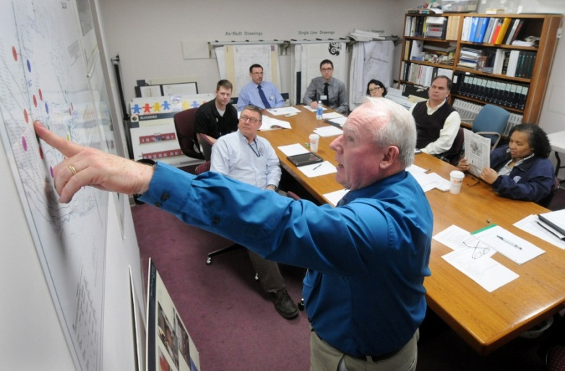
Initial Planning Team Decisions
Confirm plan purpose and mission
Review the current mitigation plan
Refine plan scope and schedule
Establish responsibilities
Develop an outreach strategy
Notes:
OVERVIEW SLIDE – Highlight and move to next slides
* This is basic project managment

Slide 38

1. Confirm Plan Purpose and Mission
Protect life, property, economy, quality of life, and environment of Lincoln County from hazards and disasters.
Notes:
QUESTION: Does anyone have one to share from their plan/experience?

Slide 39
2. Review the Current Mitigation Plan
When updating your community’s mitigation plan, a general review of the plan can provide:
Ideas for improvement
Identify areas that may require more time and resources
Impacts to the plan’s scope and schedule
Notes:
Look at your last plan review tool/plan assessment provided by FEMA/State

Slide 40
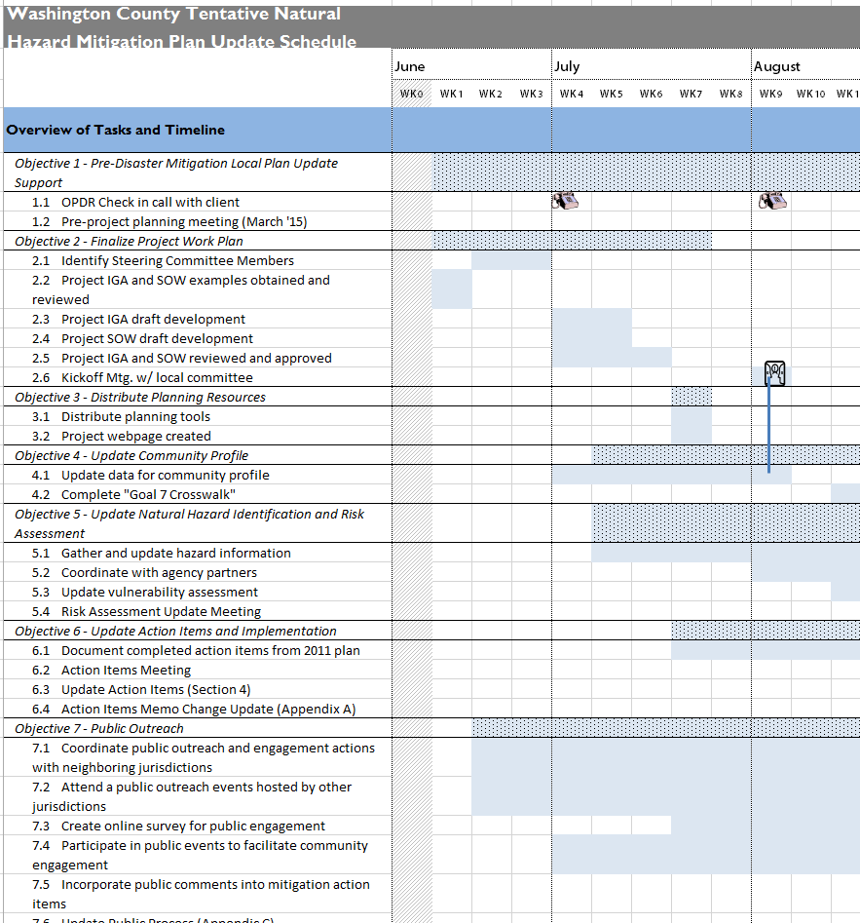
3. Refine Plan Scope and Schedule
Tasks | Target Completion Date
Notice to Proceed | September 1, 2012
Task 1: Hold Project Kickoff Meeting | October 15, 2012
Task 2: Engage Public | Ongoing
Task 3: Conduct Risk Assessment | January 15, 2013
Task 4: Develop Mitigation Strategy | March 1, 2013
Task 5: Update Plan Maintenance Process | March 15, 2013
Task 6: Review and Submit Plan | May 1, 2013
Notes:
Document
Document
Document

Slide 41
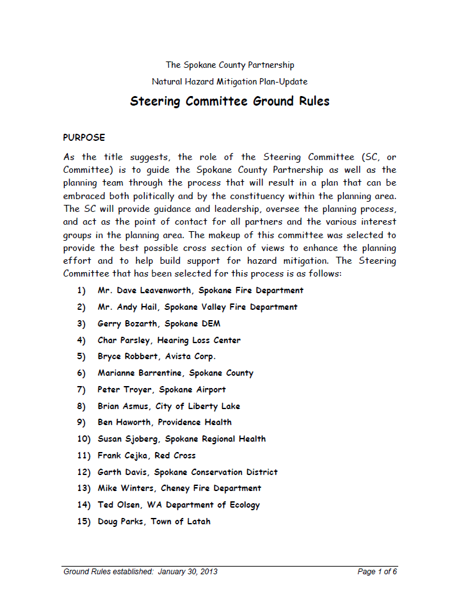
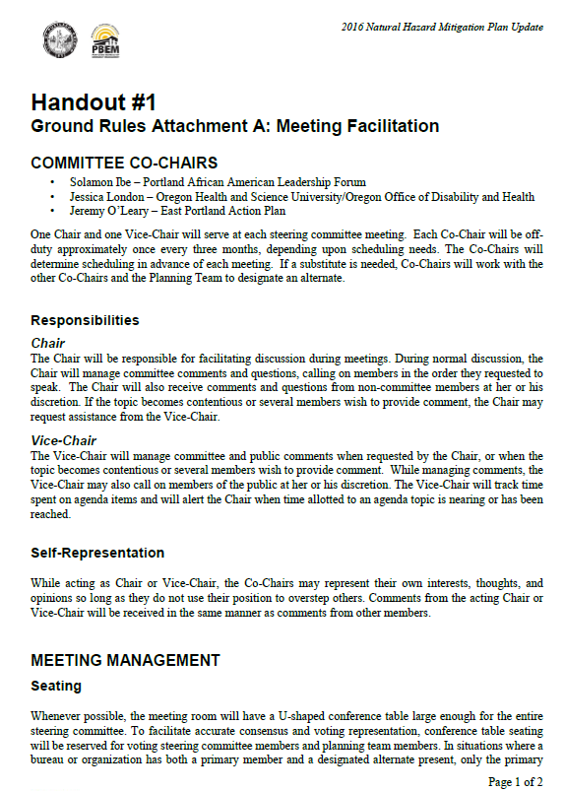
4. Establish Responsibilities
Attend meetings
Make decisions on plan process and content
Collect data
Submit mitigation action worksheets
Review drafts
Coordinate and assist with public involvement and plan adoptions
Notes:
Document, Document, Document

Slide 42
5. Develop an Outreach Strategy
1) Confirm plan purpose and mission
2) Review the current mitigation plan
3) Confirm plan scope and schedule
4) Establish responsibilities
Next Unit:
Develop an Outreach Strategy

Slide 43

Unit 4
Develop an Outreach Strategy
Notes:
Students will be able to:
Develop an outreach strategy
Promote participation by stakeholders and the public
Document the planning process and public participation

Slide 44
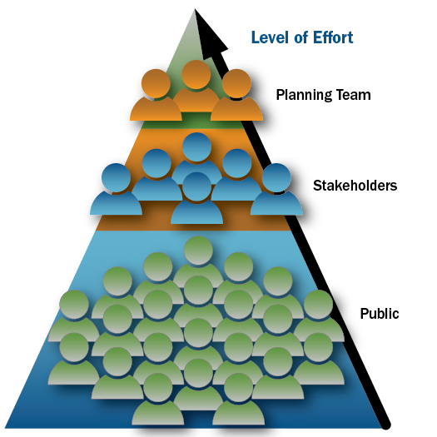
Outreach Strategy Framework

Slide 45

Opportunity for Involvement
Planning Team
Stakeholders
Public
Agencies involved in hazard mitigation activities
Agencies with authority to regulate development
Neighboring jurisdictions
Businesses
Academia
Other private and nonprofit interests
Residents
Business owners
Local workers

Slide 46
Types of Stakeholders
Elected officials
Business leaders and large employers
Regional, State, and Federal agencies
Cultural institutions
Schools and universities
Nonprofit organizations
Neighborhood groups

Slide 47
Benefits of Public Involvement
Educates people about hazards and risk
Incorporates different perspectives
Improves plan quality
Ensures transparency and builds trust
Improves opportunities for implementation through by building consensus
Strengthens community disaster resilience

Slide 48
Role of Planning Team
Develop outreach strategy for all jurisdictions
    Who? – Stakeholders and public
    How? – Messages and methods
    When? – Schedule
Coordinate and facilitate communication
Evaluate and incorporate feedback

Slide 49
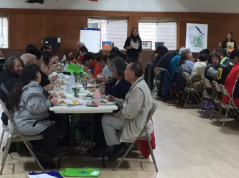
Outreach Methods
Community events
Interviews
News media
Roundtable / forums
Social media
Websites
Questionnaires / surveys
Presentations to governing bodies
Quinault Indian Nation, WA
Notes:
Look in Handbook, Worksheet 3.1 Public Opinion Survey sample

Slide 50
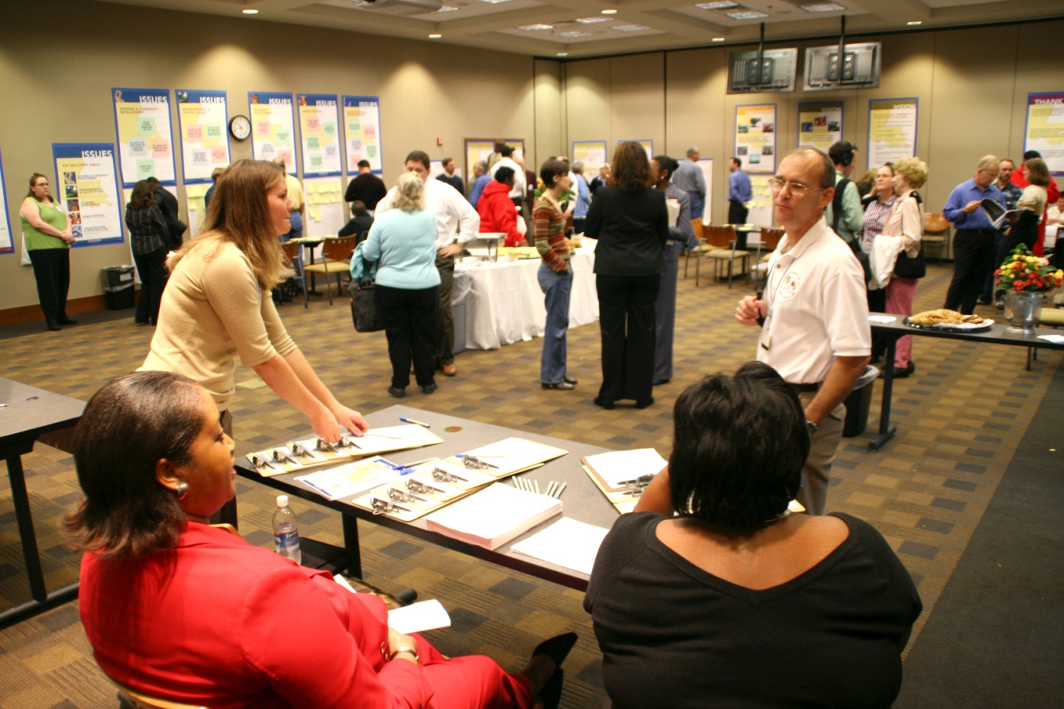
Discussion Question
In your community, what types of public outreach and involvement methods have worked well?

Slide 51


Multi-Jurisdictional Outreach
Town
County
District
Tribe
City
Notes:
* MJ Plans need an outreach strategy that encourages coordination and accountability from each jurisdiction.
* The plan must document how each jurisdiction was involved in the planning process, including how they provided opportunities for the involvement of their stakeholders and public.

Slide 52
Tips for Outreach Strategy
Brainstorm outreach activities
Determine outreach objectives and schedule
Develop clear and consistent messages that align with community values
Evaluate and incorporate feedback
Celebrate success
Notes:
For example, a good time to invite public involvement is after the risk assessment is complete and the planning team begins to create the mitigation strategy

Slide 53
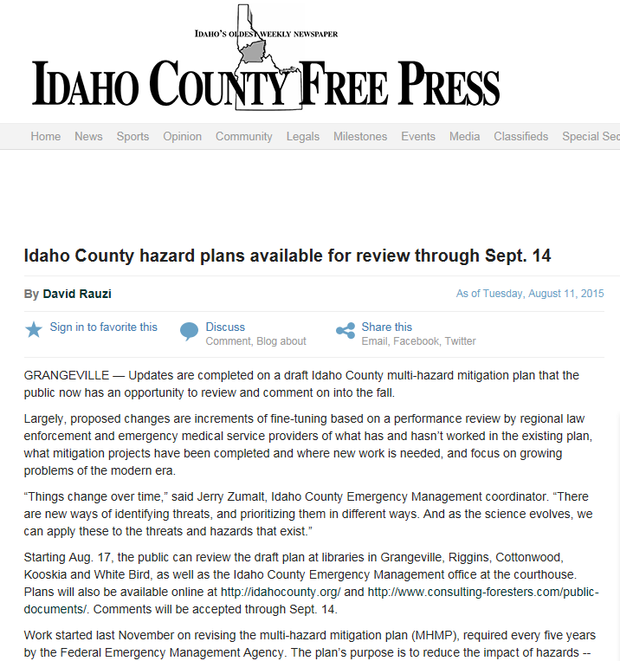
Involve the Public Prior to Plan Adoption
Make the final plan draft available for comment
Consider existing policies for public review
Use the adoption process to increase awareness
Idaho County, ID

Slide 54
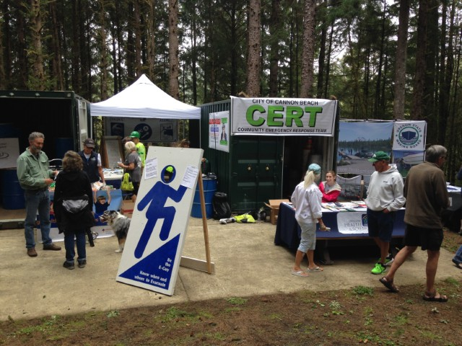
Keep Public Involved After Plan Adoption
Identify how to continue public involvement after plan adoption
Use methods that were successful during the planning process
Cannon Beach, Oregon

Slide 55
Document Who, What, and When
Who was involved?
How was the plan prepared?
    Schedule
    Activities
How was the public involved?
What future public involvement opportunities are scheduled?
Plan updates must document the current planning process
Notes:
Document so that in 5 years you can review previous process
Very important if you are using a contractor and want to try it yourself next time

Slide 56

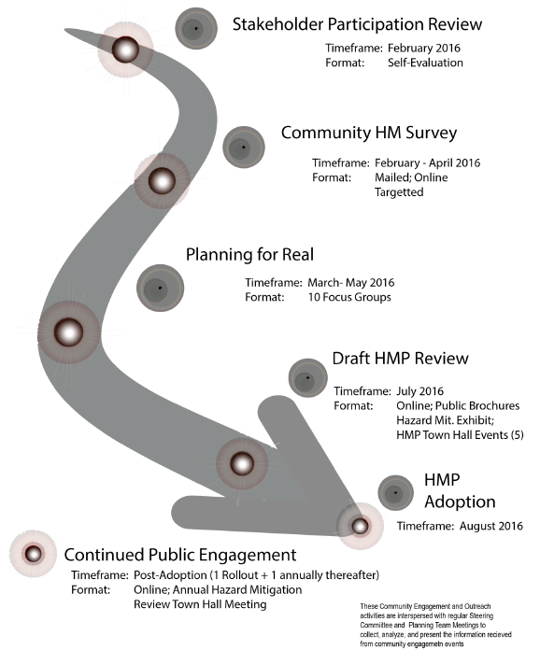
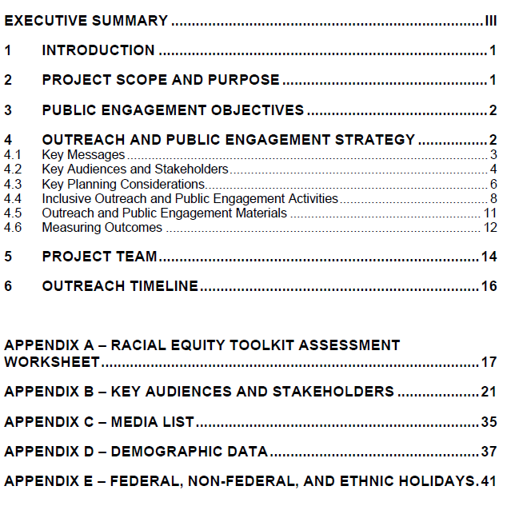
Questions?
City of Seattle Hazard Mitigation Plan

Slide 57

Activity 1.1:
Create an Outreach Strategy
Allotted Time: 30 minutes
In your small group, imagine that you are developing an outreach strategy as you begin the mitigation planning process. How will you set up a process to ensure meaningful participation from each participating jurisdiction? Respond to the questions in the handout.
Have one person from the group summarize the results of the discussion to report back to the class.

Slide 58
Activity 1.1:
Create an Outreach Strategy
Allotted Time: 30 minutes

Slide 59
Activity 1.1:
Create an Outreach Strategy
Instructions
In your small group, imagine that you are developing an outreach strategy as you begin
the mitigation planning process. How will you set up a process to ensure meaningful
participation from each participating jurisdiction?
Respond to the following questions:
How will you:
  Invite potential planning team members?
  Coordinate participation of multiple jurisdictions?
  Provide opportunities for public participation?
  Obtain buy-in from elected officials?
What challenges do you foresee in obtaining meaningful participation?
Share a story about a planning process in your community that was a success or failure,
in terms of participation and community buy-in, and why.
Have one person from the group summarize the results of the discussion to report back
to the class.

