Slide 1
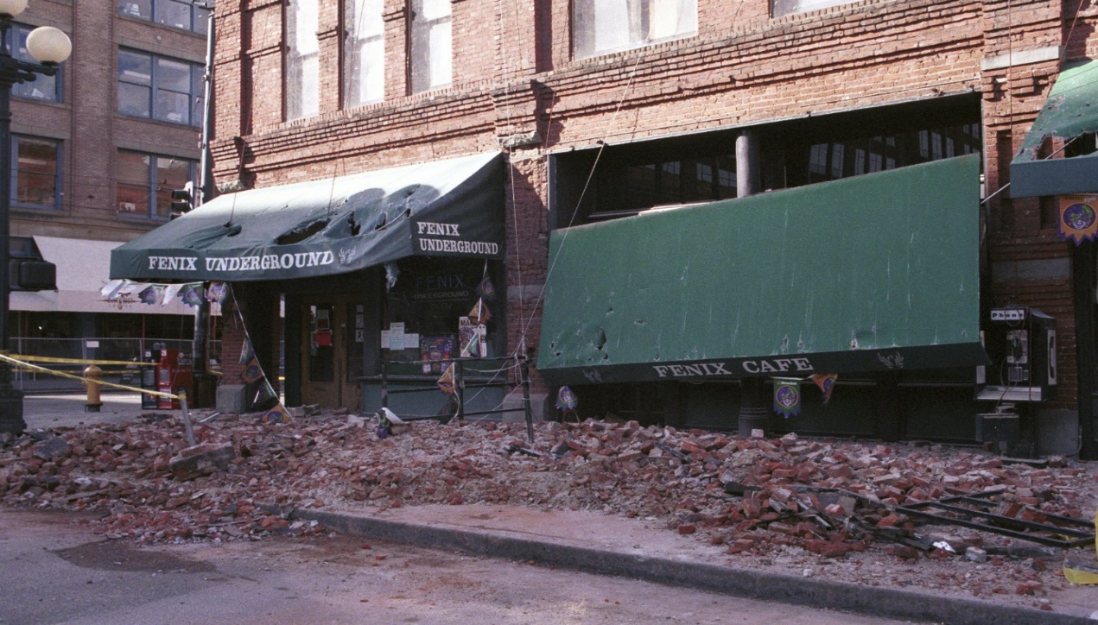
G318 Mitigation Planning Workshop Region 10

Slide 2
Introductions and Overview
Administrative
Workshop Organization
Workshop Goals and Objectives
Introductions and Responsibilities
Workshop Materials

Slide 3
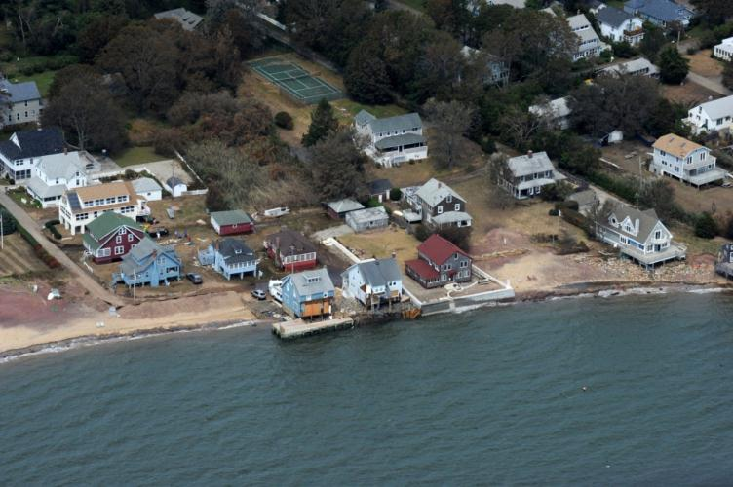
Administrative
Emergency exits
Restrooms
Cell phones
Break schedule

Slide 4
Instructors
Joseph Murray, Planner, Oregon Office of Emergency Management
Brett Holt, Mitigation Planner, FEMA Region 10
Amanda Siok, Mitigation Planner, FEMA Region 10

Slide 5
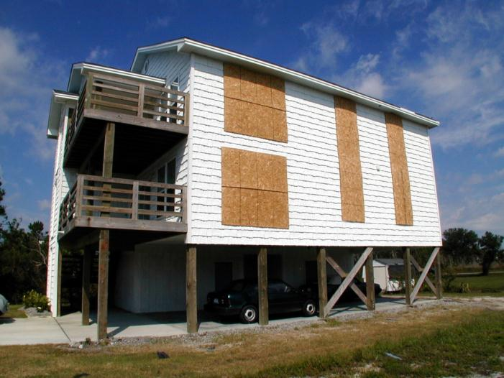
Workshop Goal
To provide plan developers with the information necessary to prepare and implement a hazard mitigation plan

Slide 6
Workshop Objectives
At the end of this workshop, participants will be able to:
Define hazard mitigation and identify the benefits of mitigation planning
Develop or update a mitigation plan
Identify resources and guidance available for mitigation planning and plan implementation

Slide 7
Participant Introductions
Name
Position and organization
Mitigation planning experience
Workshop expectations

Slide 8
Workshop Organization
Module 1: Planning Process
Module 2: Risk Assessment
Module 3: Mitigation Strategy
Module 4:
Community Resilience in Action

Slide 9
Module Goals
Module 1: Planning Process
Participants will effectively engage their community in an open public involvement process that leads to the development of a comprehensive approach to risk reduction and an effective mitigation plan
Module 2: Risk Assessment
Participants will conduct a hazard risk assessment that forms a factual basis for mitigation actions appropriate for their community

Slide 10
Module Goals
Module 3: Mitigation Strategy
Participants will develop their goals and actions for reducing potential losses to hazard risks based on existing local capabilities
Module 4: Community Resilience in Action
Participants will have the knowledge, tools, and resources to effectively implement their community’s hazard mitigation plan

Slide 11
Participant Responsibilities
Ask questions
Share experiences
Participate in activities

Slide 12
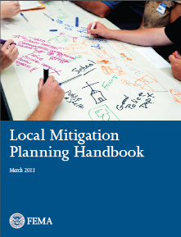
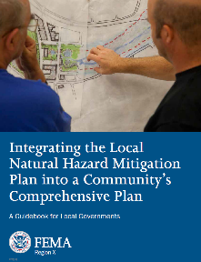
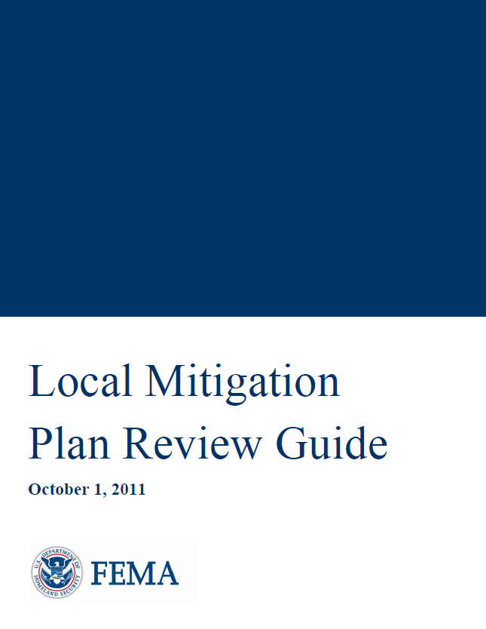
Workshop Materials (Local)
Student Manual
Plan Development Resources
Local Mitigation Planning Handbook
Local Mitigation Plan Review Tool
Integrating the NHMP into Comprehensive Plan
Mitigation Ideas
FEMA Mitigation Planning Web site: http://www.fema.gov/multi-hazard-mitigation-planning

Slide 13
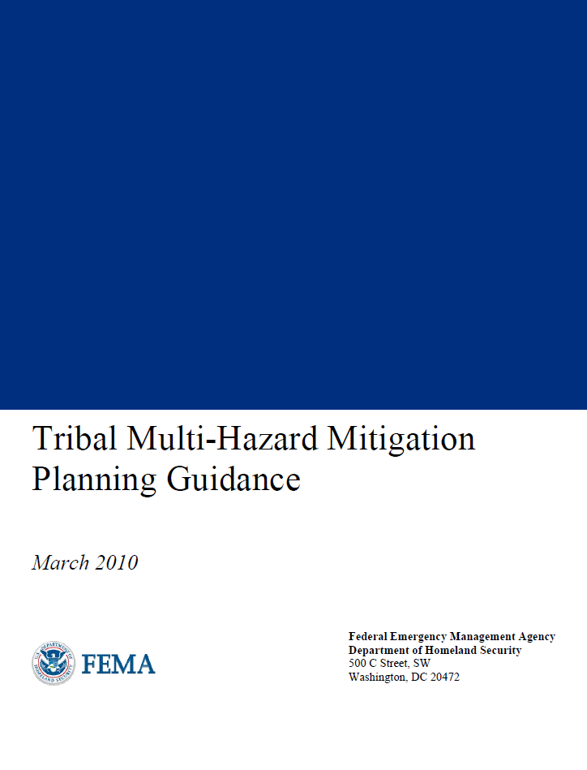
Workshop Materials (Tribal)
Plan Development Resources
Tribal Multi-Hazard Mitigation Planning Guidance
Tribal Multi-Hazard Mitigation Plan Review Crosswalk
Tribal Mitigation Plan Development Workbook
FEMA Mitigation Planning Web site: http://www.fema.gov/multi-hazard-mitigation-planning

Slide 14
Questions?

