Slide 1

Mitigation at Work in OR
Wildfire
Flood
Landslide
Earthquake
Tsunami
Planning

Slide 2

Objectives
Discuss Project Development in Oregon
How funding works in Oregon
Review a few projects that were successful in Oregon

Slide 3

Project Development
HMGP
PDM
FMA
Priorities:
  1)404/406 opportunities
  2) RL/SRL Property Acquisitions
  3) Homes in High Risk or active Landslide areas
5% and 7% projects
State IHMT

Slide 4
DR 4258 HMGP Funded Projects
Landslide Hazard – removed homes from active slide (Newport)
Underground overhead powerline – 404/406 funded (Central Lincoln PUD/Haceta Water District)
Repetitive Loss property acquired (Coos Bay)

Slide 5
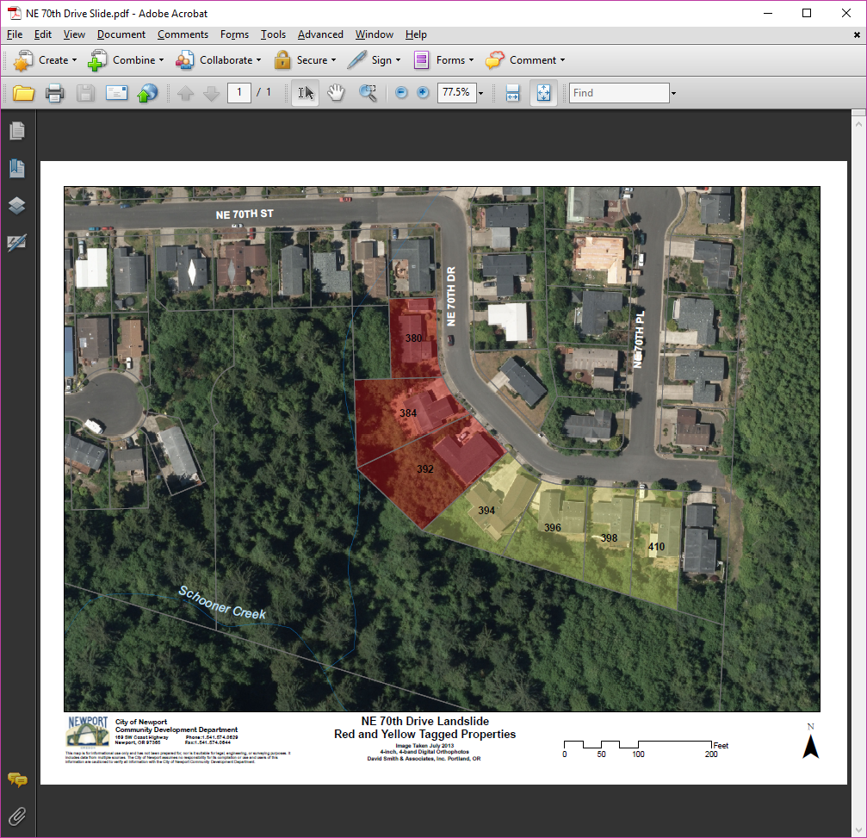
Landslide Hazard Mitigation
7 homes identified
3 of the 7 homes were “red tagged”
Total Project cost: $1,361,076

Slide 6
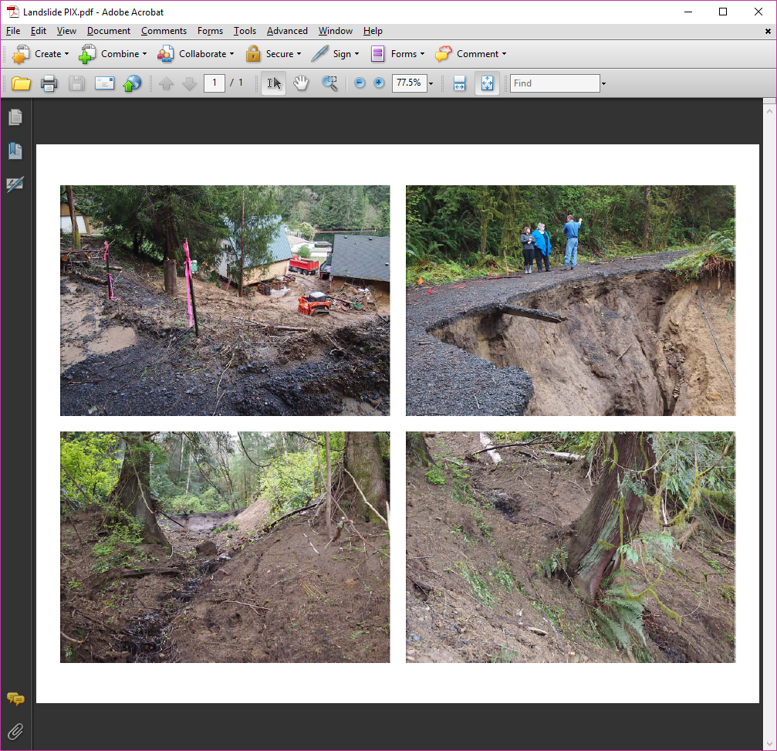
Undergrounding OH Line
Heceta Water District water line damaged during landslide
CLPUD OH line in project area
Partnered with PA funding to underground OH line during water line repair

Slide 7
RL Property Acquisition
Homes in Wireless Road neighborhood had been acquired in past disaster
Wrights did not want to go at that time, but experienced flooding again during winter storms of 2015 (the were last ones left)
City of Coos Bay was maintaining a pump station for one home
Decided that participating in HMGP program was the only option left for them

Slide 8
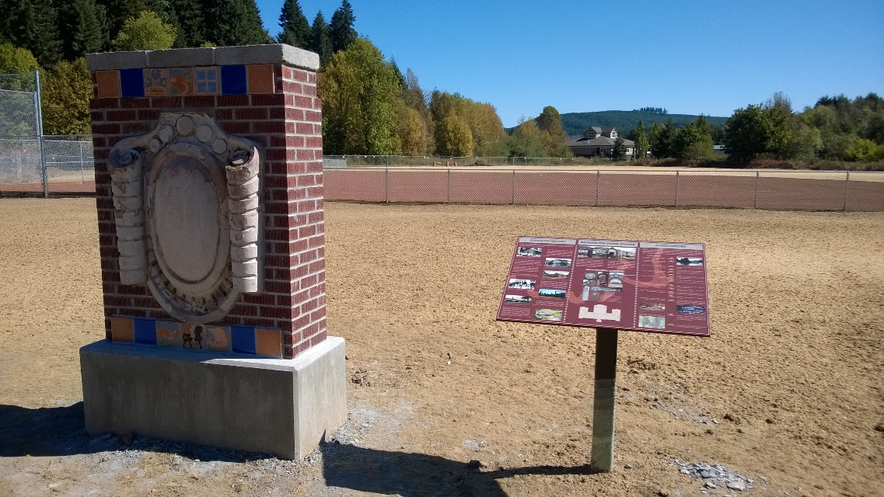
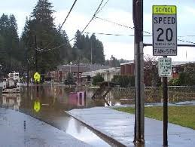
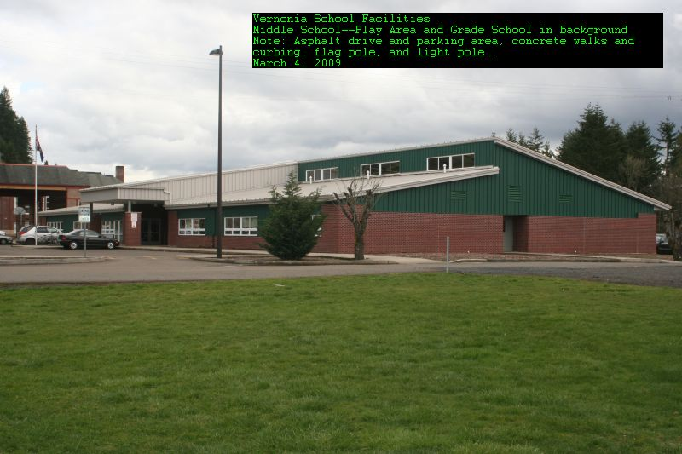
FMA Funded Project
Vernonia School District

Slide 9
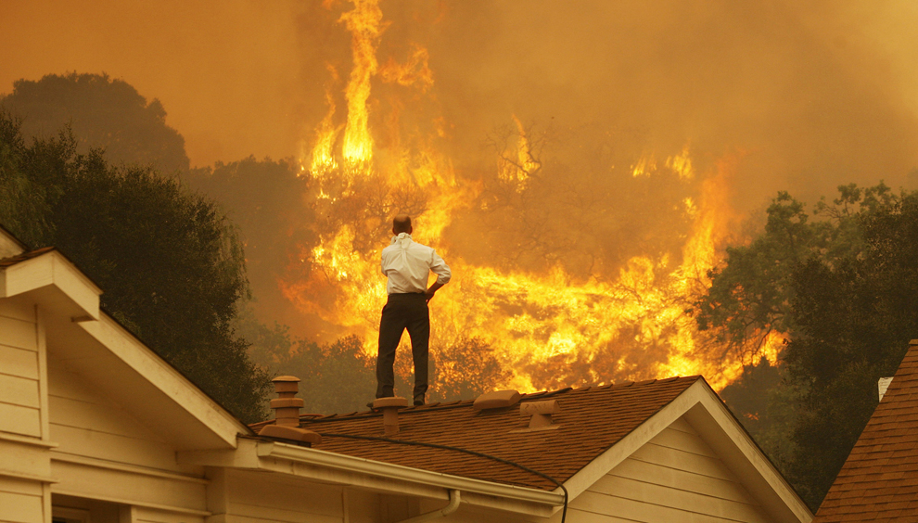
PDM Funded Projects
Planning Grants
Wildfire Mitigation (Fuels Tx and Defensible Space - $4,000,000 – Deschutes, Crook, and Klamath Counties
Seismic Retrofits
Move Waldport School from Tsunami Inundation Zone – Development issue here
Elevations
Property Acquisitions

Slide 10

Challenges
Having support from community groups
Not having the funds to make the cost match
Not leaving yourself enough time to put the application together
Not including your partners in application development
Having project management skills already in house
Having your NHMP already approved before applying for grants
Being able to read instruction on the application, and understand the limitations of HMA
Not leaving enough time to prepare the BCA or evaluate the environmental issues and permitting obstacles
Not having a good idea what your public sees are the most important hazards to address
Don’t already have a good idea where grant funding should be applied – Start formulating projects loosely like an application at the same time you are investigating funding sources for your NHMP strategies

Slide 11
Thank You for your time!

