Slide 1
Risk MAP Program
Notes:
Welcome all attendees
Introduce self, FEMA, State representatives
If appropriate, allow locals to introduce themselves (if large group, may just ask folks to name their communities)

Slide 2
The Vision for Risk MAP
Through collaboration with State, Local, and Tribal entities, Risk MAP will deliver quality data that increases public awareness and leads to action that reduces risk to life and property
Notes:
In Risk MAP, FEMA’s new NFIP program, MAP stands for Mapping, Assessment (as in "risk assessment"), and Planning (as in “mitigation planning”). Risk MAP is more than just an insurance rate map, it seeks to provide information about risk and support to communities that want to take action to reduce risk.
The vision for Risk MAP is… (read, with strong emphasis on colored text)
*T* A big focus in Risk MAP is developing more resilient communities. Let’s talk more about that…

Slide 3
Overview: Risk MAP Program
Goals: quality data, public awareness, action that reduces risk
Implemented nationally in 2009
Collaborative approach
Watershed-oriented
Focus on up-front coordination
Multi-hazard risk assessment
FEMA will….
Communicate the project status quarterly
Provide data analysis
Share project scope and any changes to the scope
Provide training: webinar/in-person
Deliver products
Discovery Report
Risk Report
Risk Geodatabase
Facilitate meetings
Discovery Meeting
Flood study Review
Resilience Workshop

Slide 4
Risk MAP Project Timeline (example)
Year 1
Year 2
Year 3
Year 4
- Flood
Mapping
Begins
- Lidar
Collection
- Resilience
Workshop
- Risk Report
Discovery
Interviews
Discovery
Report
Preliminary
Flood Maps
Discovery
Meeting
Flood
Study
Review
Effective
Flood
Maps

Slide 5
Clearwater Risk MAP Study Team
Ryan McDaniel, IDBHS, State RiskMAP Coordinator
Maureen O’Shea, IDWR, State NFIP Coordinator
Susan Cleverly, IDBHS, State Hazard Mitigation Officer/Planner
Robert Feeley, IDBHS, North Central Area Field Officer
Kelly Stone, FEMA Risk Analyst
David Ratte, FEMA Engineer Lead
Brett Holt, FEMA, Mitigation Planner
Scott Van Hoff, FEMA NFIP Coordinator
Kelly Cox, FEMA Hazard Mitigation Assistance
Jamie Mooney, Mitigation Champion (CERC)
Alisa Sauvageot, Mitigation Program Specialist (CERC)
You!

Slide 6
Watershed Selection
Watersheds selected based on State Priorities
Wildfire:
American Falls: High
Idaho Falls: High
Flood:
American Falls: High
Idaho Falls: High
Seismic:
American Falls: Medium
Idaho Falls: Medium

Slide 7
Watersheds

Slide 8
Upper Spokane Watershed

Slide 9
Discovery Process
The process of learning the communities multi-hazard concerns and floodplain mapping needs
Community Interviews
at City and County Level
Discovery Meeting
in-person, watershed-wide
Identify hazards, outreach materials, mitigation and risk assessment needs and flood study needs
Engineering Discovery Meeting
in-person or teleconference
discuss flood mapping issues
Deliverable: Discovery Report
Summarizes the community needs

Slide 10
How Risk MAP can inform your decision making…….
Increase Community Resiliency
Develop GIS data to capture community assets
Estimate Losses
Tables and Maps of Community Assets
Maps & Data of Prevalent Hazards
Mitigation Plan Input
Develop Problem Statements
Capture or Develop Hazard Data
Notes:
Speak to the process and outputs of it. Reference introductory statements when possible.

Slide 11
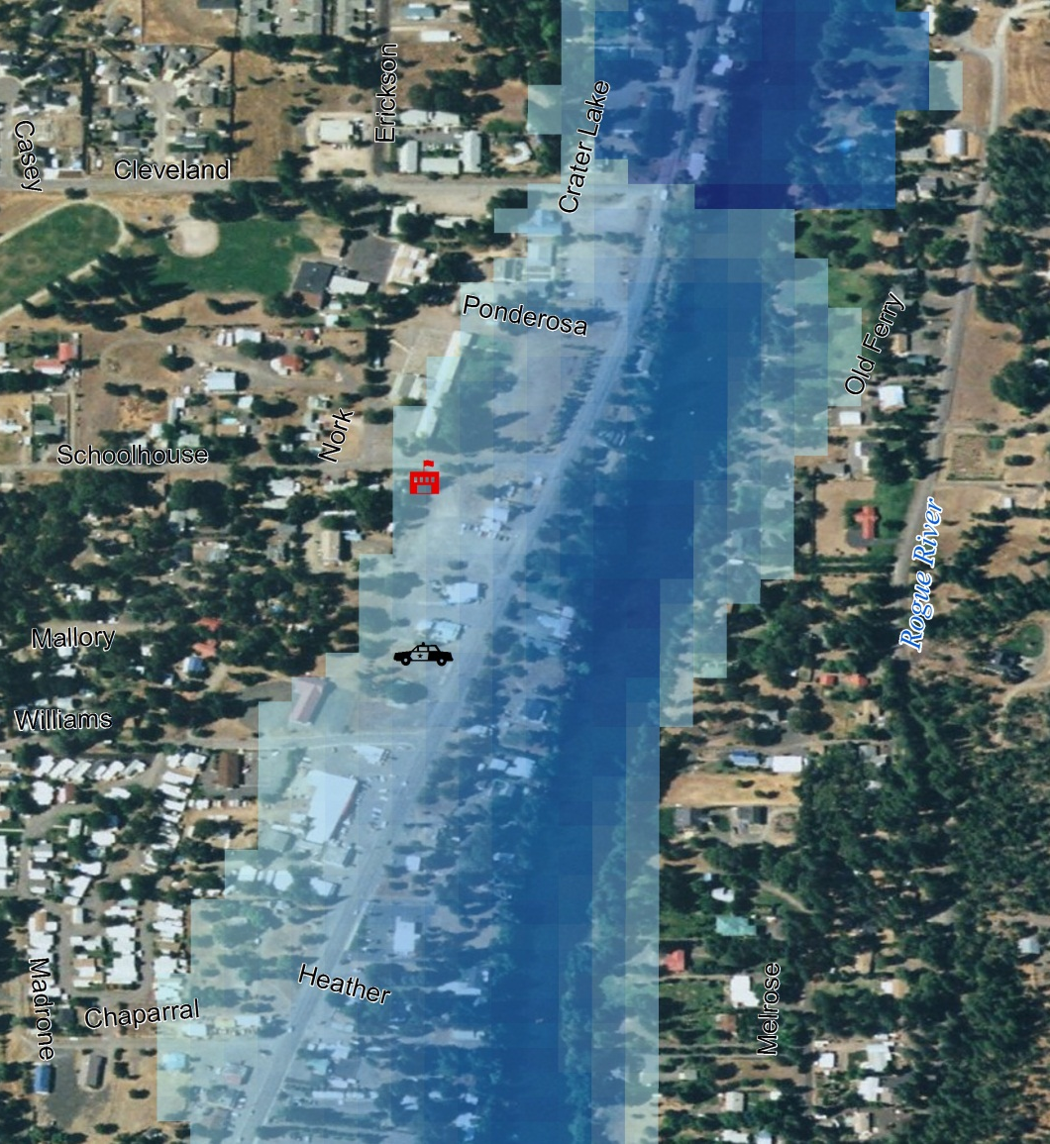
Develop GIS data to capture community assets
Capture or Develop Hazard Data
Estimate Losses
Develop Problem Statements
Potential Community Assets
Agriculture and Food
Banking and Finance
Chemical
Commercial Facilities
Communications
Critical Manufacturing
Dams
Defense Industrial Base
Emergency Services
Energy
Government Facilities
Healthcare
Information Technology
Nuclear Reactors, Materials and Waste
Postal and Shipping
Transportation Systems
Water
Notes:
Future Developable/Growth Areas

Slide 12
Develop GIS data to capture community assets
Capture or Develop Hazard Data
Estimate Losses
Develop Problem Statements
Flood
Existing Studies
USACE Studies
New FEMA Studies
Wildfire
Idaho Department of Lands
Forest Service
Landslide
Idaho Geological Survey
Earthquake
Idaho Geological Survey
USGS
*Hazard Mitigation Plan

Slide 13
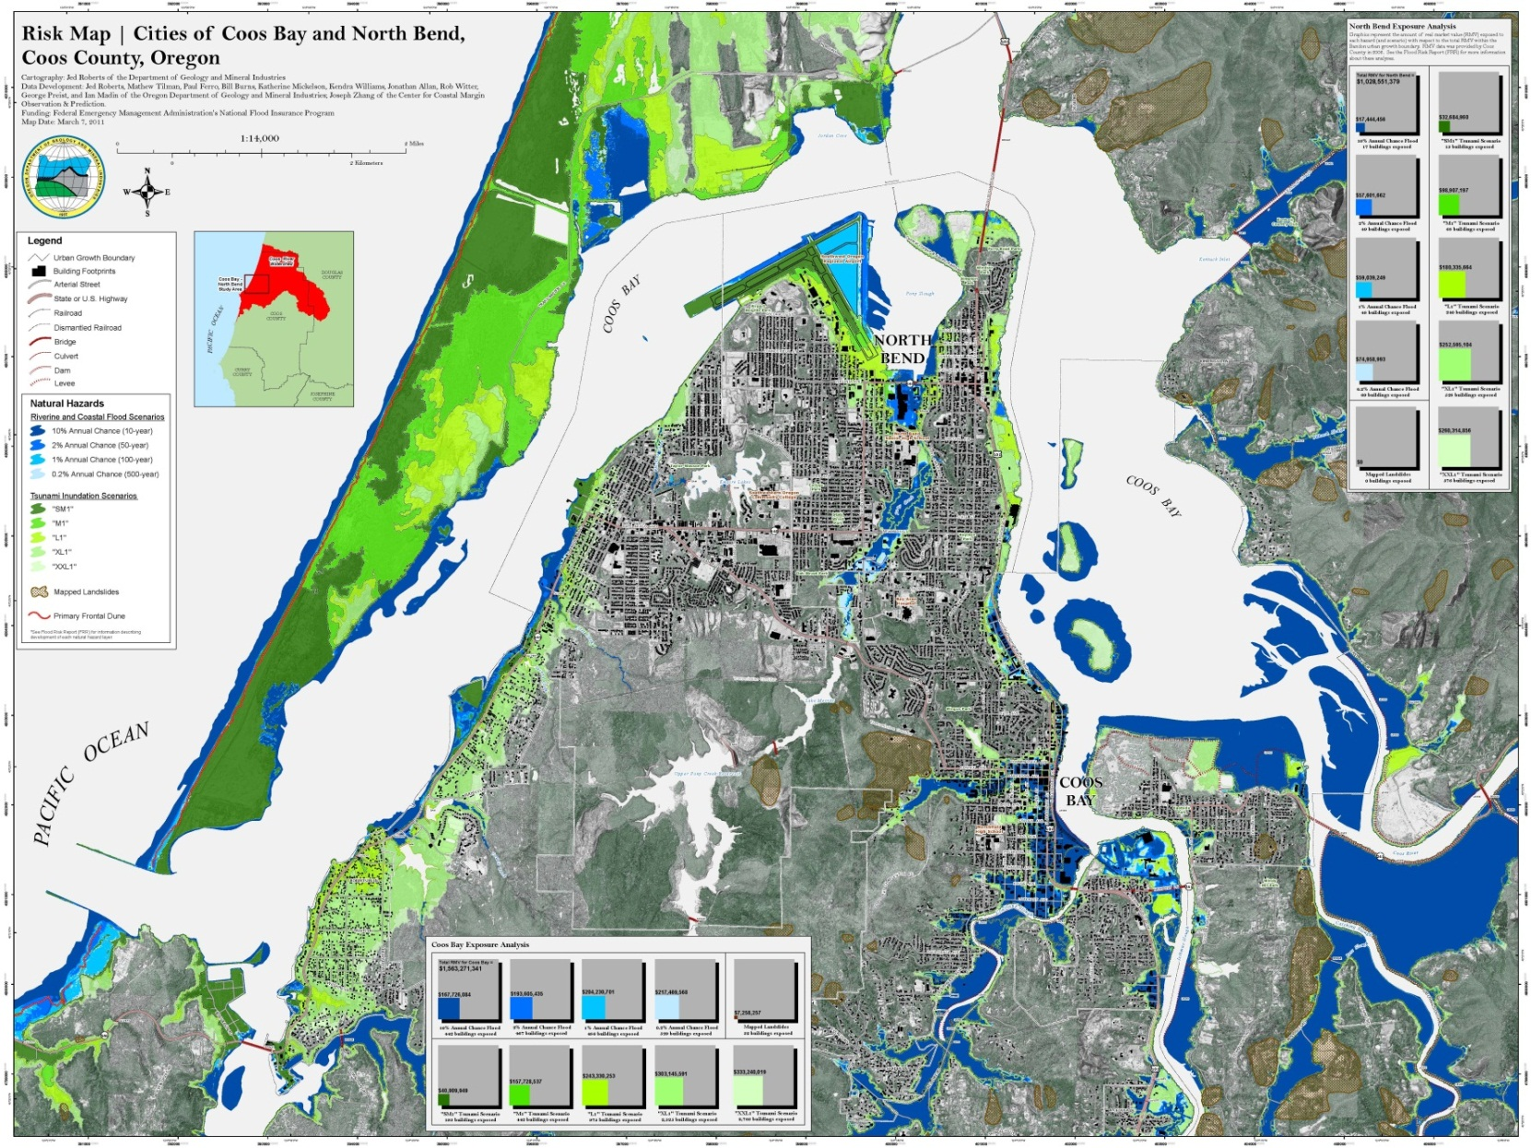
Develop GIS data to capture community assets
Capture or Develop Hazard Data
Estimate Losses
Develop Problem Statements

Slide 14
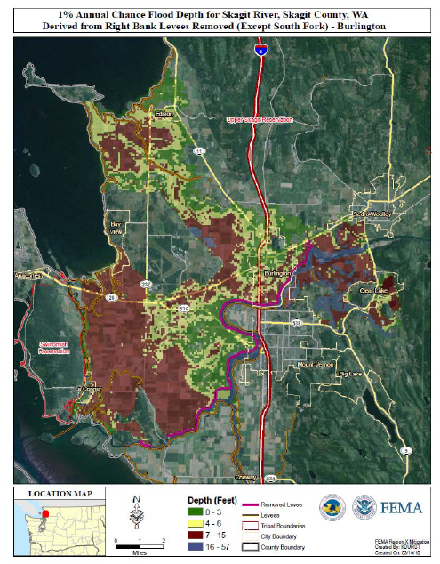
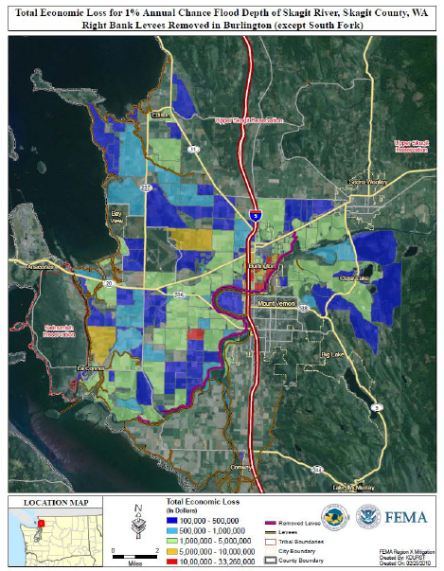
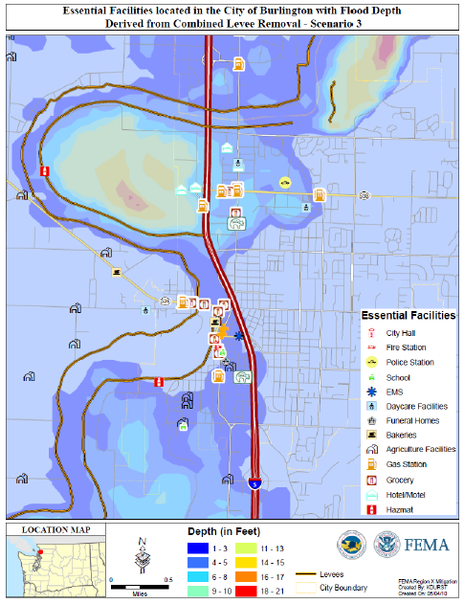
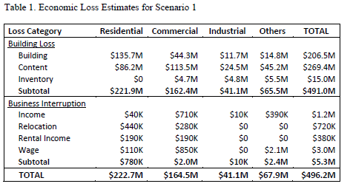
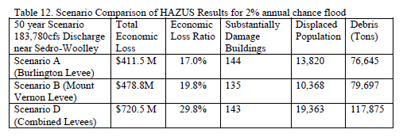
Develop GIS data to capture community assets
Capture or Develop Hazard Data
Estimate Losses
Develop Problem Statements

Slide 15
Develop GIS data to capture community assets
Capture or Develop Hazard Data
Estimate Losses
Develop Problem Statements
Review and analyze the results of the hazard loss estimations
Identify areas with highest vulnerabilities on a map
Develop list of problem statements based on findings
i.e. Major transportation routes are highly vulnerable to forest fires thereby isolating communities.
Assist with the development of risk-reduction strategies
Update Critical Areas Ordinance based on new data
Link culvert/infrastructure updates with Capital Facilities Plan
Revisit Zoning Designations per risk assessment results

Slide 16
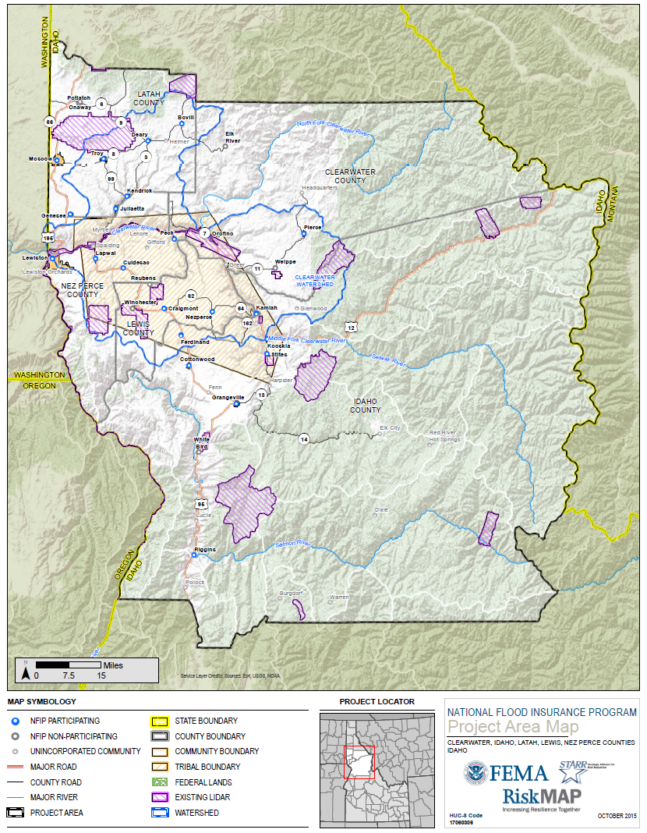
How we can help……. Mapping Needs

Slide 17
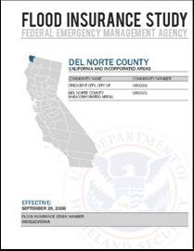
Risk MAP DFIRM/FIS
Notes:
Long-term objectives include
FIS reports will continue to be provided
Database-driven
On-demand updating and delivery
Ability to pull all FIS information related to an area of interest (e.g., political boundary, watershed)
Short-term objectives
Better align DFIRM/FIS tables
Streamlined and searchable text
Improved user guidance
Multi-color on DFIRMs
Accommodate new Risk Assessment tables and text
Provide foundation for future updates to FIS as it moves towards a geo-database driven FIS
Database-driven = FIS elements stored in database by flooding source
Get rid of unnecessary boiler plate text
Update narrative elements to table format (store in DFIRM database)
Align existing tables in FIS report in DFIRM Database
Add new tables for Levees and Coastal (5 to 10)into FIS report (store in DFIRM database and update Appendix L)
Require all new PDF text to be searchable
Deconstruct FIS to database (Need to confirm that communities will still get FIS Report)
Distribution through existing mechanisms (MSC)

Slide 18
How we can help…….……… Technical Support & Training
NFIP Training and Technical Support
Outreach Support
Hazus Training and Technical Support
Hazard Mitigation Planning Support
…other training needs?

Slide 19
Product: Risk Report & GIS Database
Community and Project-Level Results
Augment or Enhance other efforts
Local Hazard Mitigation Planning
Local Emergency Management Planning
Local Master Planning and Building Development

