Slide 1
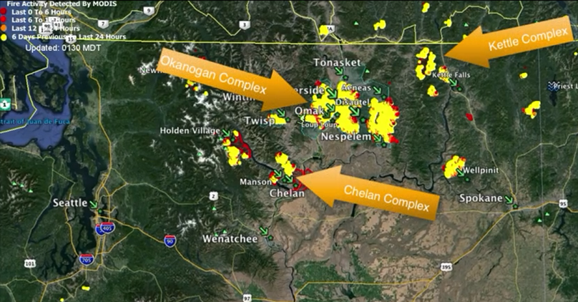
FEMA Fire Management Assistance Grant (FMAG) – Hazard Mitigation Grant Program (HMGP) Pilot Program
Brett Holt
Mitigation Planner
FEMA Region 10
October 14, 2015
Notes:
Created by Brett Holt, FEMA Region 10 Mitigation Planner, brett.holt@fema.dhs.gov

Slide 2
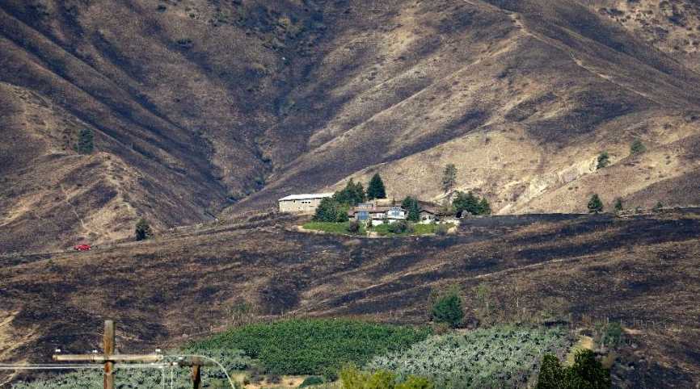
Agenda
FMAGs
FMAG-HMGP Pilot Program
HMGP
Sub-grantee Eligibility
Project Eligibility and
Considerations
R10 FMAG Declared Counties

Slide 3
Fire Management Assistance Grant
Notes:
FMAG – Eligible firefighting costs may include expenses for field camps; equipment use, repair and replacement; tools, materials and supplies; and mobilization and demobilization activities.
More FMAG information at http://www.fema.gov/fire-management-assistance-grant-program

Slide 4
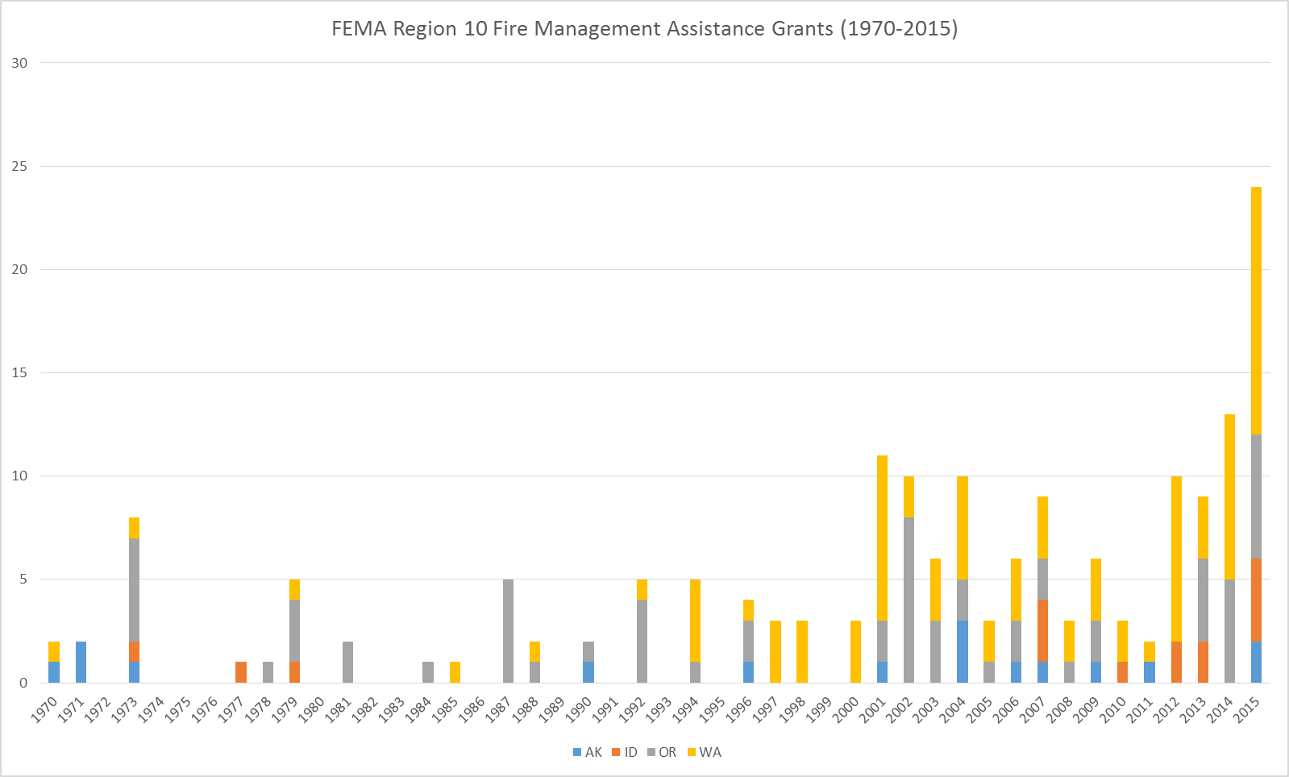
FMAGs in Region 10
Notes:
Source: FEMA Region 10

Slide 5
FMAG-HMGP Pilot Program
Authorized March 2015 in Section 570 of the Fiscal Year 2015 DHS Appropriations Act
FEMA Regions 8, 9 and 10 are part of pilot program
Authorizes FEMA to provide HMGP assistance as a result of a FMAG declaration
States and Territories that elect to become grantees with FMAG declarations from March 4, 2015 until December 11, 2015
Federally recognized Tribal Governments with land burned within FMAG declarations may elect to become Grantees or Sub-grantees

Slide 6
FMAG-HMGP Pilot Program (cont’d)
Application period of 12 months from date of FMAG declaration
FEMA encourages expedited submission of applications within 90 days of notification availability
Funds
Standard State or Tribal Mitigation Plans: $331,166 for each FMAG
Enhanced State or Tribal Mitigation Plans: $441,555 for each FMAG
These funds remain even if a FMAG declaration evolves into a major Presidential disaster declaration under the Stafford Act
Funds cannot be combined with other FMAG HMGP or HMGP sources

Slide 7
FMAG-HMGP Pilot Program: Tribes
Tribes may elect to apply as a Grantee if they have an approved tribal mitigation plan
$331,166 per FMAG provided for tribes with Standard Tribal Mitigation Plans
Tribes must have burned land within the FMAG declared counties to be eligible as a grantee
Tribes without land burned in FMAG declarations may only apply as a sub-grantee if the county is declared

Slide 8
Hazard Mitigation Grant Program (HMGP)
FMAG HMGP is similar to traditional HGMP with the following exceptions:
A FMAG declaration rather than a major Presidential disaster declaration activates the HMGP assistance
Eligibility for FMAG HMGP is restricted to the Burn Impacted Area The funding amounts are based on a national aggregate for each FMAG declaration
FEMA pays a portion of project costs (75%) and successful applicants provide a non-federal cost share (25%).

Slide 9
Sub-grantee Eligibility
Resource: Hazard Mitigation Assistance (HMA) Guidance published February 2015
Burn Impacted Area defined as any jurisdiction (county, city, special district, tribe) within the counties identified on the FMAG
Sub-grantee must have a FEMA approved natural hazard mitigation plan meeting 201.6 or 201.7 requirements
Capabilities to manage the grant

Slide 10
Project Eligibility
Encourages the mitigation of the burn impacted area to reduce the increased risk for wildfire, flood, or erosion post event. However, any mitigation of any hazard in the burn impacted area is allowed
States may provide priority preference to projects identified in the disaster-declared “burn” areas (declared by county)
The collection of environmental information, to comply with the required National Environmental Policy Act (NEPA), is essential for the state’s review and FEMA’s approval of potential projects.

Slide 11
Project Eligibility (cont’d)
FEMA requires a BCA to validate cost effectiveness.
For the FMAG-HMGP Pilot only, soil stabilization, flood diversion and reforestation projects that cost under $5,250 per acre … those project categories are determined cost effective and no further BCA is required.
If a project exceeds this per acre value then the use of FEMA’s BCA tool may be required.

Slide 12
Project Considerations
Defensible Space: Creation of perimeters around residential and non-residential buildings and structures through the removal of reduction of flammable vegetation.
Ignition Resistant Construction: Application of non-combustible building envelope assemblies, use of ignition-resistant materials, and use of proper retrofit techniques in new and existing structures.
Hazardous Fuels Reduction: Vegetation management to reduce hazardous fuels, vegetation thinning, and the reduction of flammable materials to protect life and property beyond defensible space perimeters but proximate to at-risk structures.
Erosion Control: Localized water diversions, sediment traps, erosion control mats, seeding/hydro-seeding with mulch, planting, etc. are all potential mitigation restoration treatments that can be considered.
Seeding: Includes aerial native seed application with helicopters, whirlybird grass seeders to disburse seed from trails and steep slopes, and hydro-seeding.

Slide 13
Project Consideration (cont’d)
Public Infrastructure: Projects that reduce future disaster losses to public utilities with an emphasis on consumer-owned electric utility providers, municipal water supply intakes, bridges that create waterway obstructions, etc.
Private Facility Mitigation: Includes houses that have been determined to be substantially damaged by fires and are required to be mitigated per local NFIP floodplain ordinances.
Natural Hazards Mitigation planning: Includes updating natural hazard risk assessments, comprehensive plan updates to include wildfire hazard, full plan updates.
5% Initiative: This could include the use, evaluation, demonstration, and/or application of new, unproven mitigation techniques, technologies, methods, procedures, or products.

Slide 14
Goal: Fire Adapted Communities
“Whole community” approach to preparing/recovering for wildfires
Fire Adapted Communities Principles
Defensible space and resilient structures – Firewise principles
Codes & Ordinances
Community Wildfire Protection Plans/Natural Hazard Mitigation Plans
Prevention education
Local capacity
Local Partnerships/Agreements
Safe evacuation routes or internal safety zones
Public and responder awareness and preparedness – “Ready, Set, Go!”
Fuels management near communities
Notes:
Source: http://www.fireadapted.org/
FEMA has an opportunity to ensure project and planning grants are helping communities to be fire adapted.

Slide 15
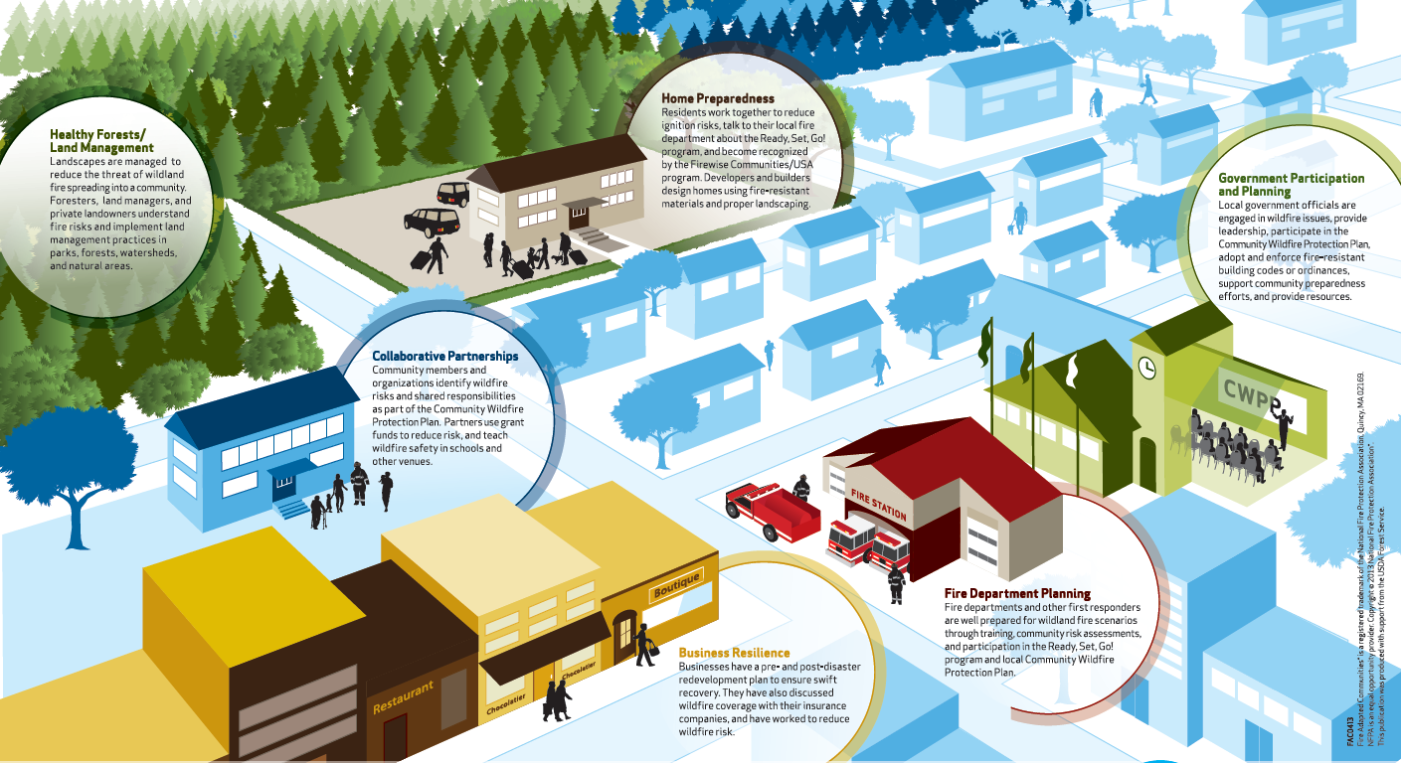
What does FAC look like?
Notes:
Source: http://www.fireadapted.org/resources.aspx

Slide 16
AK FY15 FMAGs
# | Name | Counties /Boroughs (Subgrantees) | Tribes / ANVs (Grantee/Subgrantee) | Funds
5084 | Sockeye Fire | Matanuska-Susitna Borough | Chickaloon Native Village | $331,166
5085 | Card Street Fire | Kenai Peninsula Borough | Nanwalek Native Village, Tyonek Native Village, Port Graham Native Village | $331,166

Slide 17
ID FY15 FMAGs
# | Name | Counties (Subgrantees) | Tribes (Grantee/Subgrantee) | Funds
5088 | Cape Horn Fire | Bonner County, Kootenai County | Coeur d’Alene Tribe | $331,166
5099 | Clearwater Complex Lawyer Branch Fire | Idaho County, Lewis County, Clearwater County | Nez Perce Tribe | $331,166
5105 | Municipal Fire | Clearwater County | Nez Perce Tribe | $331,166
5110 | Tepee Springs Fire | Idaho County | Nez Perce Tribe | $331,166

Slide 18
OR FY15 FMAGs
# | Name | Counties (Subgrantees) | Tribes (Grantee/Subgrantee) | Funds
5092 | Stouts Creek Fire | Douglas County | Cow Creek Tribe | $441,555
5096 | Krauss Lane Fire | Josephine County | - | $441,555
5097 | Cornet and Windy Ridge Fire Complex | Baker County | - | $441,555
5102 | Canyon Creek Fire Complex | Grant County | Warm Springs Tribe | $441,555
5107 | Grizzly Bear Complex | Wallowa County | - | $441,555
5114 | Dry Gulch Fire | Baker County | - | $441,555

Slide 19
WA FY15 FMAGs
# | Name | Counties (Subgrantees) | Tribes (Grantee/Subgrantee) | Funds
5087 | Sleepy Hollow Fire | Chelan Co. | - | $441,555
5090 | Blue Creek Fire | Walla Walla Co. | - | $441,555
5094 | Highway 8 Fire | Klickitat Co. | Yakama Nation | $441,555
5098 | Nine Mile Fire | Okanogan Co. | Colville Tribe | $441,555
5100 | Chelan Fire Complex | Chelan Co., Okanogan Co., Douglas Co. | Colville Tribe | $441,555
5101 | Stickpin Fire | Ferry Co. | Colville Tribe | $441,555
5103 | Stevens County Fire Complex | Stevens Co. | Spokane Tribe | $441,555
5104 | Okanogan County Fire Complex | Okanogan Co., Ferry Co. | Colville Tribe | $441,555
5106 | Twisp River Fire | Okanogan Co. | Colville Tribe | $441,555
5108 | Renner Fire | Ferry Co., Stevens Co. | Colville Tribe, Spokane Tribe | $441,555
5109 | Goodell Fire | Whatcom Co., Skagit Co. | Lummi Nation, Samish, Sauk-Suiattle, Swinomish, Upper Skagit | $441,555
5113 | Horsethief Butte Fire | Klickitat Co. | Yakama Nation | $441,555

Slide 20
Resources
Guidance and Policy
Hazard Mitigation Assistance (HMA) Guidance published February 2015
Project and Planning Ideas
FEMA P-737 Home Builder’s Guide to Construction in Wildfire Zones
FEMA P-754 Wildfire Hazard Mitigation Handbook for Public Facilities (P-754)
Mitigation Ideas
Rebuilding After a Wildfire

Slide 21
State Contacts – Hazard Mitigation Officers
Alaska Division of Homeland Security and Emergency Management
Ann Gravier: 970.428.7045; ann.gravier@Alaska.gov
Idaho Bureau of Homeland Security
Mark Stephensen: 208.258.6544; mstephensen@bhs.Idaho.gov
Oregon Office of Emergency Management
Dennis Sigrist: 503.378.2911; dennis.j.Sigrist@state.or.us
Washington State Emergency Management Division
Tim Cook: 253.512.7072; tim.cook@mil.wa.gov

Slide 22
FEMA Region 10 Contacts
Brett Holt – Mitigation Planner/ FMAG-HMGP Team Lead
Brett.holt@fema.dhs.gov or 425.487.4553
Brandon Sweezea – Hazard Mitigation Assistance Specialist
Brandon.Sweezea@fema.dhs.gov or 425.487.2022
Barry Gall – Deputy Regional Environmental Officer
Barry.gall@gema.dhs.gov or 425.487.4714

