Slide 1
Wildfire Integration with Mitigation Planning and Risk MAP
Brett Holt
Mitigation Planner
Region 10
April 21, 2015
Notes:
Mr. Brett Holt is a Hazard Mitigation Planner in Region 10. His natural hazard of choice is wildland fire having start his federal career as a wildland firefighter in 1998 in Prineville, Oregon and remaining involved with wildfire since this time. At FEMA, Mr. Holt has coordinated efforts between Region 10 and the Cohesive Wildland Fire Management Strategy Committee to leverage resources and improve program implementation. He is involved in the development of a State specific Mitigation Planning Review Tools which address both requirements of Natural Hazard Mitigation Plans and Community Wildfire Protection Plans (CWPPs). He continues to reach out to Federal and State agencies to educate others on Natural Hazard Mitigation Planning and how programs and agencies can support each other. Prior to working at FEMA, Mr. Holt worked for MIG, Inc. where he developed the City of Portland, Oregon’s Wildfire Gap Analysis. This document provided the framework for the City to improve its mitigation, preparedness, and responses efforts. Mr. Holt’s previous federal experience includes working as a wildland firefighter with the National Park Service, U.S. Forest Service, and Bureau of Land Management. His duties included supervising and training crew members in firefighting tactics, implementing fuel reduction projects, and developing prescribed burn plans. Mr. Holt has a Masters of Community and Regional Planning from the University of Oregon, and Bachelor of Arts degree in Environmental Studies from San Jose State University.

Slide 2
Agenda
National Cohesive Strategy
Western Regional Strategy Committee
West Wide Wildfire Risk Assessment
Fire Adapted Communities
NHMP/CWPP Guide (WA)
NHMP/CWPP Review Tool (ID)
Risk MAP Risk Reports
State Risk MAP Portfolios (ID)
Wildfire Disaster and Risk MAP
Resources
Notes:
Some of this may be new for some Regions while others Regions are already doing these suggestions. This is all about sharing ideas.

Slide 3
National Cohesive Strategy
The National Cohesive Wildland Fire Management Strategy, or Cohesive Strategy, is a strategic push to work collaboratively among all stakeholders and across all landscapes, using the best available science, to make meaningful progress towards achieving the adopted Cohesive Strategy vision and goals.
The greatest challenges and greatest opportunities for making a positive difference:
Restore and Maintain Landscapes
Create Fire-adapted Communities
Safe and Effective Wildfire Response

Slide 4
National Cohesive Strategy
Why a new strategy?
In the past two decades the nation has experienced:
Rapid escalation of extreme wildfire behavior
Significant increases in risk to responders and citizens
Greater home and property losses
Rising fire suppression costs
Increased threats to communities and landscapes

Slide 5
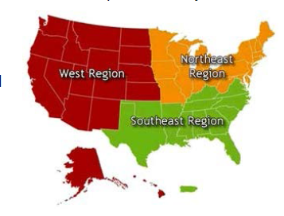
Western Regional Strategy Committee
The purpose of the Western Regional Strategy Committee (WRSC), a chartered subcommittee of the Wildland Fire Leadership Council, is to facilitate implementation of the National Cohesive Wildland Fire Management Strategy in the Western Region.

Slide 6
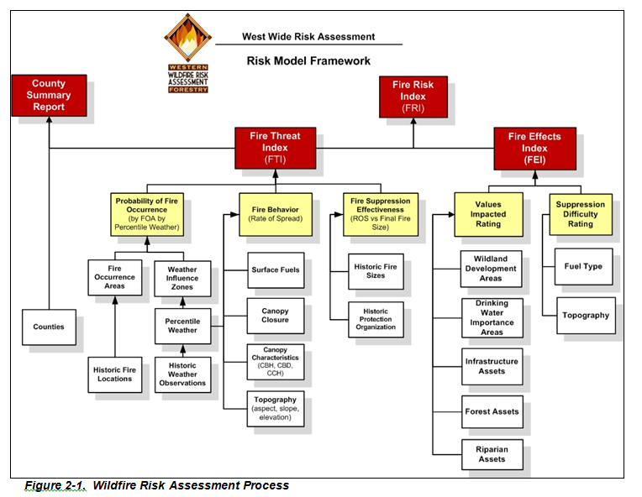
Science: West Wide Wildfire Risk Assessment
Completed 2013
Each of the 17 Western States received State specific data
High level – State supplemented data
Part of National effort for updated wildfire risk assessment
Notes:
Contact State Leads for the specific data. We will need to follow up to find out the State Lead Agencies.

Slide 7
Fire Adapted Communities
Fire Adapted Communities
Community Wildfire Protection Plans
Local Partnerships/Agreements
Safe evacuation routes or internal safety zones
Defensible space and resilient structures – Firewise principles
Codes & Ordinances
Public and responder awareness and preparedness – “Ready, Set, Go!”
Fuels management near communities
Prevention education
Local capacity
http://www.fireadapted.org/
Notes:
The areas with bold are areas we can look at supporting through the Planning Program.

Slide 8
Fire Adapted Communities Locations
Notes:
Contact a community if it is located within your Region.

Slide 9
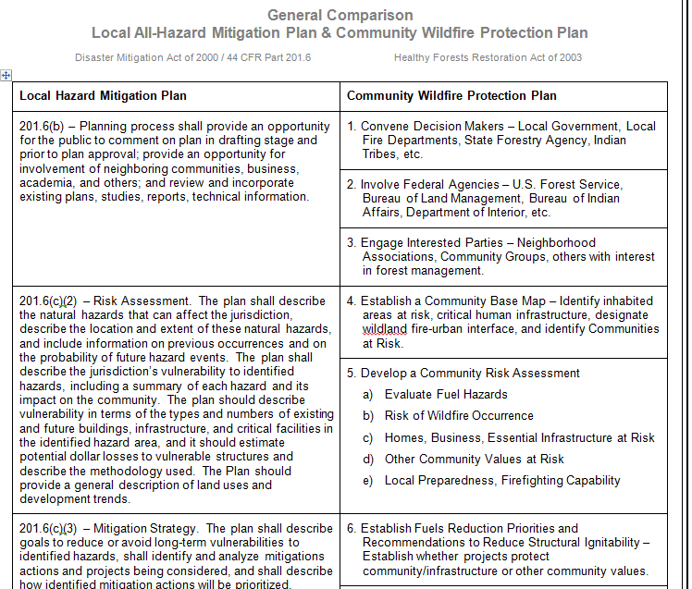
NHMP/CWPP Guide
State of Washington is developing a guide that compares NHMP and CWPP requirements
Purpose is to demonstrate to communities the similarities and differences in developing both plans, and to leverage resources to use one planning process to meet both requirements
Notes:
This is a draft will final version in the upcoming 6 months.

Slide 10
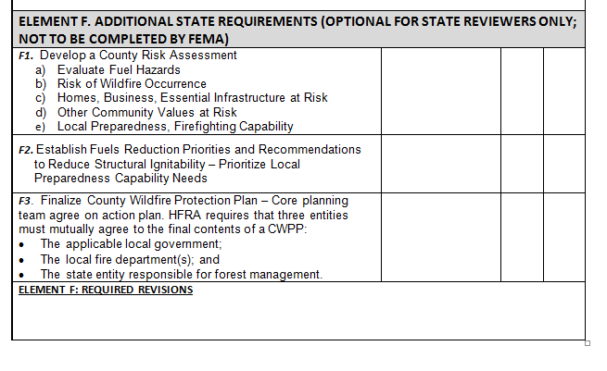
NHMP/CWPP Review Tool
State of Idaho is working with the Idaho Department of Lands to create one review tool for NHMPs and CWPPs.
Notes:
Currently in draft. Unsure of final document.

Slide 11
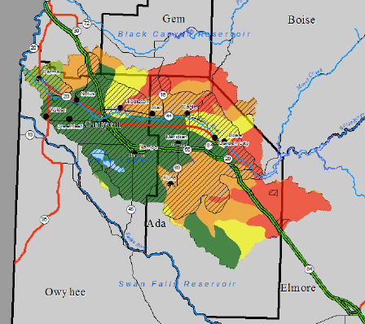
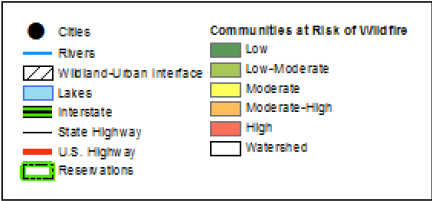
G-318 Training (ID & OR)
The September 2014 offering of G-318 in Idaho and Oregon will have State agency representatives present about how to do wildfire risk assessments.

Slide 12
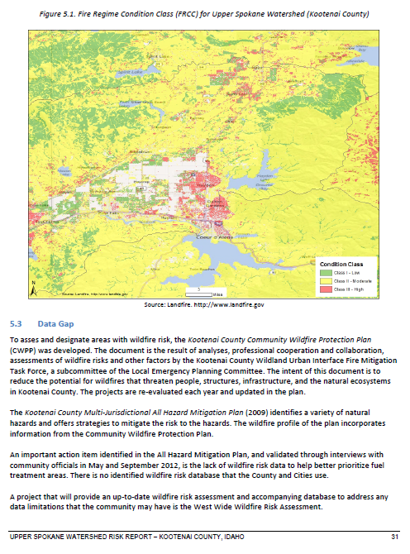
Risk MAP Risk Reports
Region 10 creates multi-hazard Risk Reports, some address the wildfire hazard
Exposure analysis of community assets and Fire Regime Condition Class
Promote latest data set (West Wide Wildfire Risk Assessment)
Discuss both wildfire mitigation planning strategies already identified in plans and those identified through Risk MAP
Offer implementation strategies
Notes:
I realize that not every region looks at multi-hazard, but for those we have an opportunity to look incorporate wildfires.

Slide 13
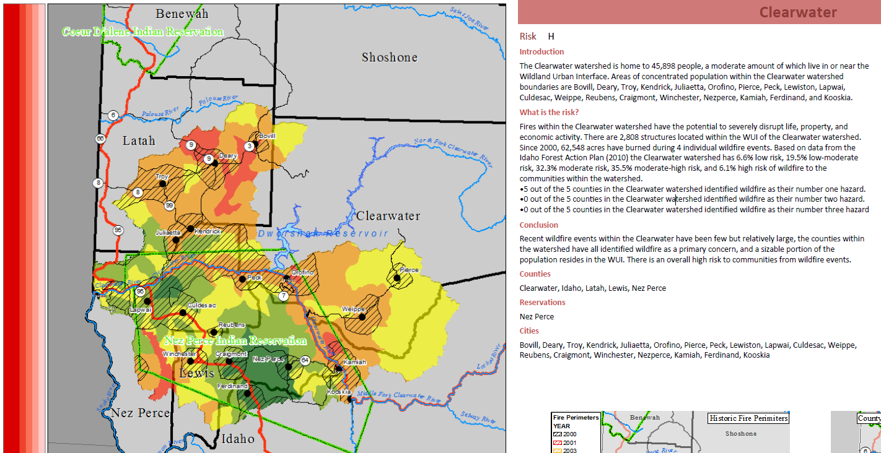
State Risk MAP Portfolios
State of Idaho considers flood, seismic, and wildfire hazards in prioritizing watersheds for Risk MAP Projects
Data considered are vegetation types, condition class, response resources, and more
Identified wildfire strategies are overlain on maps
Notes:
Though Idaho calls this the State Risk Portfolio, this is essentially their prioritization of watersheds for the State Business Plan each State produces.

Slide 14
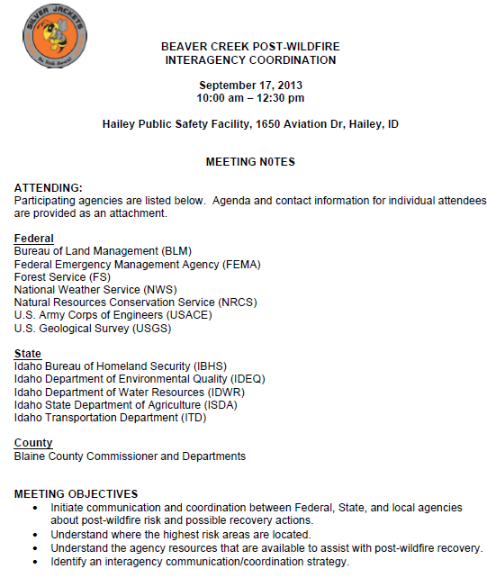
Wildfire Disaster and Risk MAP
In areas where a wildfire has occurred and we are delivering Risk MAP, Region 10 has coordinated with the Silver Jackets (lead) and State
Provided relevant NFIP information to stakeholders
Offered mitigation strategies
Notes:
Contact your Silver Jackets lead to discuss possible opportunities. Perhaps this is led by a Regional Engineer or Risk Analyst but you support the effort.

Slide 15
Resources
After Wildfire Guide
Colorado Wildfire Risk Assessment Portal
National Cohesive Wildland Fire Management Strategy
Fire Adapted Communities
Fire Adapted Communities Learning Network
Idaho Risk Portfolio
Southern Wildfire Risk Assessment Portal
Upper Spokane Risk Report
Wildfire Mitigation Desk Reference Guide

