Slide 1
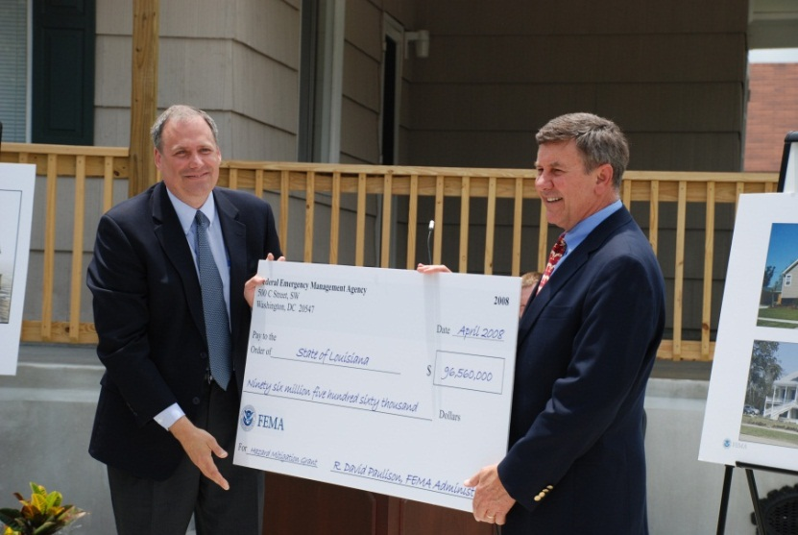
FEMA Hazard Mitigation Assistance Grants
Support mitigation projects designed to reduce the effects of hazards and/or vulnerability to future disaster damage.
Hazard Mitigation Grant Program (HMGP)
Pre-Disaster Mitigation (PDM)
Flood Mitigation Assistance (FMA)
Grants are managed, prioritized, and work verified by the state
Funding availability may vary from
year to year
Notes:
Tim

Slide 2
Hazard Mitigation Grant Program (HMGP)
Grant Program | Purpose | Competition | Available | Non-Fed. Share | Application Timeline
Hazard Mitigation Grant Program (HMGP) (Sect 404) | Post-Disaster All Hazards Plans and Projects | State-wide | After a Presidential Declaration of Major Disaster | 12.5 % -25%* * Upon approval of Governor & Legislature, the state may pay up to ½ of the non-fed cost-share, up to 12.5%. | Generally due to State 12 months after declaration
Mitigation planning initiatives
Cost-effective mitigation projects designed to reduce or eliminate future disaster damage.
Notes:
Tim
See http://www.emd.wa.gov/grants/grants_hazard_mitigation.shtml for more information about the HMGP program.

Slide 3
Pre-Disaster Mitigation (PDM)
Grant Program | Purpose | Competition | Available | Non-Fed. Share | Application Timeline
Pre-Disaster Mitigation Grant Program (PDM) | Pre-Disaster All Hazards Plans and Projects | Nationally Competitive | Annually | 10% - 25%* | Due to State ~3 months after federal announcement, which typically occurs in the spring. See WA EMD announcement at … http://www.emd.wa.gov/grants/grants_hazard_mitigation.shtml
The PDM program provides funds for hazard mitigation measures designed to reduce injuries, loss of life, and damage and destruction of property. PDM grants are available for mitigation planning initiatives and cost-effective mitigation projects.
Notes:
Tim
*PDM is a 75% federal cost share grant. Small, impoverished communities and Tribes may be eligible for a 90% federal cost share.

Slide 4
Flood Mitigation Assistance (FMA)
Grant Program | Purpose | Competition | Available | Non-Fed. Share | Application Timeline
Flood Mitigation Assistance (FMA) Program | Pre-Disaster Flood Hazard Only Funds plans & projects to reduce flood damage risk to structures with flood insurance coverage | Nationally Competitive | Annually | 0% for SRL 10% for RL 25% for all other properties | Due to State ~3 months after federal announcement, which typically occurs in the spring. See WA EMD announcement at http://www.emd.wa.gov/grants/grants_hazard_mitigation.shtml
Grants are available for planning initiatives to update the flood hazard portion of an applicant’s hazard mitigation plan and for cost-effective flood mitigation projects.
Notes:
Tim
NOTE: Repetitive Flood Claim and Severe Repetitive Loss grant programs are no longer separate.

